Slide 1


Analysis of Quantitative data
Anne Segonds-Pichon v2020-09

Slide 2
Outline of this section
Assumptions for parametric data
Comparing two means: Student’s t-test
Comparing more than 2 means
  One factor: One-way ANOVA
  Two factors: Two-way ANOVA
Relationship between 2 continuous variables: Correlation

Slide 3
Introduction
Key concepts to always keep in mind
  Null hypothesis and error types
  Statistics inference
  Signal-to-noise ratio

Slide 4
The null hypothesis and the error types
The null hypothesis (H₀): H₀ = no effect
  e.g. no difference between 2 genotypes
The aim of a statistical test is to reject or not H_{0.}
Traditionally, a test or a difference is said to be “significant” if the probability of type I error is: α =< 0.05
High specificity = low False Positives = low Type I error
High sensitivity = low False Negatives = low Type II error
Statistical decision | True state of H₀
 | H₀ True (no effect) | H₀ False (effect)
Reject H₀ | Type I error α False Positive | Correct True Positive
Do not reject H₀ | Correct True Negative | Type II error β False Negative

Slide 5
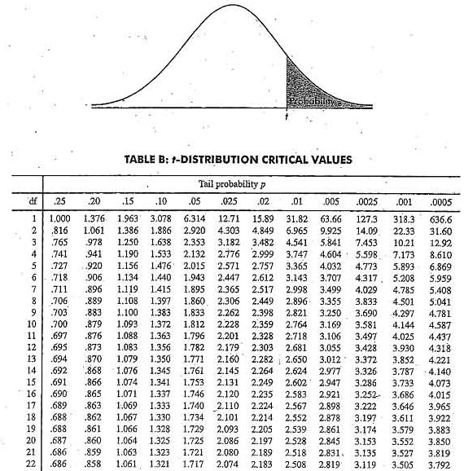
Sample
Statistical inference
Population
Difference
Meaningful?
Yes
Real?
Statistical test
Big enough?
Statistic
e.g. t, F …
=
+ Noise +
Difference
Sample

Slide 6
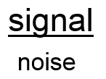
Signal-to-noise ratio
Stats are all about understanding and controlling variation.
signal
noise
signal
noise
Difference
+ Noise
Difference
Noise
If the noise is low then the signal is detectable …
= statistical significance
… but if the noise (i.e. interindividual variation) is large
then the same signal will not be detected
= no statistical significance
In a statistical test, the ratio of signal to noise determines the significance.

Slide 7
Analysis of Quantitative Data
Choose the correct statistical test to answer your question:
  They are 2 types of statistical tests:
    Parametric tests with 4 assumptions to be met by the data,
    Non-parametric tests with no or few assumptions (e.g. Mann-Whitney test) and/or for qualitative data (e.g. Fisher’s exact and χ² tests).

Slide 8
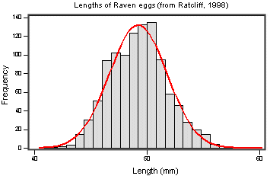
Assumptions of Parametric Data
All parametric tests have 4 basic assumptions that must be met for the test to be accurate.
  First assumption: Normally distributed data
  Normal shape, bell shape, Gaussian shape
    Transformations can be made to make data suitable for parametric analysis.
Notes:
Small sample no worth check for normality
Parametric only when it’s big sample go for non parametric if you are unsure do both the non parametric is more efficient to find a difference
Can ask to run a test if there is a departure from normality

Slide 9
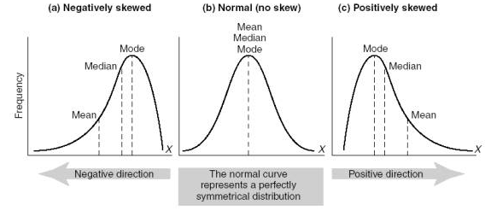

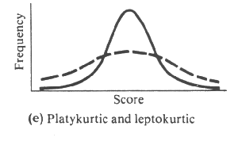

Assumptions of Parametric Data
Frequent departures from normality:
  Skewness: lack of symmetry of a distribution
  Kurtosis: measure of the degree of ‘peakedness’ in the distribution
    The two distributions below have the same variance approximately the same skew, but differ markedly in kurtosis.
Skewness < 0
Skewness = 0
Skewness > 0
More peaked distribution: kurtosis > 0
Flatter distribution: kurtosis < 0
Notes:
Departure from normality +vely skewd most common

Slide 10
Assumptions of Parametric Data
  Second assumption: Homoscedasticity (Homogeneity in variance)
    The variance should not change systematically throughout the data
  Third assumption: Interval data (linearity)
    The distance between points of the scale should be equal at all parts along the scale.
  Fourth assumption: Independence
    Data from different subjects are independent
      Values corresponding to one subject do not influence the values corresponding to another subject.
      Important in repeated measures experiments
Notes:
Variance must be same in the groups or similar
Interval data: in all group ypu measure data in the same way
Independence you have to know if it is or not tests are different in this case

Slide 11
Analysis of Quantitative Data
Is there a difference between my groups regarding the variable I am measuring?
  e.g. are the mice in the group A heavier than those in group B?
    Tests with 2 groups:
      Parametric: Student’s t-test
      Non parametric: Mann-Whitney/Wilcoxon rank sum test
    Tests with more than 2 groups:
      Parametric: Analysis of variance (one-way and two-way ANOVA)
      Non parametric: Kruskal Wallis (one-way ANOVA equivalent)
Is there a relationship between my 2 (continuous) variables?
  e.g. is there a relationship between the daily intake in calories and an increase in body weight?
    Test: Correlation (parametric or non-parametric)

Slide 12
Comparison between 2 groups

Slide 13
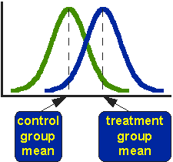
Comparison between 2 groups:
Student’s t-test
Basic idea:
  When we are looking at the differences between scores for 2 groups, we have to judge the difference between their means relative to the spread or variability of their scores.
    Eg: comparison of 2 groups: control and treatment

Slide 14


Variability does matter
Absolute difference
Absolute difference
Scatter plot
Bar chart
Notes:
Smaller variability more likely that the difference is significant case b it’s going to be difficult you nee A LOT of data

Slide 15
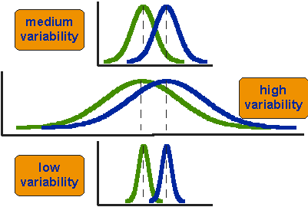
Student’s t-test
Notes:
Smaller variability more likely that the difference is significant case b it’s going to be difficult you nee A LOT of data

Slide 16
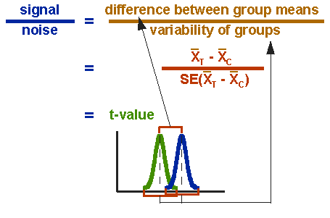
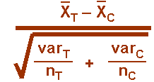
Student’s t-test

Slide 17
~ 4.5 x SEM: p~0.01
~ 2 x SEM: p~0.05
n = 3
~ 2 x SEM: p~0.01
~ 1 x SEM: p~0.05
n = 10

Slide 18
Student’s t-test
  Independent t-test
    Difference between 2 means of one variable for two independent groups
      Example: difference in weight between WT and KO mice
  Paired t-test
    Difference between two measures of one variable for one group:
      Example: before-after measurements
        the second ‘sample’ of values comes from the same subjects (mouse, petri dish …).
      Importance of experimental design!
  One-Sample t-test
    Difference between the mean of a single variable and a specified constant.
Notes:
WT vs mutant, totally independent
Time 0 then treatment and look at time 1: look difference in one group in difference condition

Slide 19
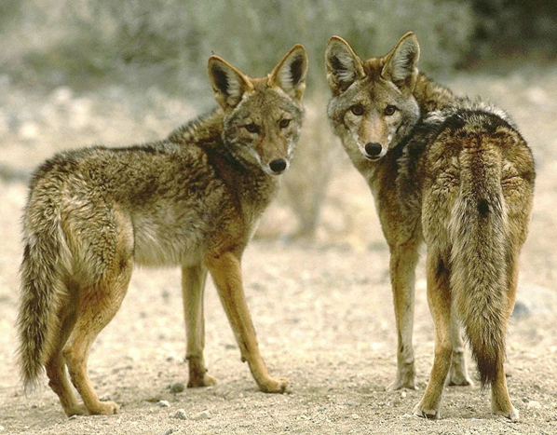
Example: coyotes
Question: do male and female coyotes differ in size?
Sample size
Data exploration
Check the assumptions for parametric test
Statistical analysis: Independent t-test

Slide 20
Exercise 3: Power analysis
Example case:
No data from a pilot study but we have found some information in the literature.
In a study run in similar conditions as in the one we intend to run, male coyotes were found to measure: 92cm +/- 7cm (SD).
We expect a 5% difference between genders.
smallest biologically meaningful difference
power.t.test(n = NULL, delta = NULL, sd = 1, sig.level = NULL,
power = NULL, type = c("two.sample", "one.sample", "paired"),
alternative = c("two.sided", "one.sided"))

Slide 21
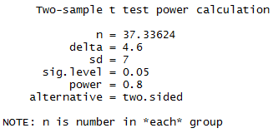
Exercise 3: Power analysis - Answers
Example case:
We don’t have data from a pilot study but we have found some information in the literature.
In a study run in similar conditions as in the one we intend to run, male coyotes were found to measure:
92cm+/- 7cm (SD)
We expect a 5% difference between genders with a similar variability in the female sample.
Mean 1 = 92
Mean 2 = 87.4 (5% less than 92cm)
delta = 92 – 87.4
sd = 7
power.t.test(delta=92-87.4, sd=7, sig.level=0.05, power=0.8)
We need a sample size of n~76 (2*38)

Slide 22

Data exploration $≠$ plotting data

Slide 23

Exercise 4: Data exploration
coyote.csv
The file contains individual body length of male and female coyotes.
Question: do male and female coyotes differ in size?
  Load coyote.csv
  Plot the data as boxplot, histogram, violinplot and stripchart
Data exploration $≠$ plotting data

Slide 24
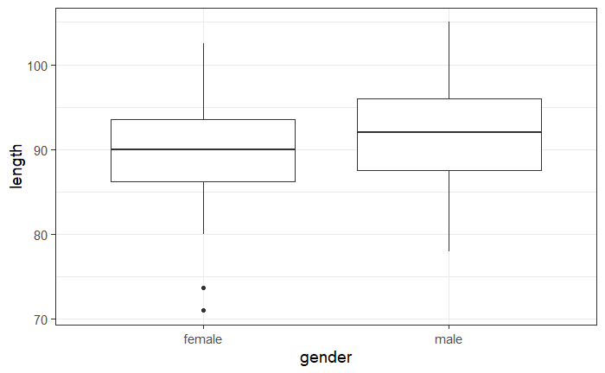
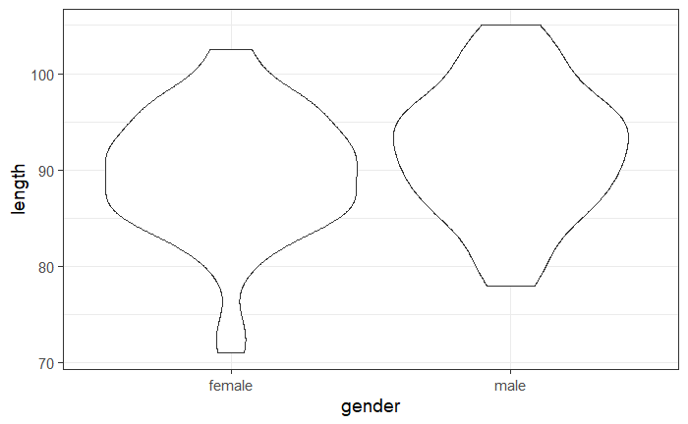
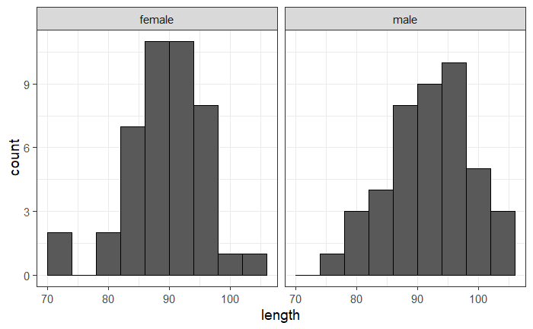
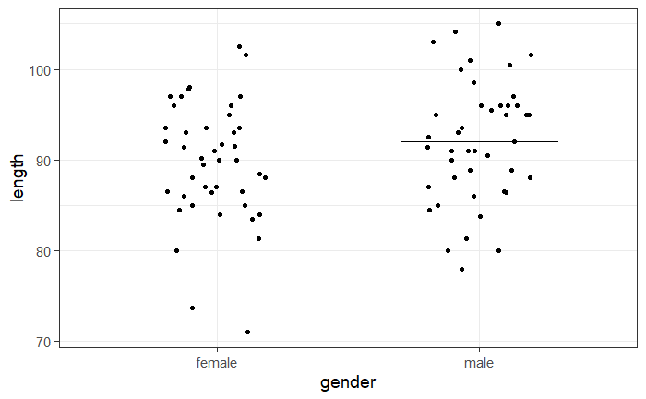
Exercise 4: Data exploration
Explore data using 4 different representations:

Slide 25
Exercise 4: facet_grid(rows=vars(row),cols=vars(column))
facet_grid(cols=vars(gender))
2 columns: one per gender
One row

Slide 26
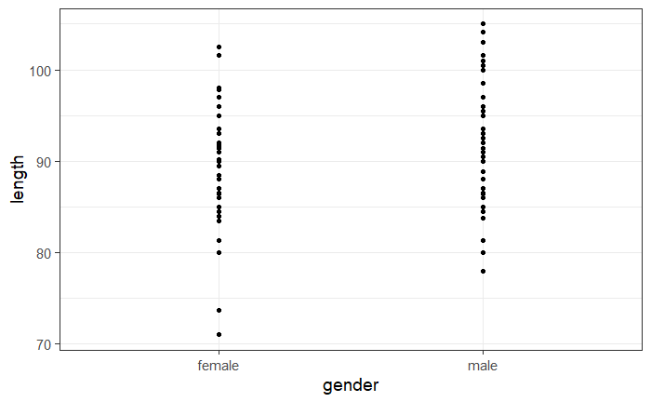
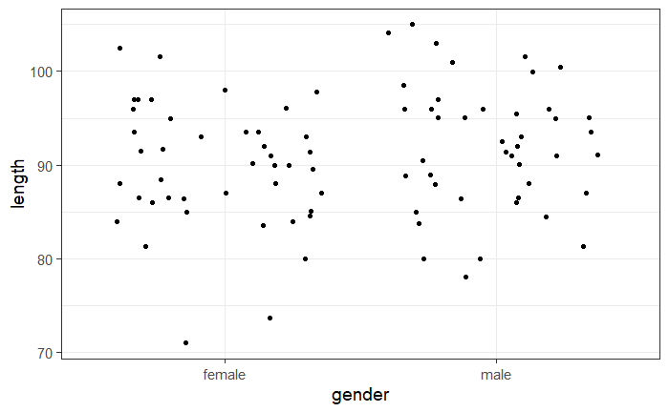
Exercise 4: geom_jitter()
Stripchart
  Variation of geom_point(): geom_jitter()
coyote %>%
ggplot(aes(x=gender,y=length)) +
geom_point()
coyote %>%
ggplot(aes(x=gender,y=length)) +
geom_jitter(height=0, width=0.3)

Slide 27
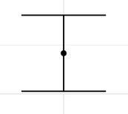
Exercise 4: stat_summary()
Stripchart
  stat_summary()
    What statistical summary: mean: fun = "mean"
    What geom(): choice of graphical representation: a line: geom_errorbar()
stat_summary(geom="errorbar", fun="mean",fun.min="mean",fun.max="mean")
mean=minimum=max
coyote %>%
ggplot(aes(gender,length)) +
geom_jitter(height=0, width=0.2)+
stat_summary(geom= "errorbar", fun="mean", fun.min="mean", fun.max="mean")

Slide 28
Exercise 4: Data exploration
coyote %>%
ggplot(aes(x=gender, y=length))+
geom_...()
Explore data using 4 different representations:
geom_boxplot()
geom_violin()
facet_grid(rows=vars(row),cols=vars(column))
geom_histogram
geom_jitter()
stat_summary()
Have a go!

Slide 29
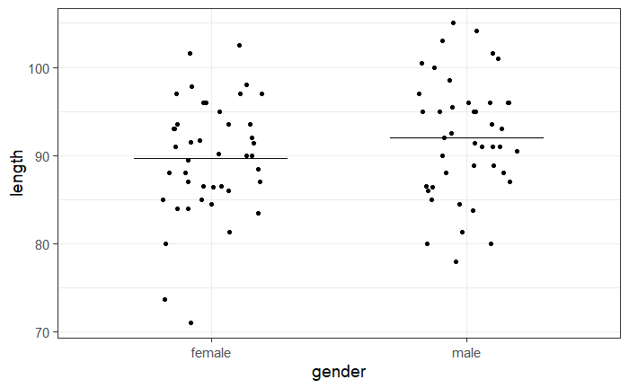
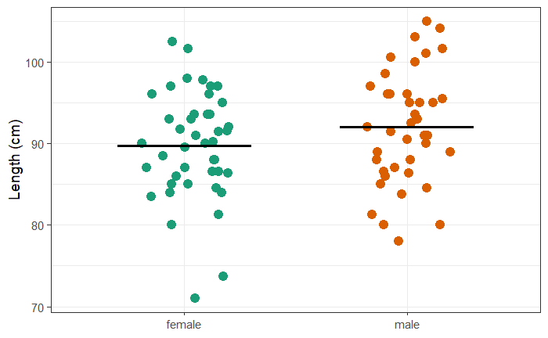
Exercise 4: Exploring data - Stripchart
coyote %>%
ggplot(aes(gender,length)) +
geom_jitter(height=0, width=0.2)+
stat_summary(geom= "errorbar", fun="mean", fun.min="mean", fun.max="mean")
coyote %>%
ggplot(aes(gender,length, colour=gender)) +
geom_jitter(height=0, size=4, width=0.2, show.legend = FALSE) +
ylab("Length (cm)")+
scale_colour_brewer(palette="Dark2")+
xlab(NULL)+
stat_summary(geom="errorbar", fun=mean, fun.min=mean, fun.max=mean, colour="black", size=1.2, width=0.6)

Slide 30
Exercise 4: Exploring data - Boxplots and beanplots
coyote %>%
ggplot(aes(x=gender, y=length)) +
geom_boxplot()
coyote %>%
ggplot(aes(x=gender, y=length)) +
geom_violin()

Slide 31
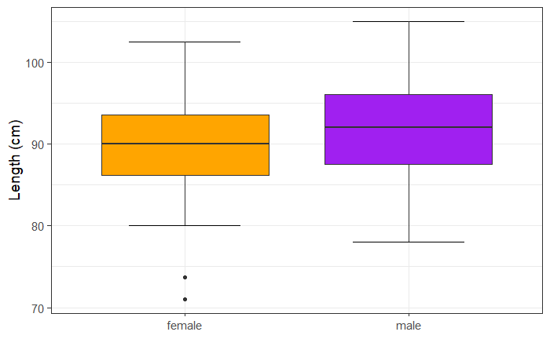
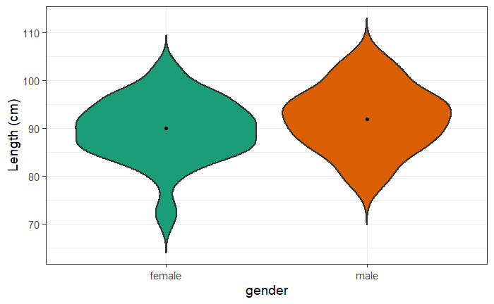
Exercise 4: Exploring data - Boxplots and beanplots
coyote %>%
ggplot(aes(x=gender, y=length, fill=gender)) +
stat_boxplot(geom="errorbar",width=0.5) +
geom_boxplot(show.legend=FALSE)+
ylab("Length (cm)")+
xlab(NULL)+
scale_fill_manual(values = c("orange","purple"))
coyote %>%
ggplot(aes(gender, length, fill=gender)) +
geom_violin(trim=FALSE, size=1, show.legend=FALSE)+
ylab("Length (cm)")+
scale_fill_brewer(palette="Dark2")+
stat_summary(geom = "point", fun = "median",show.legend=FALSE)

Slide 32
Exercise 4: Exploring data - Histograms
also works
facet_wrap(vars(gender))
coyote %>%
ggplot(aes(length))+
geom_histogram(binwidth = 4, colour="black") +
facet_grid(cols=vars(gender))

Slide 33
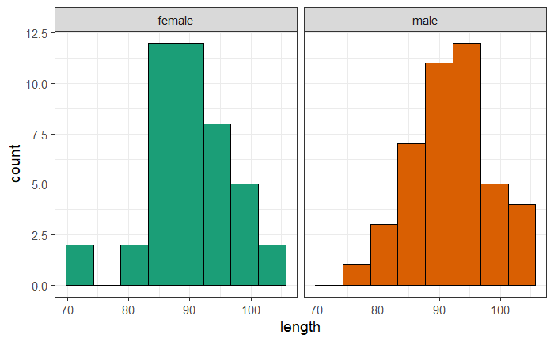
Exercise 4: Exploring data - Histograms
coyote %>%
ggplot(aes(length, fill=gender))+
geom_histogram(binwidth = 4.5, colour="black", show.legend = FALSE) +
scale_fill_brewer(palette="Dark2")+
facet_grid(cols=vars (gender))

Slide 34
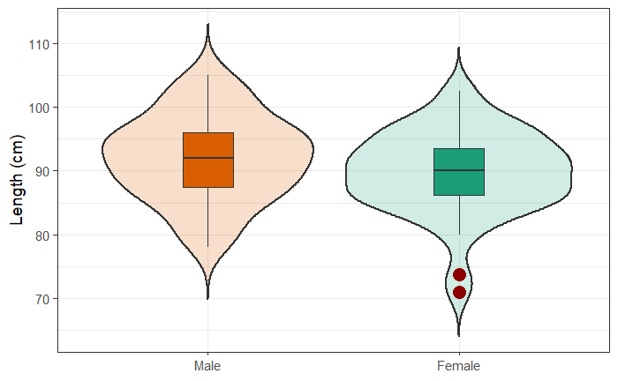
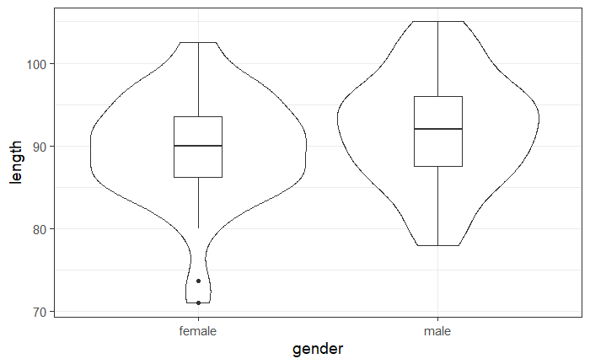
Exercise 4 extra: Exploring data - Graph combinations
coyote %>%
ggplot(aes(gender, length)) +
geom_boxplot(width=0.2)+
geom_violin()
coyote %>%
ggplot(aes(gender,length, fill=gender)) +
geom_violin(size=1, trim = FALSE, alpha=0.2, show.legend=FALSE) +
geom_boxplot(width=0.2, outlier.size=5, outlier.colour = "darkred", show.legend=FALSE)+
scale_fill_brewer(palette="Dark2")+
ylab("Length (cm)")+
xlab(NULL)+
scale_x_discrete(labels=c("female"="Female", "male"="Male"), limits =c("male", "female"))

Slide 35
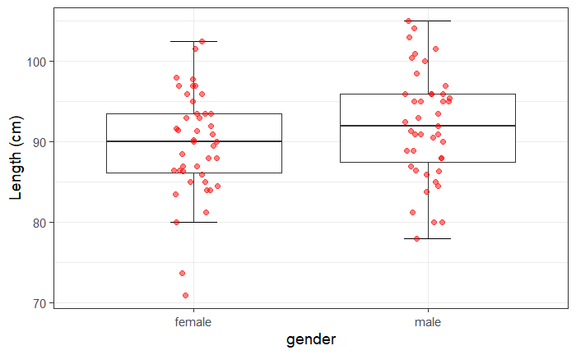
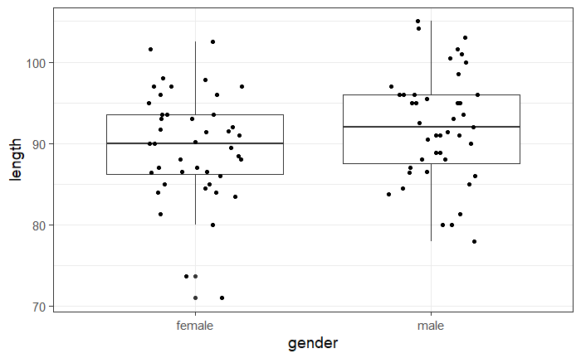
Exercise 4 extra: Exploring data - Graph combinations
coyote %>%
ggplot(aes(gender, length)) +
geom_boxplot()+
geom_jitter(height=0, width=0.2)
coyote %>%
ggplot(aes(gender, length)) +
geom_boxplot(outlier.shape=NA)+
stat_boxplot(geom="errorbar", width=0.2)+
geom_jitter(height=0, width=0.1, size=2, alpha=0.5, colour="red")+
ylab("Length (cm)")

Slide 36
Checking the assumptions

Slide 37
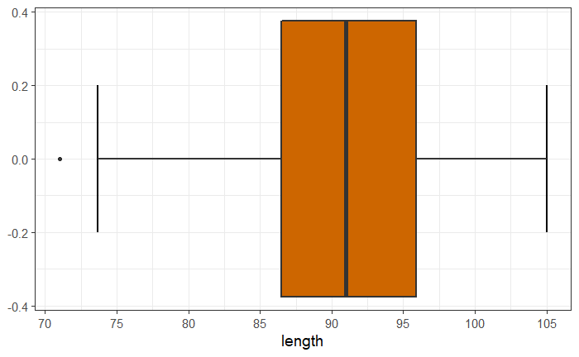
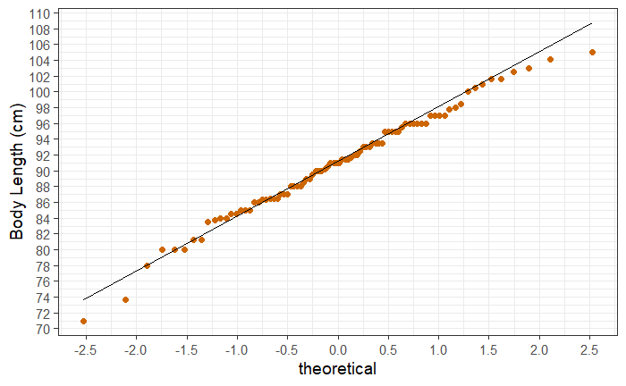
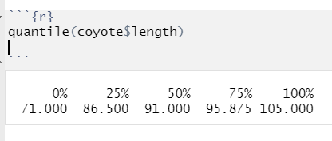
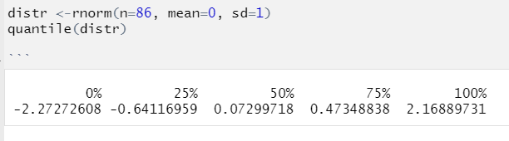
Normality assumption: QQ Plot
QQ plot= Quantile – Quantile plot
Quantiles:
Upper quartile
Lower quartile
Normality ☑ (ish)
Our coyotes
A little bit off
Quantiles:
Mean = 0
SD = 1
Same sample size
Perfectly normal distribution
Notes:
The values in our data are ranked and sorted, and each value is then compared to the expected value that the score should have in a normal distribution. If our data are normally distributed, the values in our data should have approximately the same values as those from a normal distribution, which would result in a straight diagonal line.

Slide 38
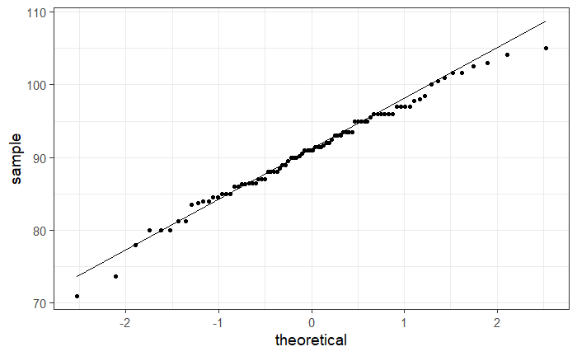
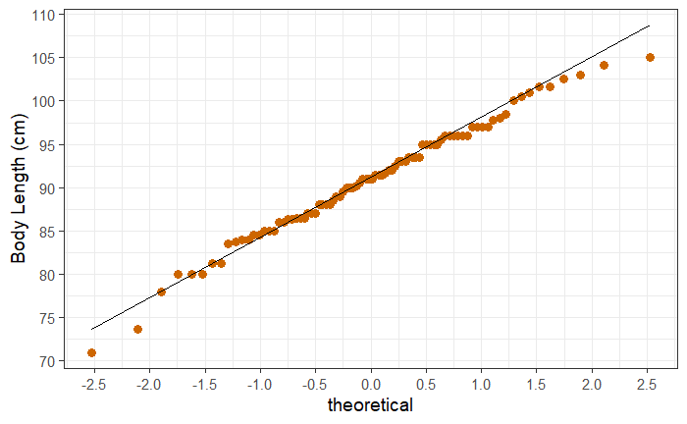
Normality assumption: QQ plot
coyote %>%
ggplot(aes(sample = length)) +
stat_qq()+
stat_qq_line()
coyote %>%
ggplot(aes(sample = length)) +
stat_qq(size=2, colour="darkorange3")+
stat_qq_line()+
ylab("Body Length (cm)")+
scale_y_continuous(breaks=seq(from=70, by=5, to=110))+
scale_x_continuous(breaks=seq(from=-3, by=0.5, to=3))

Slide 39
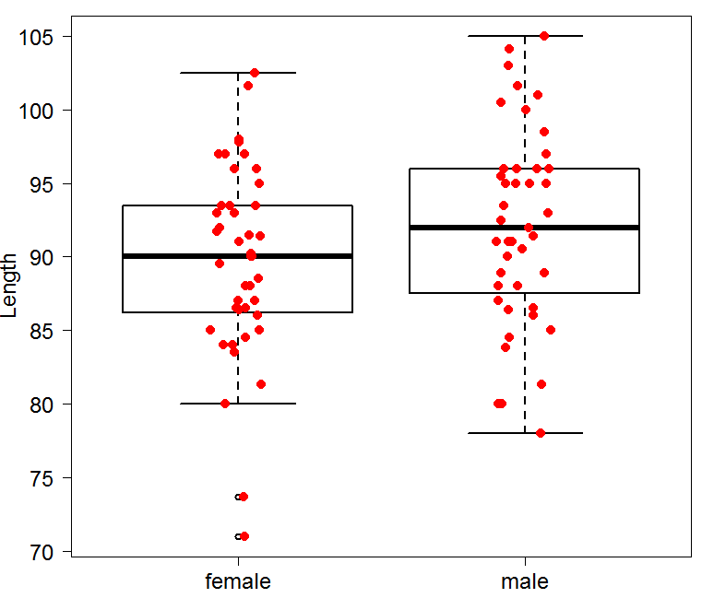


Assumptions of Parametric Data
First assumption: Normality
  Shapiro-Wilk test shapiro_test() # rstatix package #
    It is based on the correlation between the data and the corresponding normal scores.
Second assumption: Homoscedasticity
  Levene test levene_test()
coyote %>%
group_by(gender) %>%
shapiro_test(length)%>%
ungroup()
Normality
Other classic: D’Agostino-Pearson test
# fBasic package #
dagoTest()
Normality ☑
Homoscedasticity
coyote %>%
levene_test(length ~ gender)
More robust: Brown-Forsythe test
# onewaytests package #, bf()
Other classic: Bartlett test
bartlett.test()
Homogeneity in variance ☑

Slide 40

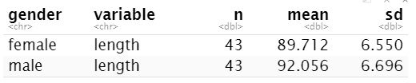
Independent t-test: results (tidyverse) coyote.csv
coyote %>%
t_test(length~gender)
coyote %>%
group_by(gender) %>%
get_summary_stats(length, type = "mean_sd") %>%
ungroup()
Answer: Males tend to be longer than females but not significantly so (p=0.1045).
Power : How many more coyotes to reach significance?
  Re-run the power analysis with mean=89.7 for females: n~250
    But does it make sense?

Slide 41
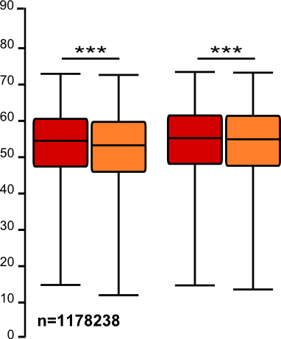
Sample size: the bigger the better?
It takes huge samples to detect tiny differences but tiny samples to detect huge differences.
What if the tiny difference is meaningless?
  Beware of overpower
  Nothing wrong with the stats: it is all about interpretation of the results of the test.
Remember the important first step of power analysis
  What is the effect size of biological interest?

Slide 42
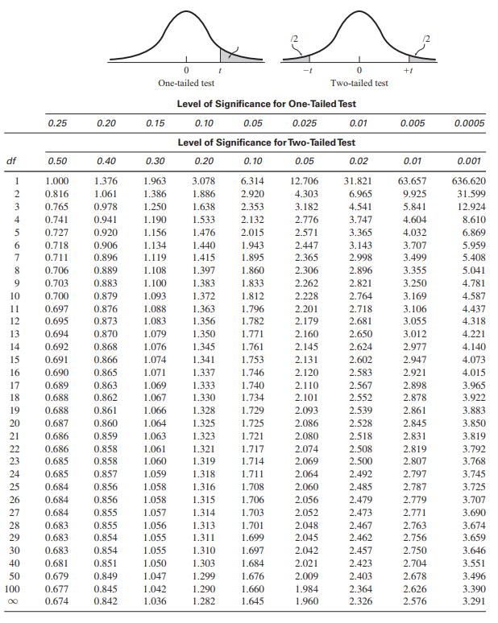

Independent t-test: results
The old-fashion way
t = 1.641 < 1.984: not significant
Critical value

Slide 43
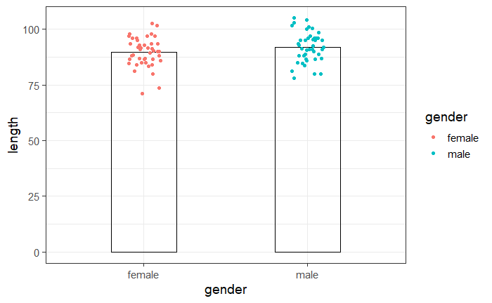
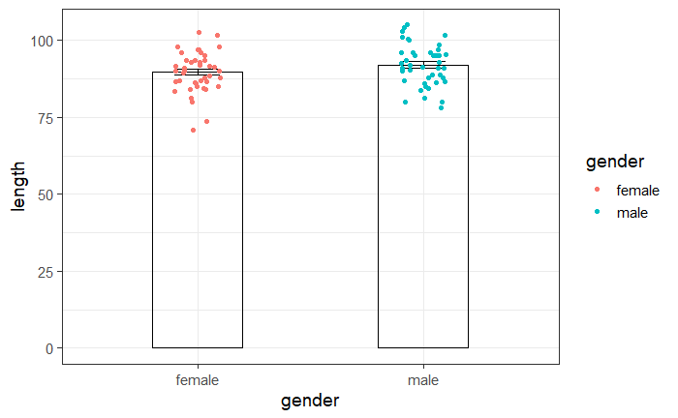
Plot ‘coyote.csv’ data: Plotting data
coyote %>%
ggplot(aes(gender,length, colour=gender)) +
geom_bar(stat = "summary", fun="mean", width=0.4, alpha=0, colour="black")+
geom_jitter(height=0, width=0.1)
Add error bars
coyote %>%
ggplot(aes(gender,length, colour=gender)) +
geom_bar(stat = "summary", fun="mean", width=0.4, alpha=0, colour="black")+
geom_jitter(height=0, width=0.1)+
stat_summary(geom="errorbar", colour="black", width=0.2)

Slide 44
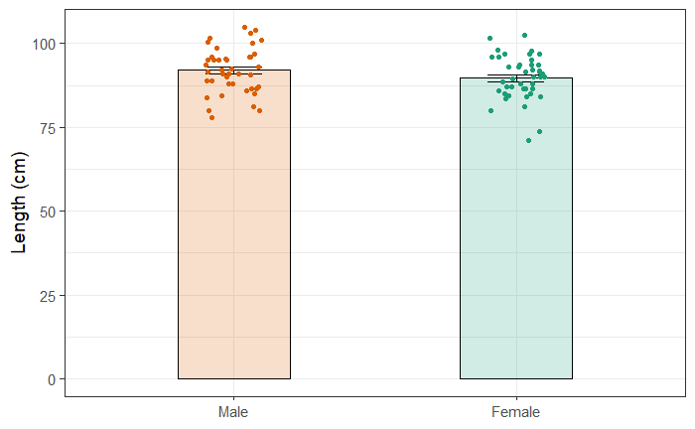
Plot ‘coyote.csv’ data: Plotting data
Prettier version
coyote %>%
ggplot(aes(gender,length, colour=gender, fill=gender)) +
geom_bar(stat="summary", fun="mean", width=0.4, alpha=0.2, colour="black", show.legend=FALSE)+
stat_summary(geom="errorbar", colour="black", width=0.2)+
geom_jitter(height=0, width=0.1, show.legend=FALSE)+
scale_colour_brewer(palette="Dark2")+
scale_fill_brewer(palette="Dark2")+
theme(legend.position = "none")+
scale_x_discrete(limits = c("male", "female"), labels = c("male"="Male", "female"="Female"))+
xlab(NULL)+
ylab("Length (cm)")

Slide 45
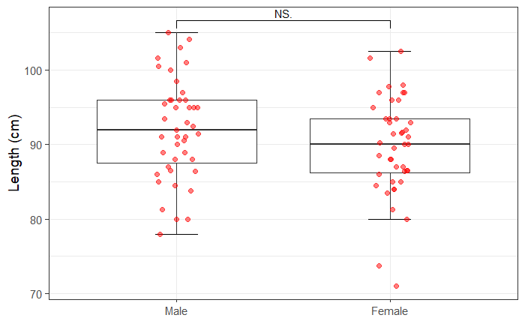
Plot ‘coyote.csv’ data: Plotting data
Work in progress # ggsignif package #
coyote %>%
ggplot(aes(gender, length)) +
stat_boxplot(geom="errorbar", width=0.2)+
geom_boxplot(outlier.shape = NA)+
geom_jitter(height=0, width=0.1, size = 2, alpha = 0.5, colour="red")+
scale_x_discrete(limits = c("male", "female"), labels = c("male"="Male", "female"="Female"))+
ylab("Length (cm)")+
xlab(NULL)+
geom_signif(comparisons = list(c("female", "male")), map_signif_level=T, test = "t.test")

Slide 46
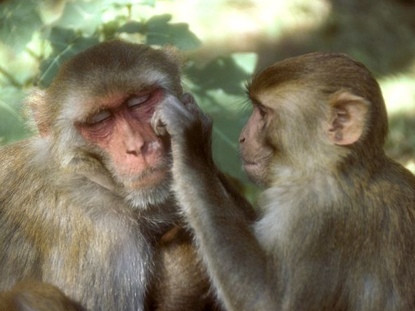

Exercise 5: Dependent or Paired t-test
working.memory.csv
A researcher is studying the effects of dopamine depletion on working memory in rhesus monkeys.
  A group of rhesus monkeys (n=15) performs a task involving memory after having received a placebo. Their performance is graded on a scale from 0 to 100. They are then asked to perform the same task after having received a dopamine depleting agent.
Question: does dopamine affect working memory in rhesus monkeys?
  Load working.memory.csv and check out the structure of the data.
  Work out the difference: DA.depletion – placebo and
  assign the difference to a column: working.memory$difference
  Plot the difference as a stripchart with a mean
  Add confidence intervals as error bars
    Clue: stat_summary(…, fun.data=mean_cl_normal)
    # Hmisc package #
  Run the paired t-test. t_test(var ~ 1, mu=0)

Slide 47
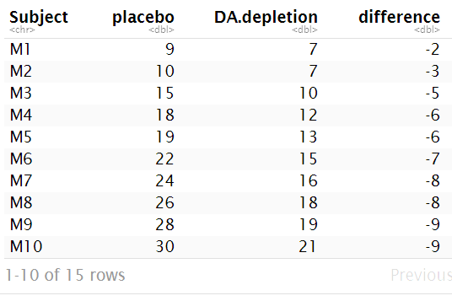
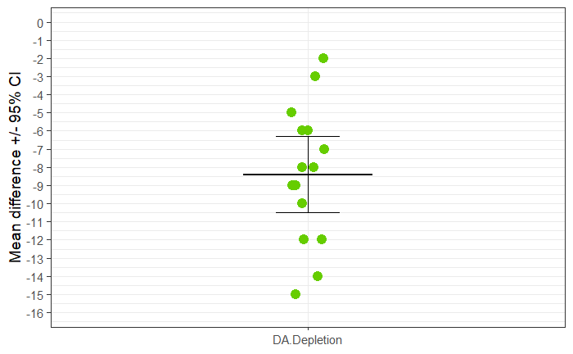
Exercise 5: Dependent or Paired t-test - Answers
working.memory %>%
mutate(difference = DA.depletion - placebo) -> working.memory
# Hmisc package #
working.memory %>%
ggplot(aes("DA.Depletion", difference))+
geom_jitter(height=0, width=0.05, size=4, colour="chartreuse3")+
stat_summary(geom="errorbar",fun="mean", fun.min="mean", fun.max="mean", width=0.3, size=1)+
stat_summary(geom="errorbar", fun.data=mean_cl_normal, width=0.15)+
scale_y_continuous(breaks=-16:0, limits=c(-16, 0))+
xlab(NULL)+
ylab("Mean difference +/- 95% CI")

Slide 48
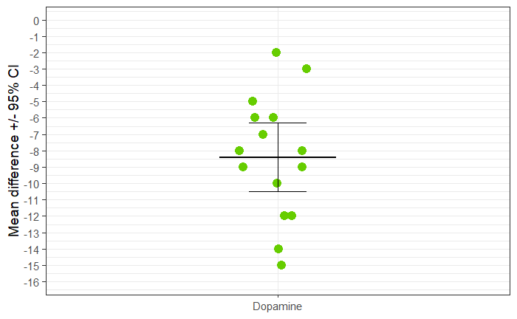

Exercise 5: Dependent or Paired t-test (tidyverse)
Question: does dopamine affect working memory in rhesus monkeys?
working.memory %>%
shapiro_test(difference)
working.memory %>%
t_test(difference ~ 1, mu=0)
Answer: the injection of a dopamine-depleting agent significantly affects working memory in rhesus monkeys (t=-8.62, df=14, p=5.715e-7).

Slide 49
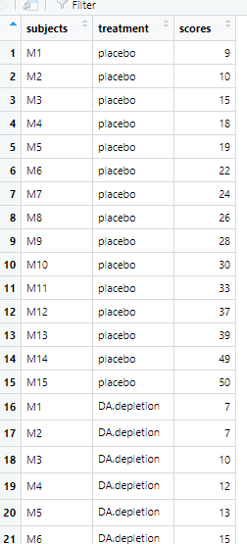
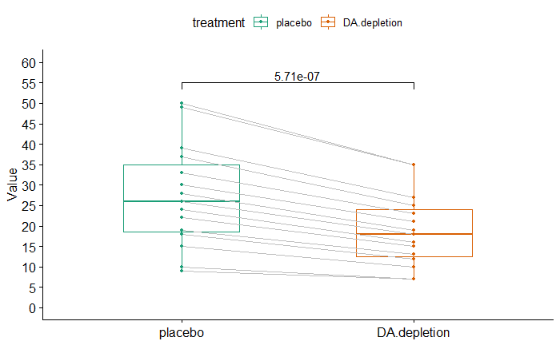
Dependent or Paired t-test
Work in progress # ggpubr package #
working.memory.long %>%
t_test(scores ~ treatment, paired = TRUE) -> stat.test
working.memory.long %>%
ggpaired(x = "treatment", y = "scores", color = "treatment",
palette = "Dark2", line.color = "gray", line.size = 0.4)+
scale_y_continuous(breaks=seq(from =0, by=5, to=60),
limits = c(0,60))+
stat_pvalue_manual(stat.test, label = "p", y.position = 55)
working.memory.long

Slide 50
Comparison between more than 2 groups
One factor = One predictor
One-Way ANOVA

Slide 51
Signal-to-noise ratio
Signal
Difference
=
Noise
Variability
Signal
= statistical significance
Noise
Signal
= no statistical significance
Noise

Slide 52
Analysis of variance: how does it work?
Signal
=
Difference between the means
Noise
Variability in the groups
=
F ratio

Slide 53
One-Way Analysis of variance
Step 1: Omnibus test
It tells us if there is a difference between the means but not which means are significantly different from which other ones.
Step 2: Post-hoc tests
They tell us if there are differences between the means pairwise.

Slide 54
Analysis of variance: how does it work?
Source of variation | Sum of Squares | df | Mean Square | F | p-value
Between Groups | 18.1 | 4 | 4.5 | 6.32 | 0.0002
Within Groups | 51.8 | 73 | 0.71
Total | 69.9

Slide 55
Analysis of variance: how does it work?
grand mean
78 differences: $\sum_{1}^{78}{\text{(}{value}_{n}\text{ – }\text{grand} \text{mean}\text{)}2 }$
=
Sum of squared errors
Source of variation | Sum of Squares | df | Mean Square | F | p-value
Between Groups
Within Groups
Total | 69.9

Slide 56
Analysis of variance: how does it work?
grand mean
5 differences: $\sum_{1}^{5}{\text{(}{mean}_{n}\text{ – }\text{grand} \text{mean}\text{)}2 }$
=
Sum of squared errors
Between the groups
Source of variation | Sum of Squares | df | Mean Square | F | p-value
Between Groups | 18.1
Within Groups
Total | 69.9

Slide 57
Analysis of variance: how does it work?
grand mean
group mean
78 differences: $\sum_{1}^{78}{\text{(}\text{value}\text{n}\text{ –} \text{group} \text{mean}\text{)}2}$
=
Sum of squared errors
Within the Groups
Source of variation | Sum of Squares | df | Mean Squares | F | p-value
Between Groups | 18.1
Within Groups | 51.8
Total | 69.9

Slide 58
Analysis of variance: how does it work?
Source of variation | Sum of Squares | df | Mean Squares | F ratio | p-value
Between Groups | 18.1 | k-1
Within Groups | 51.8 | n-k
Total | 69.9
Signal
Noise
  df: degree of freedom with df = n-1
  n = number of values, k=number of groups
  Between groups: df = 4 (k-1)
  Within groups: df = 73 (n-k = n₁-1 + … + n₅-1)

Slide 59
Analysis of variance: how does it work?
Source of variation | Sum of Squares | df | Mean Squares | F ratio | p-value
Between Groups | 18.1 | 4 | 4.5
Within Groups | 51.8 | 73 | 0.71
Total | 69.9
Signal
Noise
  df: degree of freedom with df = n-1
  18.2/4 = 4.5 51.8/73 = 0.71
Mean squares = Sum of Squares / n-1 = Variance!

Slide 60
Analysis of variance: how does it work?
Source of variation | Sum of Squares | df | Mean Squares | F ratio | p-value
Between Groups | 18.1 | 4 | 4.5 | 6.34 | 0.0002
Within Groups | 51.8 | 73 | 0.71
Total | 69.9
Mean squares = Sum of Squares / n-1 = Variance
Variance between the groups
Variance within the groups (individual variability)
4.5
0.71
F ratio =
=
= 6.34

Slide 61
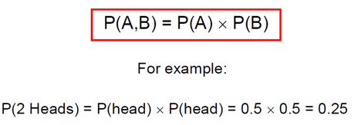
Comparison of more than 2 means
Running multiple tests on the same data increases the familywise error rate.
What is the familywise error rate?
  The error rate across tests conducted on the same experimental data.
One of the basic rules (‘laws’) of probability:
  The Multiplicative Rule: The probability of the joint occurrence of 2 or more independent events is the product of the individual probabilities.
Notes:
Compare many groups to each other, wrong to use multiple t-tests, It increases the error

Slide 62
Familywise error rate
Example: All pairwise comparisons between 3 groups A, B and C:
  A-B, A-C and B-C
Probability of making the Type I Error: 5%
  The probability of not making the Type I Error is 95% (=1 – 0.05)
Multiplicative Rule:
  Overall probability of no Type I errors is: 0.95 * 0.95 * 0.95 = 0.857
So the probability of making at least one Type I Error is 1-0.857 = 0.143 or 14.3%
    The probability has increased from 5% to 14.3%
Comparisons between 5 groups instead of 3, the familywise error rate is 40% (=1-(0.95)^{n})

Slide 63
Familywise error rate
Solution to the increase of familywise error rate: correction for multiple comparisons
  Post-hoc tests
Many different ways to correct for multiple comparisons:
  Different statisticians have designed corrections addressing different issues
    e.g. unbalanced design, heterogeneity of variance, liberal vs conservative
However, they all have one thing in common:
  the more tests, the higher the familywise error rate: the more stringent the correction
Tukey, Bonferroni, Sidak, Benjamini-Hochberg …
  Two ways to address the multiple testing problem
    Familywise Error Rate (FWER) vs. False Discovery Rate (FDR)

Slide 64
Multiple testing problem
FWER: Bonferroni: α_{adjust} = 0.05/n comparisons e.g. 3 comparisons: 0.05/3=0.016
  Problem: very conservative leading to loss of power (lots of false negative)
  10 comparisons: threshold for significance: 0.05/10: 0.005
  Pairwise comparisons across 20.000 genes ☹
FDR: Benjamini-Hochberg: the procedure controls the expected proportion of “discoveries” (significant tests) that are false (false positive).
  Less stringent control of Type I Error than FWER procedures which control the probability of at least one Type I Error
  More power at the cost of increased numbers of Type I Errors.
Difference between FWER and FDR:
  a p-value of 0.05 implies that 5% of all tests will result in false positives.
  a FDR adjusted p-value (or q-value) of 0.05 implies that 5% of significant tests will result in false positives.

Slide 65
One-Way Analysis of variance
Step 1: Omnibus test
It tells us if there is (or not) a difference between the means but not which means are significantly different from which other ones.
Step 2: Post-hoc tests
They tell us if there are (or not) differences between the means pairwise.
A correction for multiple comparisons will be applied on the p-values.
These post hoc tests should only be used when the ANOVA finds a significant effect.

Slide 66
Example: protein.expression.csv
Question: is there a difference in protein expression between the 5 cell lines?
1 Plot the data
2 Check the assumptions for parametric test

Slide 67
Exercise 6: One-way ANOVA: Data Exploration
protein.expression.csv
Question: Difference in protein expression between 5 cell types?
  Load protein.expression.csv
  Plot the data using at least 2 types of graph
    geom_boxplot(), geom_jitter(), geom_violin()
  Draw a QQplot
    ggplot(aes(sample =)) + stat_qq() + stat_qq_line()
  Check the first assumption (Normality) with a formal test
    shapiro_test()

Slide 68
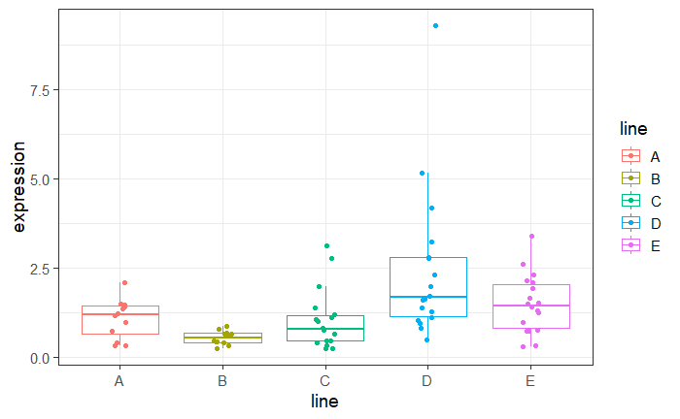
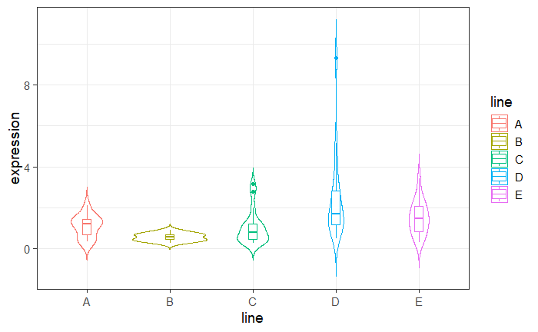
Exercise 6: One-way ANOVA : Data Exploration - Answers
protein %>%
ggplot(aes(x=line, y=expression, colour=line))+
geom_boxplot(outlier.shape = NA)+
geom_jitter(height=0, width=0.1)
protein %>%
ggplot(aes(x=line, y=expression, colour=line))+
geom_violin(trim=FALSE)+
geom_boxplot(width=0.1)

Slide 69

Exercise 6: One-way ANOVA – Answers
protein %>%
ggplot(aes(sample = expression))+
stat_qq(size=3)+
stat_qq_line()

Slide 70

Exercise 6: One-way ANOVA – Answers. What do we do now?
protein %>%
group_by(line) %>%
shapiro_test(expression)%>%
ungroup()

Slide 71


One-way ANOVA: change of scale
protein %>%
ggplot(aes(line, expression, colour=line))+
geom_jitter(height=0, width=0.2, size=3, show.legend=FALSE)+
stat_summary(geom="errorbar", fun=mean, fun.min=mean, fun.max=mean, colour="black", size=1)
+ scale_y_log10()
Linear scale
Log scale
protein %>%
mutate(log10.expression=log10(expression)) -> protein

Slide 72


One-way ANOVA: change of scale
protein %>%
ggplot(aes(x=line, y=log10.expression, colour=line))+
geom_boxplot(outlier.shape = NA)+
geom_jitter(height=0, width=0.1)
protein %>%
ggplot(aes(x=line, y=log10.expression, colour=line))+
geom_violin(trim=FALSE)+
geom_boxplot(width=0.1)

Slide 73

One-way ANOVA – Outliers identification
protein %>%
group_by(line) %>%
identify_outliers(expression)%>%
ungroup()

Slide 74


One-way ANOVA: change of scale
protein %>%
ggplot(aes(sample=log10.expression))+
stat_qq(size=3)+
stat_qq_line()
Before log-transformation
First assumption ü

Slide 75


Assumptions of Parametric Data
protein %>%
group_by(line) %>%
shapiro_test(log10.expression)%>%
ungroup()
First assumption üish
protein %>%
levene_test(log10.expression ~ line)
Second assumption ü

Slide 76
Analysis of variance
Step 1: omnibus test
Step 2: post-hoc tests
data %>%
anova_test(y~x)
Default
Tukey correction
Bonferroni correction
# emmeans package #
data %>%
tukey_hsd(y~x)
data %>%
emmeans_test(y~x, p.adjust.method="bonferroni")
  R way:
  aov(y~x, data= ) -> model then summary(model)
  pairwise.t.test(y, x, p.adj = "bonf")
    TukeyHSD(model)
Have a go!

Slide 77


Analysis of variance
protein %>%
anova_test(log10.expression~line)
generalised effect size (Eta squared η²) = R² ish
protein %>%
tukey_hsd(log10.expression~line)
Tukey correction

Slide 78

Analysis of variance
protein %>%
anova_test(log10.expression~line)
generalised effect size (Eta squared η²) = R² ish
protein %>%
emmeans_test(log10.expression ~ line, p.adjust.method = "bonferroni")
Bonferroni correction

Slide 79



Analysis of variance (R)
To plot confidence intervals
aov(log10.expression~line,data=protein.stack.clean) -> anova.log.protein
summary(anova.log.protein)
TukeyHSD(anova.log.protein)->tukey
plot(tukey, las=1)
TukeyHSD(anova.log.protein,"line")

Slide 80


Analysis of variance (tidyverse)
To plot confidence intervals
protein %>%
tukey_hsd(log10.expression~line)%>%
mutate(comparison = paste(group1, sep=".", group2)) -> tukey.conf
tukey.conf %>%
ggplot(aes(x=comparison, y=estimate, ymin=conf.low, ymax=conf.high)) +
geom_errorbar(colour="black", size=1)+
geom_point(size=3, colour="darkred")+
geom_hline(yintercept=0, linetype="dashed", color = "red")+
coord_flip()

Slide 81

Analysis of variance
protein %>%
ggplot(aes(line, expression, colour=line))+
geom_jitter(height = 0, width=0.2, size=3, show.legend=FALSE)+
stat_summary(geom="errorbar",fun=mean,fun.min=mean,fun.max = mean, colour="black", size=1)+
scale_y_log10()

Slide 82

Analysis of variance
protein %>%
ggplot(aes(x=line, y=expression, fill=line)) +
geom_bar(stat = "summary", fun="mean", colour="black")+
stat_summary(geom="errorbar", colour="black", width=0.4)

Slide 83

Analysis of variance
protein %>%
ggplot(aes(x=line, y=expression, fill=line)) +
geom_bar(stat="summary", fun="mean", colour="black")+
stat_summary(geom="errorbar", colour="black", width=0.4)+
geom_jitter(heigth=0, width=0.1, alpha=0.5)

Slide 84

Analysis of variance
protein %>%
ggplot(aes(x=line, y=log10.expression, fill=line)) +
geom_bar(stat="summary", fun="mean", colour="black")+
stat_summary(geom="errorbar", colour="black", width=0.4)+
geom_jitter(heigth=0, width=0.1, alpha=0.5)

Slide 85

Exercise 7: Repeated measures ANOVA
neutrophils.long.csv
A researcher is looking at the difference between 4 cell groups.
He has run the experiment 5 times. Within each experiment, he has neutrophils from a WT (control), a KO, a KO+Treatment 1 and a KO+Treatment2.
Question: Is there a difference between KO with/without treatment and WT?
Load neutrophils.long.csv
Plot the data so that you have an idea of the consistency of the results between the experiments.
Check the first assumption
Run the repeated measures ANOVA and post-hoc tests
anova_test(dv =, wid =, within =) -> res.aov
get_anova_table(res.aov)
pairwise_t_test(p.adjust.method =)
Choose a graphical presentation consistent with the experimental design

Slide 86

Exercise 7: Repeated measures ANOVA
neutrophils.long.csv
Plot the data so that you have an idea of the consistency of the results
between the experiments.
neutrophils.long %>%
ggplot(aes(Group, Values, group=Experiment, colour=Experiment, fill=Experiment))+
geom_line(size=2)+
geom_point(size=4, shape = 21, colour= "black", stroke=2)+
scale_x_discrete(limits = c("WT", "KO", "KO+T1", "KO+T2"))

Slide 87


Exercise 7: Repeated measures ANOVA
neutrophils.long.csv
Check the first assumption
neutrophils.long %>%
ggplot(aes(Group, Values))+
geom_boxplot(outlier.shape = NA)+
geom_jitter(height = 0, width = 0.2)
neutrophils.long %>%
group_by(Group) %>%
shapiro_test(Values) %>%
ungroup()

Slide 88


Exercise 7: Repeated measures ANOVA
neutrophils.long.csv
Run the repeated measures ANOVA and post-hoc tests
neutrophils.long %>%
anova_test(dv = Values, wid = Experiment, within = Group) -> res.aov
get_anova_table(res.aov)
neutrophils.long %>%
pairwise_t_test(Values~Group, paired=TRUE, ref.group = "WT", p.adjust.method = "bonferroni")

Slide 89

Exercise 7: Repeated measures ANOVA
neutrophils.long.csv
Run the repeated measures ANOVA and post-hoc tests
neutrophils.long %>%
pairwise_t_test(Values~Group, paired=TRUE, ref.group = "WT", p.adjust.method = "bonferroni")
neutrophils.long %>%
pairwise_t_test(Values~Group, paired=TRUE, ref.group = "WT", p.adjust.method = "holm")
Tukey ☹

Slide 90

Exercise 7: Repeated measures ANOVA
neutrophils.long.csv
Choose a graphical presentation consistent with the experimental design
neutrophils.long %>%
group_by(Experiment) %>%
mutate(Difference=Values-Values[Group=="WT"]) %>%
ungroup() -> neutrophils.long

Slide 91

Exercise 7: Repeated measures ANOVA
neutrophils.long.csv
Choose a graphical presentation consistent with the experimental design
neutrophils.long %>%
filter(Group !="WT") %>%
ggplot(aes(Group, Difference, fill=Group)) +
geom_bar(stat = "summary", fun="mean", colour="black")+
stat_summary(geom="errorbar", fun.data=mean_cl_normal, width=0.15)+
geom_jitter(height = 0, width=0.1, alpha=0.5, size=3)+
ylab("Mean difference from WT +/- 95% CI")+
scale_y_continuous(breaks=seq(from=-40, by=10, to=80))+
scale_fill_brewer(palette = "PuOr")

Slide 92
Comparison between more than 2 groups
Two factors = Two predictors
Two-Way ANOVA

Slide 93
Two-way Analysis of Variance
(Factorial ANOVA)
Source of variation | Sum of Squares | Df | Mean Square | F | p-value
Variable A * Variable B | 1978 | 2 | 989.1 | F (2, 42) = 11.91 | P < 0.0001
Variable B (Between groups) | 3332 | 2 | 1666 | F (2, 42) = 20.07 | P < 0.0001
Variable A (Between groups) | 168.8 | 1 | 168.8 | F (1, 42) = 2.032 | P = 0.1614
Residuals | 3488 | 42 | 83.04
Source of variation | Sum of Squares | Df | Mean Square | F | p-value
Variable A (Between Groups) | 2.665 | 4 | 0.6663 | 8.42 | <0.0001
Within Groups (Residual) | 5.775 | 73 | 0.0791
Total | 8.44 | 77
One-way ANOVA= 1 predictor variable
2-way ANOVA= 2 predictor variables: A and B
SST
Total variance in the Data
SST
Total variance in the Data
Total
SSM
Variance Explained by the Model
SSR
Unexplained Variance
SSM
Variance Explained by the Model
Between Groups
SSR
Unexplained Variance
Within Groups
SSA
Variance Explained by Variable A
SSB
Variance Explained by Variable B
SSAxB
Variance Explained by the Interaction of A and B

Slide 94
Two-way Analysis of Variance
Interaction plots: Examples
  Fake dataset:
    2 factors: Genotype (2 levels) and Condition (2 levels)

Slide 95


Two-way Analysis of Variance
Interaction plots: Examples
  2 factors: Genotype (2 levels) and Condition (2 levels)
Single Effect
Genotype Effect
Condition Effect

Slide 96


Two-way Analysis of Variance
Interaction plots: Examples
  2 factors: Genotype (2 levels) and Condition (2 levels)
Zero or Both Effect
Zero Effect
Both Effect

Slide 97


Two-way Analysis of Variance
Interaction plots: Examples
  2 factors: Genotype (2 levels) and Condition (2 levels)
Interaction

Slide 98

Two-way Analysis of Variance
Example: goggles.csv
  The ‘beer-goggle’ effect
  Study: effects of alcohol on mate selection in night-clubs.
  Pool of independent judges scored the levels of attractiveness of the person that the participant was chatting up at the end of the evening.
  Question: is subjective perception of physical attractiveness affected by alcohol consumption?
    Attractiveness on a scale from 0 to 100

Slide 99
Exercise 8: Two-way ANOVA
goggles.csv
Load goggles.csv
Graphically explore the data
  effect of alcohol only
  effect of gender only
  effect of both
Check the assumptions visually (plot+qqplot) and formally (test)
levene_test(y ~ factor1*factor2)

Slide 100


Two-way Analysis of Variance
As always, first step: get to know the data
goggles %>%
ggplot(aes(x=alcohol, y=attractiveness))+
geom_boxplot()+
geom_jitter(height=0, width=0.1)
goggles %>%
ggplot(aes(x=gender, y=attractiveness))+
geom_boxplot()+
geom_jitter(height=0, width=0.1)

Slide 101

Two-way Analysis of Variance
goggles %>%
ggplot(aes(alcohol, attractiveness, fill=gender))+
geom_boxplot(alpha=0.5)+
scale_fill_brewer(palette="Dark2")

Slide 102

Two-way Analysis of Variance
goggles %>%
ggplot(aes(gender, attractiveness, fill=alcohol))+
geom_boxplot(alpha=0.5)+
scale_fill_brewer(palette="Dark2")

Slide 103

Two-way Analysis of Variance
goggles %>%
ggplot(aes(x=gender, y=attractiveness))+
geom_boxplot()+
geom_jitter(height=0, width=0.1)+
facet_grid(cols=vars(alcohol))

Slide 104

Two-way Analysis of Variance
Checking the assumptions
goggles %>%
ggplot(aes(sample = attractiveness, colour=gender))+
stat_qq()+
stat_qq_line()+
facet_grid(cols=vars(gender))+
scale_colour_brewer(palette = "Accent")
First assumption ü

Slide 105


Two-way Analysis of Variance
Checking the assumptions
goggles %>%
group_by(gender, alcohol) %>%
shapiro_test(attractiveness) %>%
ungroup()
First assumption ü
goggles %>%
levene_test(attractiveness ~ gender*alcohol)
Second assumption ü

Slide 106
Two-way Analysis of Variance
With significant interaction (real data)
ANOVA table | SS | DF | MS | F (DFn, DFd) | P value
Interaction | 1978 | 2 | 989.1 | F (2, 42) = 11.91 | < 0.0001
Alcohol Consumption | 3332 | 2 | 1666 | F (2, 42) = 20.07 | < 0.0001
Gender | 168.8 | 1 | 168.8 | F (1, 42) = 2.032 | 0.1614
Residual | 3488 | 42 | 83.04
Without significant interaction (fake data)
ANOVA table | SS | DF | MS | F (DFn, DFd) | P value
Interaction | 7.292 | 2 | 3.646 | F (2, 42) = 0.06872 | 0.9337
Alcohol Consumption | 5026 | 2 | 2513 | F (2, 42) = 47.37 | < 0.0001
Gender | 438.0 | 1 | 438.0 | F (1, 42) = 8.257 | 0.0063
Residual | 2228 | 42 | 53.05

Slide 107


Two-way Analysis of Variance
goggles %>%
anova_test(attractiveness~alcohol+gender+alcohol*gender)
goggles %>%
group_by(alcohol) %>%
tukey_hsd(attractiveness ~ gender) %>%
ungroup()
Answer: there is a significant effect of alcohol consumption on the way the attractiveness of a date is perceived but it varies significantly between genders (p=7.99e-05).
With 2 pints or less, boys seem to be very slightly more picky about their date than girls (but not significantly so) but with 4 pints the difference is reversed and significant (p=0.0003)

Slide 108


Two-way Analysis of Variance
Work in progress # ggpubr package #
goggles %>%
group_by(alcohol) %>%
tukey_hsd(attractiveness ~ gender) %>%
add_xy_position(x = "alcohol") %>%
ungroup() -> tukey.results
goggles %>%
ggplot(aes(alcohol, attractiveness, colour = gender))+
geom_boxplot()+
stat_pvalue_manual(tukey.results)+
scale_colour_brewer(palette = "Dark2")

Slide 109

Two-way Analysis of Variance
Work in progress # ggpubr package # Actual p-values rather than NS or *
goggles %>%
group_by(alcohol) %>%
tukey_hsd(attractiveness ~ gender) %>%
mutate(p.adj.signif = p.adj) %>%
add_xy_position(x = "alcohol") %>%
ungroup() -> tukey.results
goggles %>%
ggplot(aes(alcohol, attractiveness, colour = gender))+
geom_boxplot()+
stat_pvalue_manual(tukey.results)+
scale_colour_brewer(palette = "Dark2")

Slide 110


Two-way Analysis of Variance
Now a quick way to have a look at the interaction
goggles %>%
group_by(gender, alcohol)%>%
summarise(mean=mean(attractiveness))%>%
ungroup() -> goggles.summary
goggles.summary %>%
ggplot(aes(x=alcohol, y= mean, colour=gender, group=gender))+
geom_line()+
geom_point()

Slide 111
Association between 2 continuous variables
One variable X and One variable Y
One predictor
Correlation

Slide 112

Signal-to-noise ratio
Signal
Similarity
=
Noise
Variability
Signal
= statistical significance
Noise
Signal
= no statistical significance
Noise

Slide 113



Signal-to-noise ratio and Correlation
Signal is similarity of behaviour between variable x and variable y.
similarity
Signal
Coefficient of correlation: r =
=
variability
Noise
covariance
$$\frac{COV_{xy}}{SD_{x}SD_{y}}$$
$$\frac{\sum{ }\left(x_{i} −\overline{x}\right)\left(y_{i} −\overline{y}\right)}{\left(n −1\right) SD_{x}SD_{y}}$$
r
similarity
variability
Standard Deviation

Slide 114

Correlation
Most widely-used correlation coefficient:
  Pearson product-moment correlation coefficient “r”
    The magnitude and the direction of the relation between 2 variables
    It is designed to range in value between -1 and +1
    -0.6 < r > +0.6 : exciting
  Coefficient of determination “r²”
    It gives the proportion of variance in Y that can be explained by X (in percentage).
      It helps with the interpretation of r
      It’s basically the effect size

Slide 115




Correlation
p = 0.0002
p = 0.04
r = - 0.34
r = - 0.83
r² = 0.12
r² = 0.68
Power!!

Slide 116
Correlation
Assumptions
Assumptions for correlation
  Regression and linear Model (lm)
Linearity: The relationship between X and the mean of Y is linear.
Homoscedasticity: The variance of residual is the same for any value of X.
Independence: Observations are independent of each other.
Normality: For any fixed value of X, Y is normally distributed.

Slide 117

Correlation
Outliers and High leverage points
Outliers: the observed value for the point is very different from that predicted by the regression model.

Slide 118
Correlation
Outliers and High leverage points
Leverage points: A leverage point is defined as an observation that has a value of x that is far away from the mean of x.
Outliers and leverage points have the potential to be Influential observations:
  Change the slope of the line. Thus, have a large influence on the fit of the model.
One method to find influential points is to compare the fit of the model with and without the dodgy observation.

Slide 119
Correlation
Outliers and High leverage points
All good

Slide 120
Correlation
Outliers and High leverage points
Outlier but not influential value

Slide 121
Correlation
Outliers and High leverage points
High leverage but not influential value

Slide 122
Correlation
Outliers and High leverage points
Outlier and High leverage: Influential value

Slide 123
Correlation: Two more things
Thing 1: Pearson correlation is a parametric test
First assumption for parametric test: Normality
Correlation: bivariate Gaussian distribution
Symmetry-ish of the values on either side of the line of best fit.

Slide 124
Correlation: Two more things
Thing 2: Line of best fit comes from a regression
Correlation: nature and strength of the association
Regression: nature and strength of the association and prediction
Y
x
Correlation = Association
Regression = Prediction
Y = A + B*X

Slide 125
Correlation: correlation.csv
Questions:
  What is the nature and the strength of the relationship between X and Y?
  Are there any dodgy points?

Slide 126


Correlation: correlation.csv
Question: are there any dodgy points?
read_csv("correlation.csv") -> correlation
correlation %>%
ggplot(aes(variable.x, variable.y, colour=Gender)) +
geom_point(size=3, colour="sienna2")

Slide 127

Correlation: correlation.csv
For the lines of best-fit: 3 new functions:
lm(y~x, data=) -> fit
coefficients(fit) -> cf.fit (vector of 2 values)
geom_abline(intercept=cf.fit[1], slope=cf.fit[2])
lm(variable.y ~ variable.x, data=correlation)-> fit.correlation
coefficients(fit.correlation) -> coef.correlation
coef.correlation
intercept slope

Slide 128

Correlation: correlation.csv
correlation %>%
ggplot(aes(variable.x, variable.y, label = ID)) +
geom_point(size=3, colour="sienna2") +
geom_abline(intercept = coef.correlation[1], slope = coef.correlation[2])+
geom_text(hjust = 0, nudge_x = 0.15)

Slide 129


Correlation: correlation.csv
Assumptions, outliers and influential cases
par(mfrow=c(2,2))
plot(fit.correlation)
Linearity, homoscedasticity and outlier
Normality and outlier
cooks.distance()
The Cook’s distance is a combination of each observation’s leverage and residual values ; the higher the leverage and residuals, the higher the Cook’s distance (influential observation).
It summarizes how much all the values in the regression model change when the ith observation is removed.
Consensus: cut-off point =1 (0.5).
Homoscedasticity
Influential cases

Slide 130


Correlation: correlation.csv
summary(fit.correlation)
Line of best fit: Y=8.38 + 3.59*X
correlation %>%
cor_test(variable.x, variable.y)

Slide 131
Correlation: correlation.csv
Have a go: Remove ID 23, then re-run the model and plot the graph again.
Then decide what you want to do with ID 21 and 22.
correlation %>%
filter(ID != 23) -> correlation.23

Slide 132


Correlation: correlation.csv
correlation %>%
filter(ID != 23) -> correlation.23
lm(variable.y ~ variable.x, correlation.23) -> fit.correlation.23
summary(fit.correlation.23)

Slide 133

Correlation: correlation.csv
correlation.23 %>%
filter(ID != 21) -> correlation.23.21
lm(variable.y ~ variable.x, correlation.23.21) -> fit.correlation.23.21
summary(fit.correlation.23.21)
Correlation.23.21 %>%
cor_test(variable.x, variable.y)

Slide 134
Extra exercise
Correlation: exam.anxiety.csv
Question: Is there a relationship between time spent revising and exam anxiety?
And, if yes, are boys and girls different?
Build a fit for the boys and a fit for the girls
  data %>% filter() lm(y~x, data=)
Plot the 2 lines of best fit on the same graph
  coefficients() geom_abline()
Check the assumptions visually from the data and with the output for models
  par(mfrow=c(2,2)) plot(fit.male)
Filter out misbehaving values based on the standardised residuals
  rstandard() add_column()
Plot the final (improved!) model
  bind_rows()

Slide 135


Correlation: exam.anxiety.csv
Question: Is there a relationship between time spent revising and exam anxiety?
And, if yes, are boys and girls different?
read_csv("exam.anxiety.csv") -> exam.anxiety
exam.anxiety %>%
ggplot(aes(x=Revise, y=Anxiety, colour=Gender)) + geom_point(size=3)

Slide 136
Correlation: exam anxiety.csv
Is there a relationship between time spent revising and exam anxiety?
exam.anxiety %>%
filter(Gender=="Female") -> exam.anxiety.female
lm(Anxiety~Revise, data=exam.anxiety.female) -> fit.female
coefficients(fit.female) -> cf.fit.female
Fit for the females
exam.anxiety %>%
filter(Gender=="Male") -> exam.anxiety.male
lm(Anxiety~Revise, data=exam.anxiety.male) -> fit.male
coefficients(fit.male) -> cf.fit.male
Fit for the males

Slide 137

Correlation: exam anxiety.csv
Is there a relationship between time spent revising and exam anxiety?
exam.anxiety %>%
ggplot(aes(x=Revise, y=Anxiety, colour=Gender))+
geom_point(size=3)+
geom_abline(intercept=cf.fit.male[1], slope=cf.fit.male[2])+
geom_abline(intercept=cf.fit.female[1], slope=cf.fit.female[2])

Slide 138

Correlation: exam anxiety.csv
Assumptions, outliers and influential cases
par(mfrow=c(2,2))
plot(fit.male)

Slide 139

Correlation: exam anxiety.csv
Assumptions, outliers and influential cases
plot(fit.female)

Slide 140


Correlation: exam anxiety.csv
summary(fit.male)
Anxiety=84.19 - 0.53*Revise
summary(fit.female)
Anxiety=91.94 - 0.82*Revise
exam.anxiety %>%
group_by(Gender) %>%
cor_test(Revise, Anxiety) %>%
ungroup()

Slide 141

Correlation: exam.anxiety.csv
Influential outliers: Boys
rstandard(fit.male) -> st.resid.m
exam.anxiety.male %>%
add_column(st.resid.m) %>%
filter(abs(st.resid.m)<3) -> exam.anxiety.male.clean
lm(Anxiety~Revise, data=exam.anxiety.male.clean) -> fit.male2
summary(fit.male2)
exam.anxiety.male.clean %>%
cor_test(Revise, Anxiety)

Slide 142

Correlation: exam.anxiety.csv
Influential outliers: Girls
rstandard(fit.female) -> st.resid.f
exam.anxiety.female %>%
add_column(st.resid.f) %>%
filter(abs(st.resid.f) < 3) -> exam.anxiety.female.clean
lm(Anxiety~Revise, data=exam.anxiety.female.clean) -> fit.female2
summary(fit.female2)
exam.anxiety.female.clean %>%
cor_test(Revise, Anxiety)

Slide 143

Correlation: exam.anxiety.csv
Question: Is there a relationship between time spent revising and exam anxiety? Yes!
bind_rows(exam.anxiety.female.clean, exam.anxiety.male.clean) -> exam.anxiety.clean
coefficients(fit.male2) -> cf.fit.male2
coefficients(fit.female2) -> cf.fit.female2
exam.anxiety.clean %>%
ggplot(aes(Revise, Anxiety, colour=Gender))+geom_point(size=3)+
geom_abline(aes(intercept=cf.fit.male2[1], slope=cf.fit.male2[2]), colour="orange")+
geom_abline(aes(intercept=cf.fit.female2[1], slope=cf.fit.female2[2]), colour="purple")+
scale_colour_manual(values = c("purple", "orange"))

Slide 144




Correlation: exam.anxiety
Influential outliers: Another check
exam.anxiety.male %>%
shapiro_test(st.resid.m)
exam.anxiety.female %>%
shapiro_test(st.resid.f)
exam.anxiety.male.clean %>%
shapiro_test(st.resid.m)
exam.anxiety.female.clean %>%
shapiro_test(st.resid.f)

Slide 145

Correlation: exam anxiety.csv
Difference between boys and girls?
lm(Anxiety~Revise*Gender, data=exam.anxiety.clean) -> fit.genders
summary(fit.genders)

