Slide 1


Analysis of Qualitative data
Anne Segonds-Pichon v2020-09

Slide 2
Variable
Quantitative
Qualitative
Discrete
Continuous
Nominal
Ordinal
Ratio
Interval

Slide 3
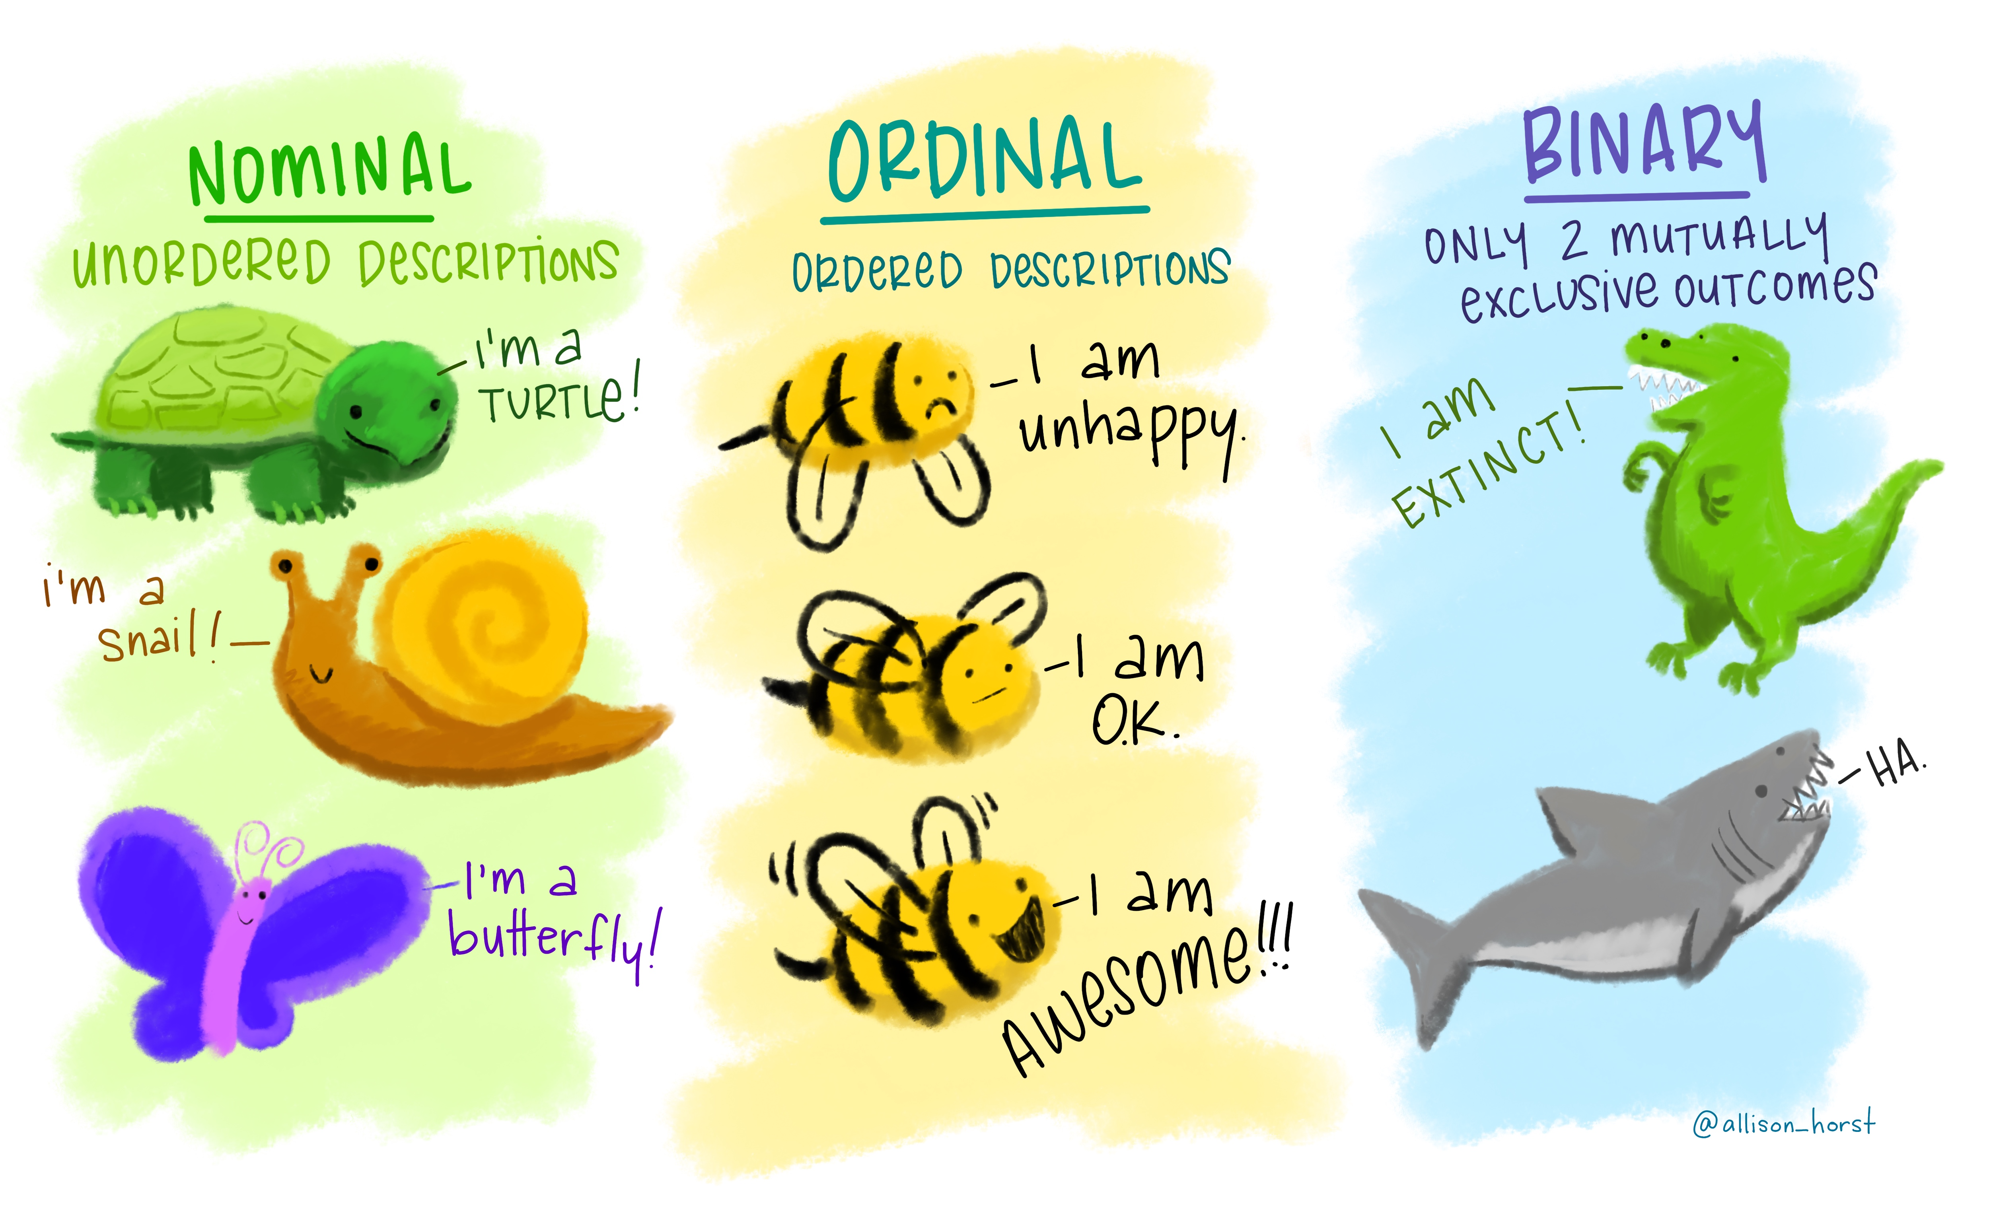
Qualitative data
= not numerical
= values taken = usually names (also nominal)
    e.g. genotypes
Values can be numbers but not numerical
    e.g. group number = numerical label but not unit of measurement
Qualitative variable with intrinsic order in their categories = ordinal
Particular case: qualitative variable with 2 categories: binary or dichotomous
    e.g. alive/dead or presence/absence
https://github.com/allisonhorst/stats-illustrations#other-stats-artwork
Notes:
Can be good or horrible data qualitative data do not use many stats, one is chi square
Cats and dogs, first plot it

Slide 4

  Fisher’s exact and Chi²
Example: cats.dat
Cats trained to line dance
2 different rewards: food or affection
Question: Is there a difference between the rewards?
Is there a significant relationship between the 2 variables?
  does the reward significantly affect the likelihood of dancing?
To answer this type of question:
  Contingency table
  Fisher’s exact or Chi² tests
 | Food | Affection
Dance | ? | ?
No dance | ? | ?
But first: how many cats do we need?
Notes:
Is there a difference between the rewards?
Dogs more happy, cats more picky (on demonstration is the other way around, so cats more picky

Slide 5
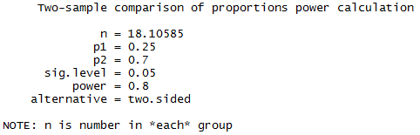
Power calculation cats.dat
Preliminary results from a pilot study: 25% line-danced after having received affection as a reward vs. 70% after having received food.
How many cats do we need?
power.prop.test(p1= 0.25, p2= 0.7, sig.level= 0.05, power= 0.8)
Providing the effect size observed in the experiment is similar to the one observed in the pilot study, we will need 2 samples of 18 to 19 cats to reach significance (p<0.05) with a Fisher’s exact test.

Slide 6
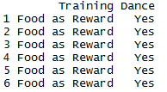
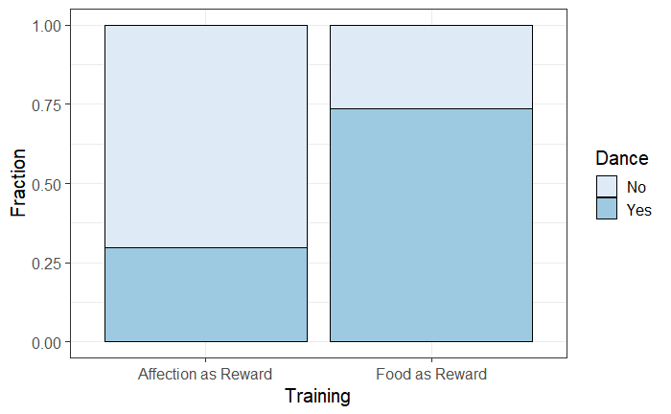
Plot cats data (From raw data)
read_tsv("cats.dat") -> cats
cats
ggplot(cats, aes(Training, fill=Dance))+
geom_bar(position="fill", colour="black")+
scale_fill_brewer(palette = 1)+
ylab("Fraction")

Slide 7
Chi-square and Fisher’s tests
Chi² test very easy to calculate by hand but Fisher’s very hard
Many software will not perform a Fisher’s test on tables > 2x2
Fisher’s test more accurate than Chi² test on small samples
Chi² test more accurate than Fisher’s test on large samples
Chi² test assumptions:
  2x2 table: no expected count <5
  Bigger tables: all expected > 1 and no more than 20% < 5
Yates’s continuity correction
  All statistical tests work well when their assumptions are met
  When not: probability Type 1 error increases
  Solution: corrections that increase p-values
    Corrections are dangerous: no magic
    Probably best to avoid them

Slide 8
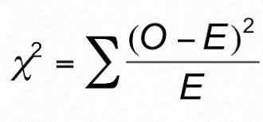
Chi-square test
In a chi-square test, the observed frequencies for two or more groups are compared with expected frequencies by chance.
  O = Observed frequencies
  E = Expected frequencies
Example with ‘cats and dogs’
Notes:
Your frequency, compare the frequencies with the expected ones observed by chance. HOW DIFFERENT IS WHAT I observe from what I expect? THIS DIFFERENCE CAN BE BIG SO SIGNOFICANT OR NOT

Slide 9
  How are the expected frequencies calculated?
Example: expected frequency of cats line dancing
after having received food as a reward.
Direct counts approach:
Expected frequency = (row total)*(column total)/grand total
= 38*76/200 = 14.4
Probability approach: The Multiplicative Rule
Probability of line dancing: 76/200
Probability of receiving food: 38/200
Expected frequency:(76/200)*(38/200)=0.072: 7.2% of 200 = 14.4
Observed frequencies
 | Food | Affection | Total
Dance | 28 | 48 | 76
No dance | 10 | 114 | 124
Total | 38 | 162 | 200
Expected frequencies
 | Food | Affection
Dance | 14.4 | 61.6
No dance | 23.6 | 100.4
Notes:
Is there a difference between the rewards?
Dogs more happy, cats more picky (on demonstration is the other way around, so cats more picky

Slide 10

Chi² test
Observed frequencies
Expected frequencies
 | Food | Affection
Dance | 28 | 48
No dance | 10 | 114
 | Food | Affection
Dance | 14.4 | 61.6
No dance | 23.6 | 100.4
Chi² = (28-14.4)²/14.4 + (48-61.6)²/61.6 + (10-23.6)²/23.6 + (114-100.4)²/100.4
= 25.35
Is 25.35 big enough for the test to be significant?
Notes:
Distance between expected and observed

Slide 11
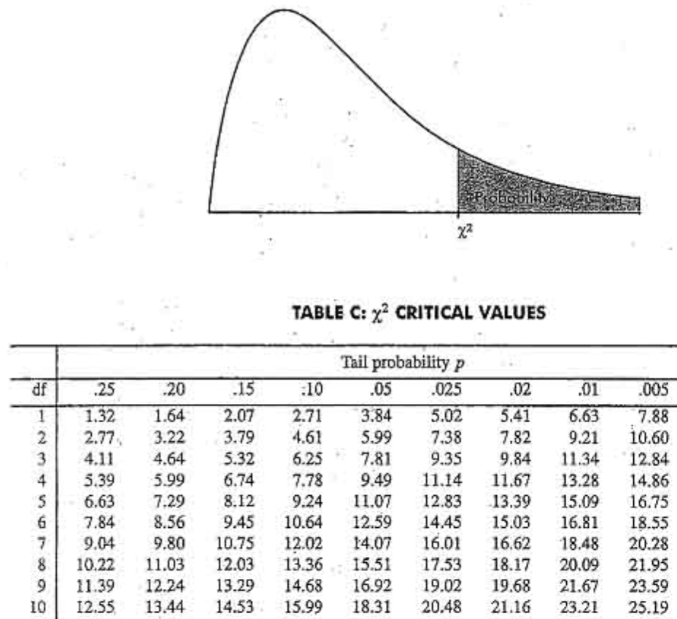
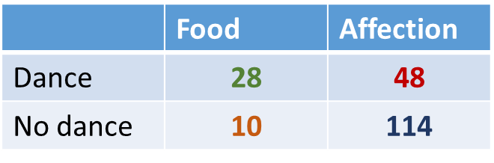
Is 28.4 big enough for the test to be significant?
The old fashion way
Degree of freedom: df
df = (row-1)(col-1)=1
Critical value
χ² = 25.35 > 3.84 so Yes!

Slide 12

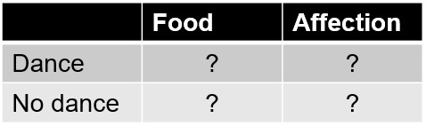
Prepare cats data for the stats
chisq_test()
fisher_test()

Slide 13
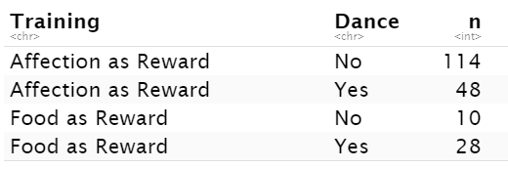
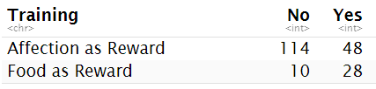
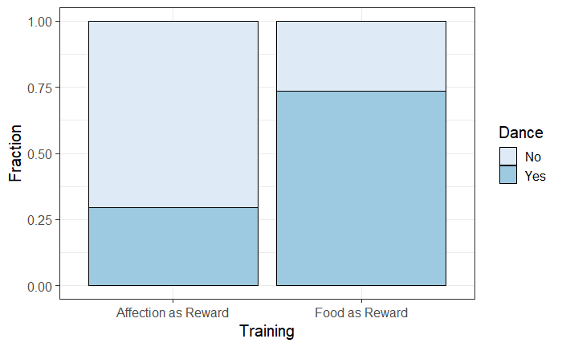

Plot cats data (From raw data)
cats %>%
group_by(Training, Dance) %>%
count() %>%
ungroup() %>%
pivot_wider(names_from = Dance, values_from = n)-> cats.summary
cats.summary %>%
select(No,Yes) %>%
fisher_test()
chisq_test()
fisher_test()
Have a go!

Slide 14


Chi-square and Fisher’s Exact tests
cats.summary %>%
select(No,Yes) %>%
fisher_test()
cats.summary %>%
select(No,Yes) %>%
chisq_test()
cats.summary %>%
select(No,Yes) %>%
chisq_test(correct = FALSE)
Answer: Training significantly affects the likelihood of cats line dancing (p=4.8e-07).

