Slide 1


Introduction to Linear Modelling
Anne Segonds-Pichon v2020-09

Slide 2
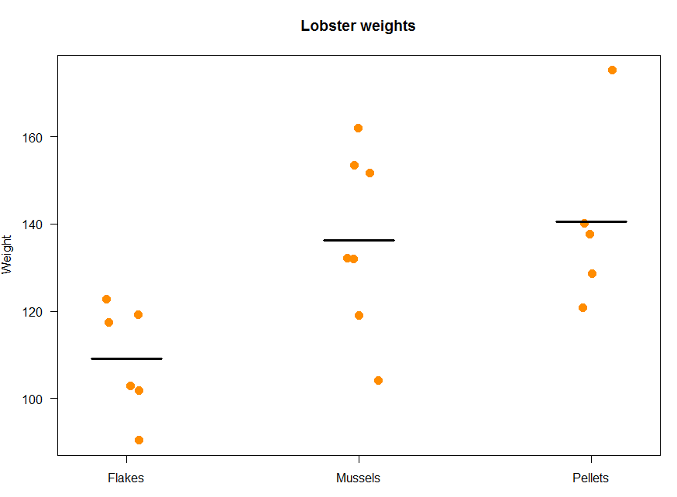
Linear modelling is about language
Is there a difference between the 3 diets?
Can diet predict lobster weight?
Model(Diet) = Weight

Slide 3
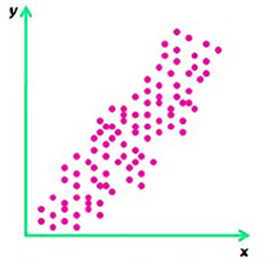
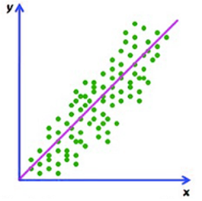
Simple linear model
Linear regression
  Correlation: is there an association between 2 variables?
  Regression: is there an association and
can one variable be used to predict the values of the other?
Correlation = Association
Regression = Prediction

Slide 4

Simple linear model
Linear regression models the dependence between 2 variables:
a dependent y and a independent x.
      Causality
        Model(x) = y
In R:
Correlation: cor()
Linear regression: lm()
predictor
response
Model

Slide 5
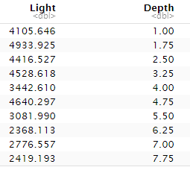
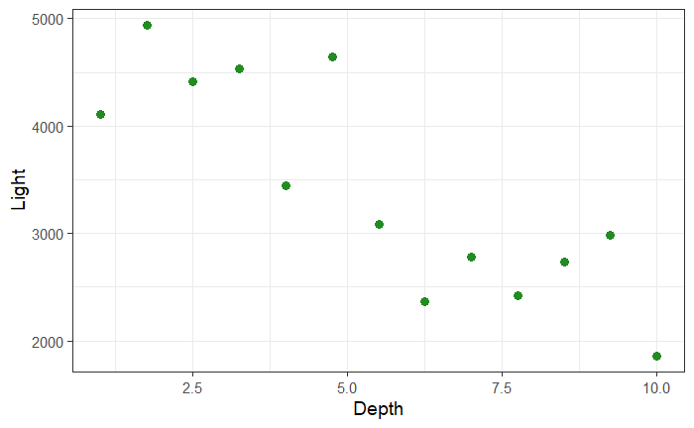
Linear regression
Example: coniferlight.csv
conifer<-read_csv("coniferlight.csv")
Question: how is light (lux) affected by the depth (m) at which it is measured from the top of the canopy?
light = β₀ + β₁*depth
conifer %>%
ggplot(aes(Depth, Light))+
geom_point(colour="forestgreen", size=3)

Slide 6
Linear regression
Linear modelling in R: lm(y~x)
Regression: lm(conifer$Light~conifer$Depth)
or: lm(Light~Depth, data=conifer)
lm(Light~Depth, data=conifer) -> linear.conifer

Slide 7
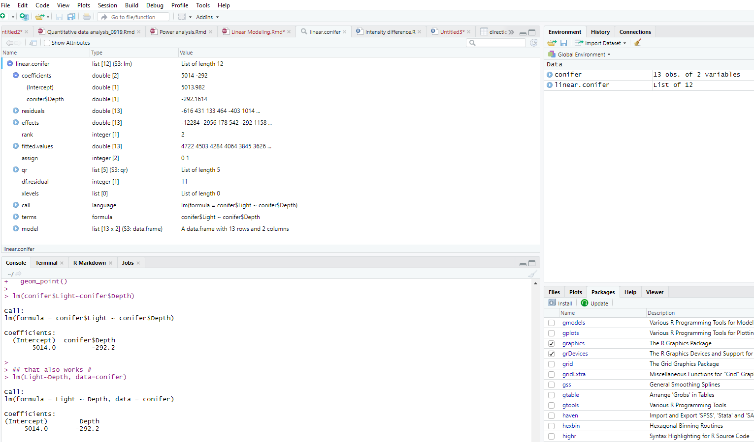
Linear regression
light = β₀ + β₁*depth
light = 5014 - 292*depth

Slide 8
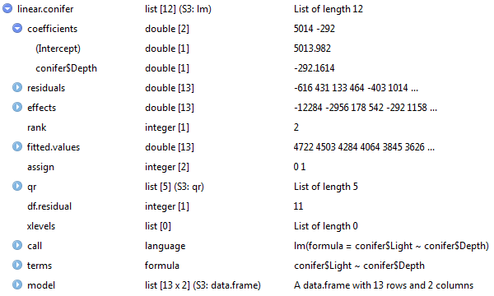


Linear regression
light = 5014 - 292*depth
Line of best fit (= regression line)
geom_abline(intercept= , slope= )
coefficients()
cf.abline[1]
It’s a vector!

Slide 9
Linear regression
coefficients(linear.conifer) -> cf.abline
conifer %>%
ggplot(aes(Depth, Light))+
geom_point( colour="forestgreen", size=3)+
geom_abline(aes(intercept=cf.abline[1], slope=cf.abline[2]))
light = 5014 - 292*depth

Slide 10
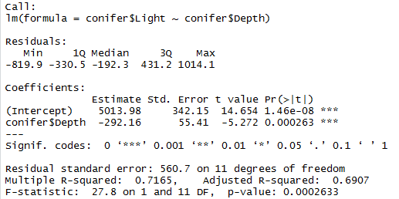
Linear regression
lm(Light~Depth, data=conifer) -> linear.conifer
summary(linear.conifer)
p-value
Coefficient of determination

Slide 11

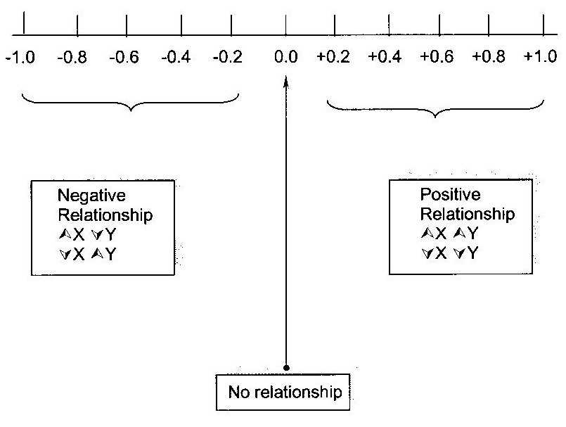
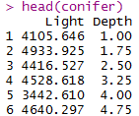

Linear regression
  Coefficient of determination:
    R-squared (r²):
      It quantifies the proportion of variance in Y that can be explained by X, it can be expressed as a percentage.
      e.g. here 71.65% of the variability observed in light is explained by the depth at which it is measured in a conifer tree.
    r: coefficient of correlation between x (depth) and y (light)
      e.g. here: r = -0.846 so r² = -0.846 * -0.846 = 0.716 = R-squared
conifer %>%
cor_test(Light, Depth)

Slide 12
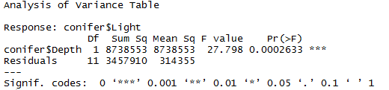
Linear regression
summary(linear.conifer)
Total amount of variability:
8738553 + 3457910 = 12196463
Proportion explained by depth:
8738553/12196463 = 0.716
anova(linear.conifer)
Model
Error

Slide 13
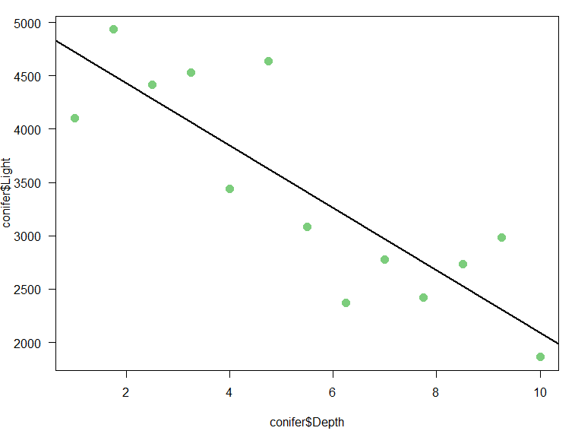
Linear regression the error Ɛ
Depth predicts about 72% (R-Squared) of the variability of light
  so 28% is explained by other factors (e.g. Individual variability…)
Example: the model predicts 3627 lux at a depth of 4.75 m in a conifer.
3627 = 5014 - 292*4.75
y = β₀ + β₁*x + Ɛ
3627 lux
4.75m

Slide 14
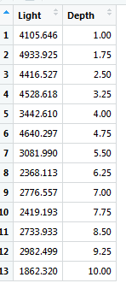
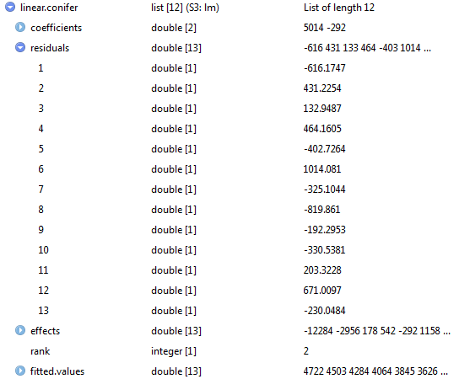
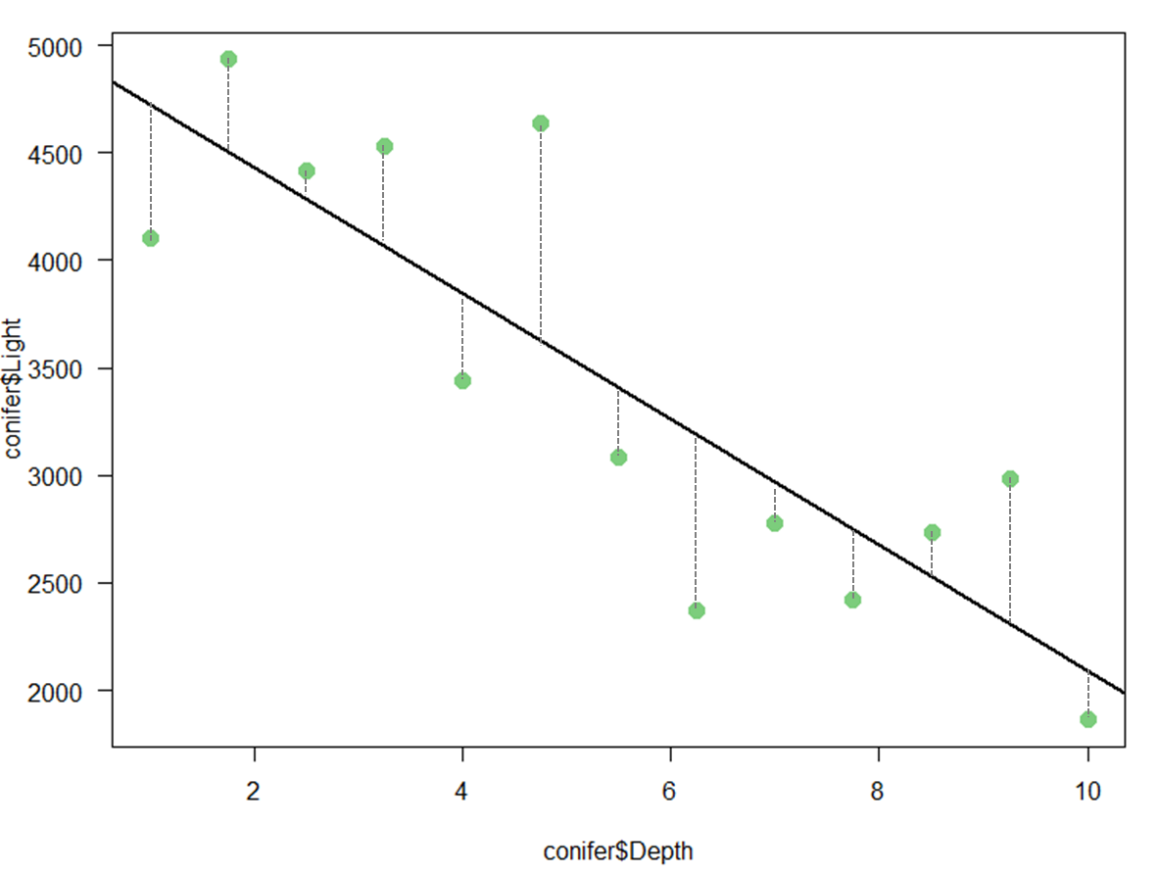
linear.conifer <-lm(Light~Depth, data=conifer)
Residual=error Ɛ
light = 5014 - 292*depth
3627 = 5014 - 292*4.75
3627+1014=4641
light = 5014 - 292*depth+ Ɛ

Slide 15
Assumptions
The usual ones: normality, homogeneity of variance, linearity and independence.
Outliers: the observed value for the point is very different from that predicted by the regression model
Leverage points: A leverage point is defined as an observation that has a value of x that is far away from the mean of x
Influential observations: change the slope of the line. Thus, have a large influence on the fit of the model. One method to find influential points is to compare the fit of the model with and without each observation.
  The Cook's distance statistic is a measure of the influence of each observation on the regression coefficients.
Bottom line: influential outliers are problematic.

Slide 16

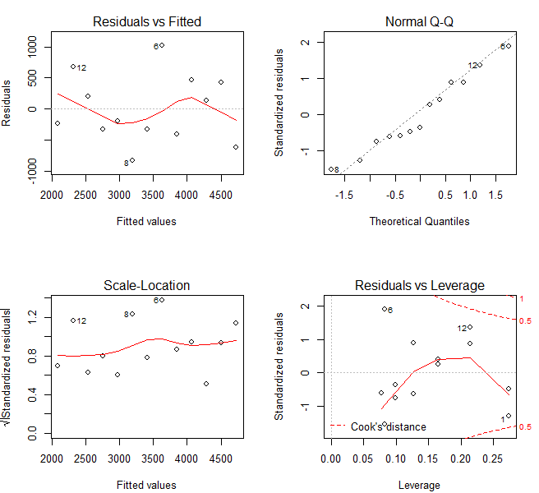
Assumptions
par(mfrow=c(2,2))
plot(linear.conifer)
Linearity
Normality
Good model
Homogeneity
of
variance
Outliers
Influential cases

Slide 17
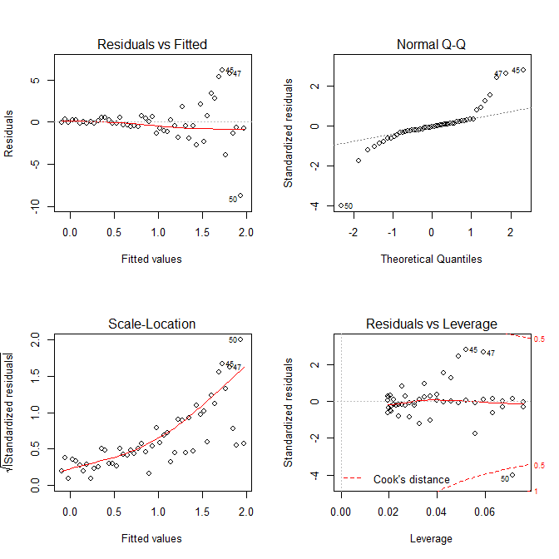
Assumptions
Linearity
Normality
Bad model
Homogeneity
of
variance
Outliers
Influential cases

Slide 18
Linear regression
Your turn!
Load coniferlight.csv -> conifer
Plot the data geom_point()
Build the model: lm(Light~Depth, data=conifer)-> linear.conifer
Identify the coefficients of the model
Add a line of best-fit
  coefficients(linear.conifer) -> cf.abline
  geom_abline(intercept=cf.abline[1], slope=cf.abline[2])
Is the relationship between Depth and Light significant? summary(linear.conifer)
How much of the variance is explained? R²
What is the coefficient of correlation? cor_test(conifer)
Compare the outputs of summary(linear.conifer) and anova(linear.conifer)
Check out the assumptions
  par(mfrow=c(2,2))
  plot(linear.conifer)

Slide 19
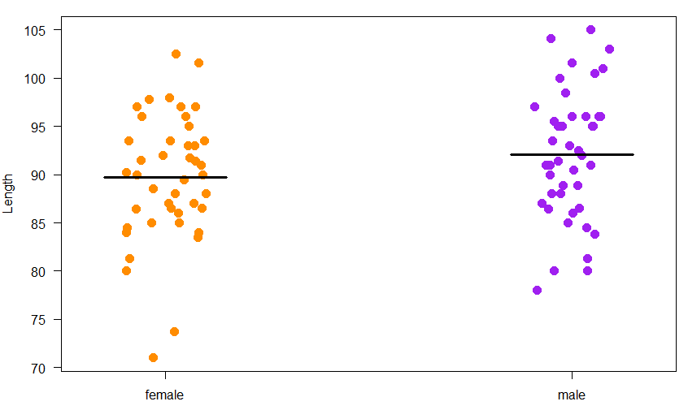
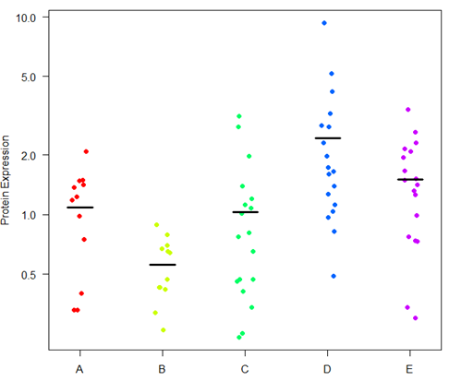
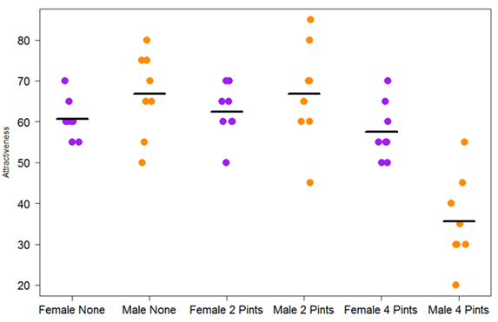
The linear model perspective
Coyotes= Body length~Gender
Protein = Expression~Cell line
Goggles = Attractiveness~Alcohol and Gender

Slide 20
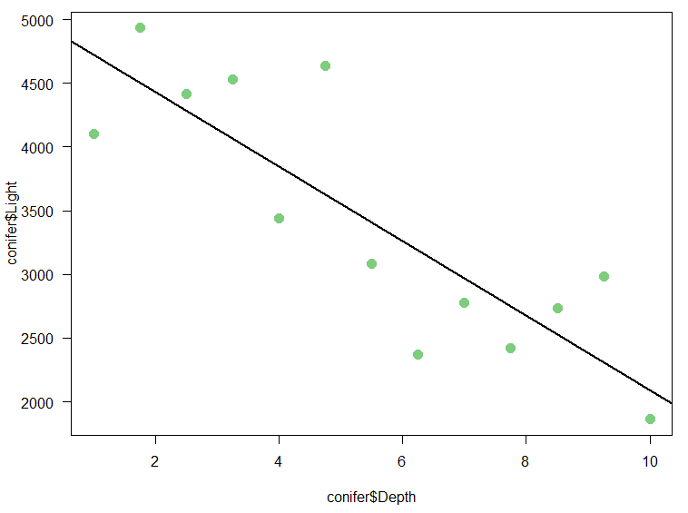
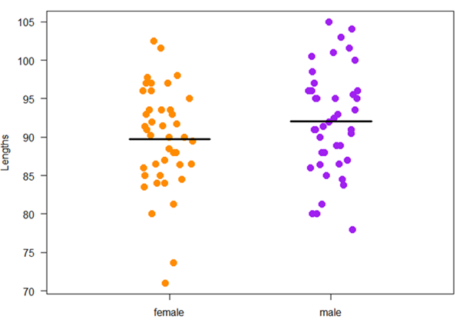
The linear model perspective
Continuous predictor
Categorical predictor
Coyotes body length
Is there a difference between the 2 genders?
becomes
Does gender predict coyote body length?

Slide 21
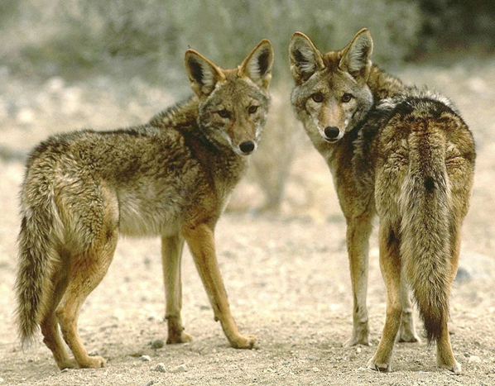
Example: coyotes
Questions: do male and female coyotes differ in size?
  does gender predict coyote body length?
  how much of body length is predicted by gender?

Slide 22
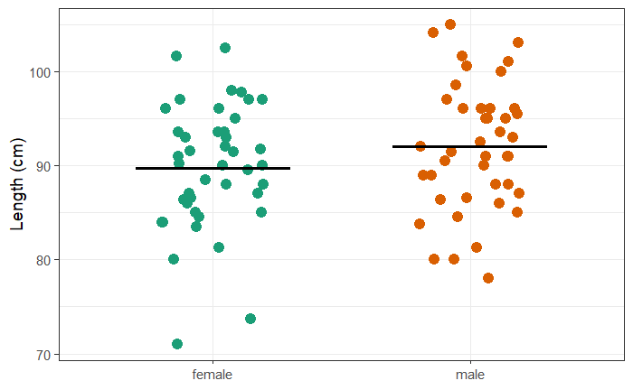
The linear model perspective
Comparing 2 groups
read_csv("coyote.csv") -> coyote
coyote %>%
ggplot(aes(gender,length, colour=gender)) +
geom_jitter(height=0, size=4, width=0.2) +
theme(legend.position = "none")+
ylab("Length (cm)")+
scale_colour_brewer(palette="Dark2")+
xlab(NULL)+
stat_summary(fun=mean, fun.min=mean, fun.max=mean, geom="errorbar",colour="black", size=1.2, width=0.6)

Slide 23
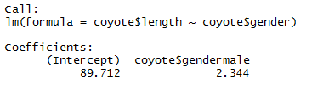
The linear model perspective
Comparing 2 groups
coyote %>%
t_test(length~gender, var.equal=T)
lm(length~gender, data=coyote)
Females=89.71 cm, Males=89.71 + 2.34=92.05

Slide 24



The linear model perspective
Comparing 2 groups
lm(length~gender, data=coyote)
Body length = β₀ + β₁*Gender
Model
Body length = 89.712 + 2.344*Gender

Slide 25
The linear model perspective
Comparing 2 groups
y = β₀ + β₁*x
continuous
conifer.csv
light = 5014 - 292*depth
categorical
coyote.csv
Body length = 89.712 + 2.344*Gender
vector
y = β₀ + β₁*x

Slide 26
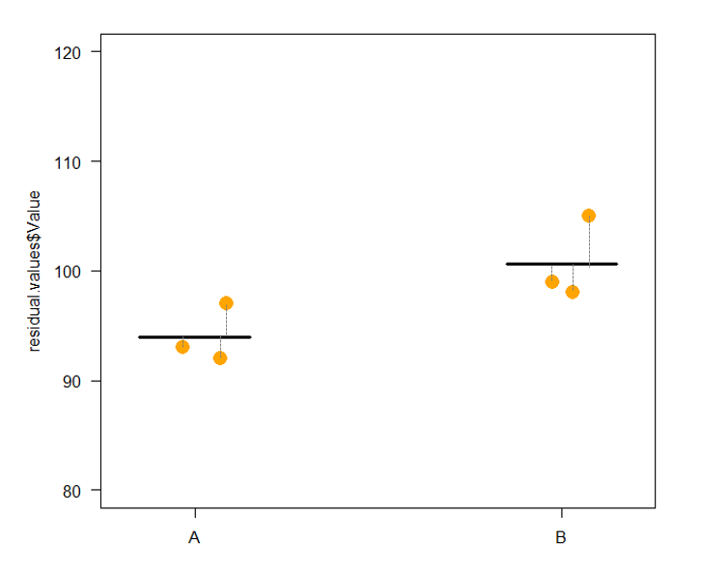
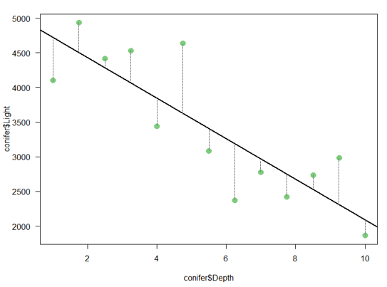
The linear model perspective
Comparing 2 groups
Model
Residuals

Slide 27
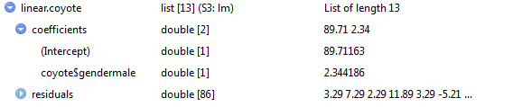

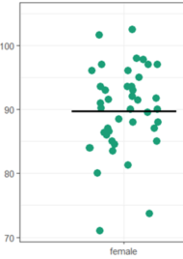
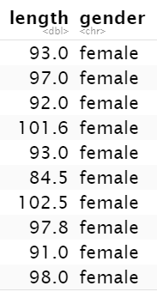
The linear model perspective
Comparing 2 groups
linear.coyote<-lm(length~gender, data=coyote)
linear.coyote
86 coyotes
Female 1: 89.71 + 3.29 = 93 cm

Slide 28
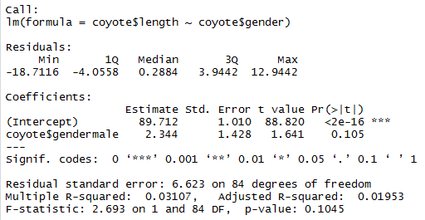

The linear model perspective
Comparing 2 groups
coyote %>%
t_test(length~gender, var.equal=T)
summary(linear.coyote)
anova(linear.coyote)

Slide 29
The linear model perspective
Comparing 2 groups
summary(linear.coyote)
About 3% of the variability
in body length is explained
by gender.
anova(linear.coyote)
118.1 + 3684.9 = 3803: total amount of variance in the data
Proportion explained by gender: 118.1/3803 = 0.031

Slide 30

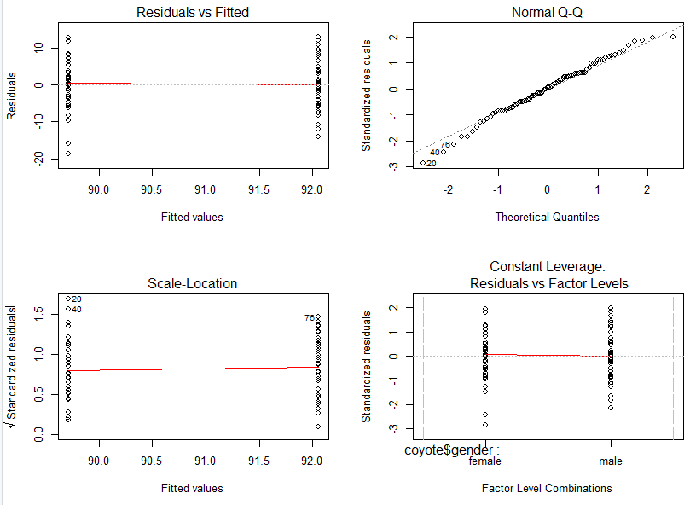
The linear model perspective
Comparing 2 groups
linear.coyote
Assumptions
par(mfrow=c(2,2))
plot(linear.coyote)
Linearity
Normality
~ shapiro_test()
Equality of
Variance
levene_test()
!
Outliers

Slide 31
Example: coyote.csv
Questions: do male and female coyotes differ in size?
  does gender predict body length?
    Answer: Quite unlikely: p = 0.105
  how much of body length is predicted by gender?
    Answer: About 3% (R²=0.031)

Slide 32
Exercises 9 and 10: coyotes and protein expressions
coyote.csv coyote<-read_csv("coyote.csv")
  Run the t-test again t_test()
  Run the same analysis using a linear model approach lm()
  Compare the outputs and understand the coefficients from lm()
  Use summary() and anova() to explore further the analysis
  Work out R² from the anova() output
  Don’t forget to check the assumptions
protein.expression.csv protein<-read_csv("protein.expression.csv")
  Log-transformed the expression log10()
  Run again the anova using anova_test()
  Use lm() and summary() for the linear model approach
  Compare the 2 outputs
  Work out the means log10.expression for the 5 cell lines
  Compare the outputs and understand the coefficients from lm()
  Work out R² from the anova() output
  Don’t forget to check out the assumptions

Slide 33
Exercise 10 : protein.expression.csv
Questions: is there a difference in protein expression between the 5 cell lines?
  does cell line predict protein expression?
  how much of the protein expression is predicted by the cell line?

Slide 34
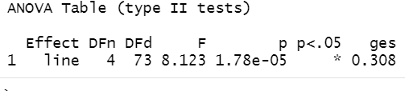
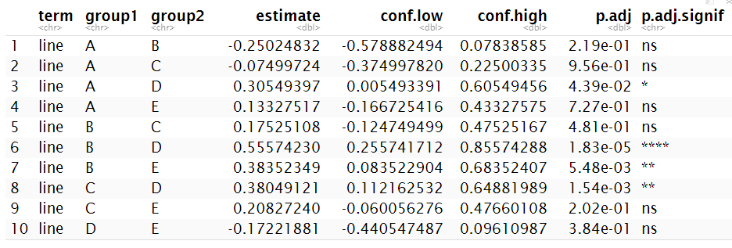
Exercise 10 : protein.expression.csv - Answers
protein %>%
anova_test(log10.expression~line)
generalised effect size (Eta squared η²) = R² ish
protein %>%
tukey_hsd(log10.expression~line)
Tukey correction

Slide 35
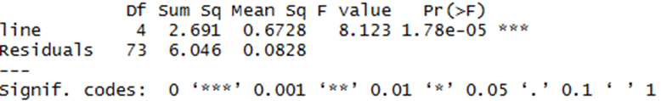
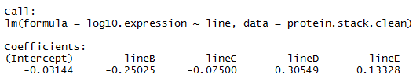
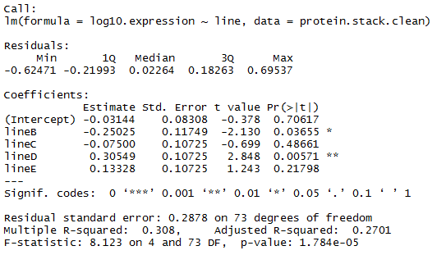
Exercise 10 : protein.expression.csv - Answers
linear.protein<-lm(log10.expression~line, data=protein)
anova(linear.protein)
lm(log10.expression~line,data=protein)
summary(linear.protein)

Slide 36
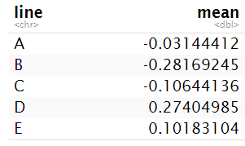
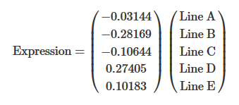
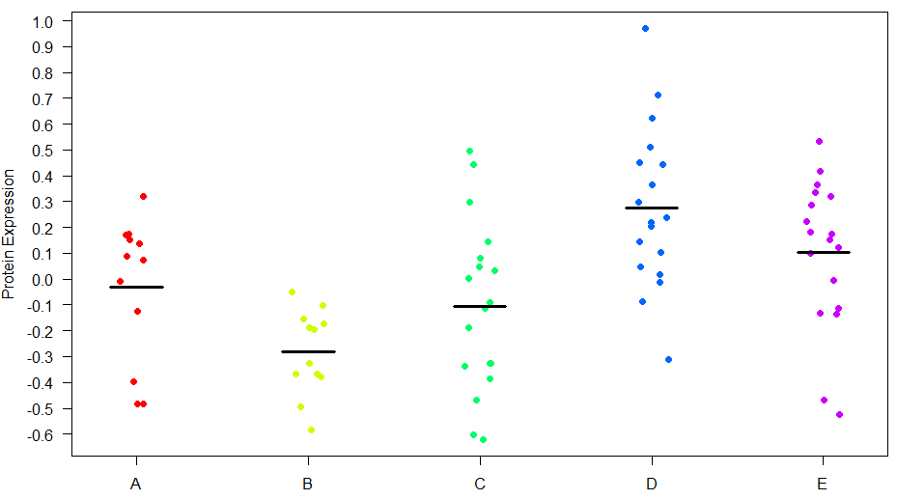
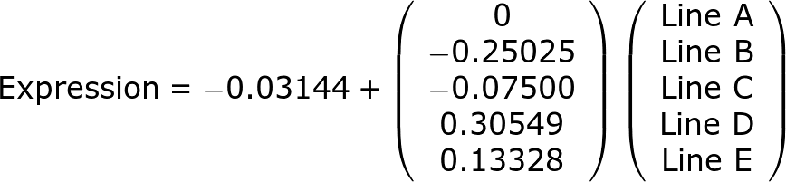
Exercise 10 : protein.expression.csv - Answers
protein %>%
group_by(line) %>%
summarise(mean=mean(log10.expression))
Model
lm(log10.expression~line,data=protein)
Expression= β₀ + β₁*Line
Example:
Line B = -0.03-0.25 = -0.28

Slide 37

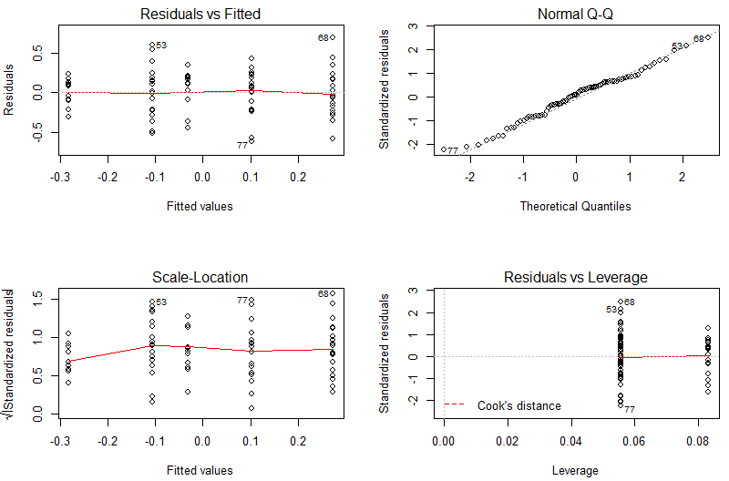
Exercise 10: protein.expression.csv - Answers
par(mfrow=c(2,2))
plot(linear.protein)
Linearity
Normality
shapiro_test()
Equality of
Variance
levene_test()
!
Outliers

Slide 38
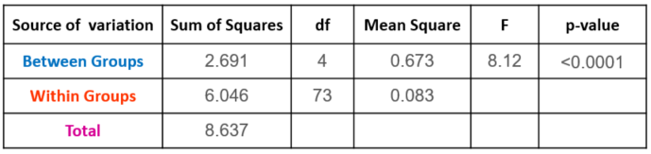
Exercise 10 : protein.expression.csv - Answers
linear.protein<-lm(log10.expression~line,data=protein)
summary(linear.protein)
Proportion of variance explained
by cell lines: 31%
protein %>%
anova_test(log10.expression~line, detailed = TRUE)
SSn
+
SSd
2.691 + 6.046 = 8.737: total amount of variance in the data
Proportion explained by gender: 2.691/8.737 = 0.308

Slide 39
Exercise 10 : protein.expression.csv
Questions: is there a difference in protein expression between the 5 cell lines?
  does cell line predict protein expression?
    Answer: Yes p=1.78e-05
  how much of the protein expression is predicted by the cell line?
    Answer: About 31% (R²=0.308)

Slide 40
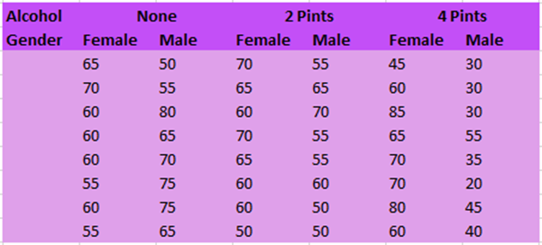
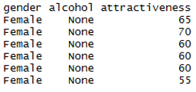
Two-way Analysis of Variance
Example: goggles.csv
  The ‘beer-goggle’ effect
  Study: effects of alcohol on mate selection in night-clubs.
  Pool of independent judges scored the levels of attractiveness of the person that the participant was chatting up at the end of the evening.
  Question: is subjective perception of physical attractiveness affected by alcohol consumption?
    Attractiveness on a scale from 0 to 100
goggles<-read_csv("goggles.csv")
head(goggles)

Slide 41
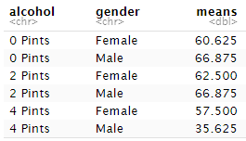
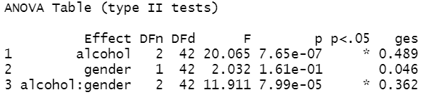
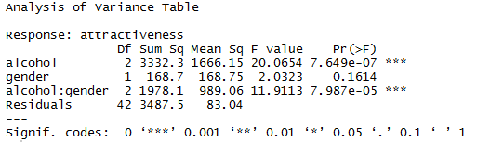

The linear model perspective
Two factors
goggles %>%
group_by(alcohol, gender) %>%
summarise(means=mean(attractiveness))
goggles %>%
anova_test(attractiveness~alcohol+gender+alcohol*gender)
linear.goggles<-lm(attractiveness~alcohol+gender+alcohol*gender,data=goggles)
anova(linear.goggles)
(3332.3+168.7+1978.1)/(3332.3+168.7+1978.1+3487.5) = 0.611
R² = 61%
Model
y = β₀ + β₁*x + β₂*x₂ + β₃*x₁x₂

Slide 42
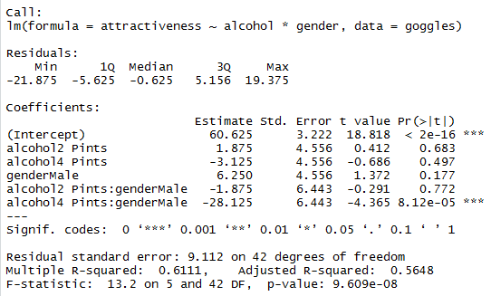
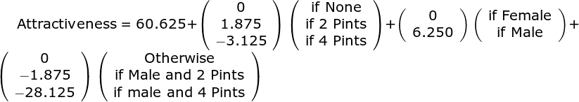
The linear model perspective
Two factors
linear.goggles<-lm(attractiveness~alcohol+gender+alcohol*gender,data=goggles)
summary(linear.goggles)
Attractiveness= β₀ + β₁Alcohol + β₂Gender + β₃Gender*Alcohol

Slide 43
Exercise 11: goggles.csv
goggles.csv goggles<-read_csv("goggles.csv")
  Run again the 2-way ANOVA anova_test()
  Run the same analysis using a linear model approach lm()
  Work out R² from the anova()output
  Work out the equation of the model from the summary()output
    Hint: Attractiveness= β₀ + β₁Gender + β₂Alcohol + β₃Gender*Alcohol
  Predict the attractiveness of a date:
    for a female with no drinks
    for a male with no drinks
    for a male with 4 pints

Slide 44
Exercise 11: goggles.csv - Answers
goggles.csv
  Predict the attractiveness of a date:
    for a female with no drinks
    60.625+0+0 = 60.625
    for a male with no drinks
    60.625+0+6.250= 66.875
    for a male with 4 pints
    60.625-3.125+6.250-28.125= 35.625
goggles %>%
group_by(alcohol, gender) %>%
summarise(means=mean(attractiveness))

Slide 45

The linear model perspective
Categorical and continuous factors
Nothing special stats-wise with a mix of categorical and continuous factors
  Same logic
  But R makes it a little tricky to plot the model
treelight<-read_csv("treelight.csv")
treelight %>%
ggplot(aes(x=Depth, y=Light, colour=Species))+
geom_point(size=3)

Slide 46


The linear model perspective
Categorical and continuous factors
lm(Light~Depth+Species+Depth*Species, data=treelight)
linear.treelight<-lm(Light~Depth*Species, data=treelight)
summary(linear.treelight)
Complete model

Slide 47




The linear model perspective
Categorical and continuous factors
Additive model:
linear.treelight.add<-lm(Light~Depth+Species, data=treelight)
summary(linear.treelight.add)
No interaction

Slide 48

The linear model perspective
Categorical and continuous factors
cf.add<-coefficients(linear.treelight.add)
cf.add[1]
It’s a vector!
geom_abline(intercept=cf.add[1], slope=cf.add[2])+
geom_abline(intercept=(cf.add[1]+cf.add[3]), slope=cf.add[2])
Broadleaf:
Light = 7962.03 -262.17*Depth
Conifer:
Light = (7962.03-3113.03) -262.17*Depth

Slide 49
Exercise 12: treelight.csv
treelight.csv treelight<-read_csv("treelight.csv")
  Plot the data
  Run a linear model lm()
  Extract the parameters from the additive model
  Plot a line of best fit for each species
  Extract the parameters from the complete model
  Write the new equations for broadleaf and conifer species.
  Plot a line of best fit for each species (use dashed lines to distinguish between
  the 2 models).
  Calculate the amount of light predicted:
    In a conifer, 4 metres from the top of the canopy
    In a broadleaf tree, 6 metres from the top of the canopy
  How much of the variability of light is predicted by the depth and the species?

Slide 50

Exercise 12 : treelight.csv
cf<-coefficients(linear.treelight)
ggplot(treelight, aes(x=Depth, y=Light, group=Species, colour=Species))+
geom_point(size=3)+
geom_abline(intercept=cf.add[1], slope=cf.add[2])+
geom_abline(intercept=(cf.add[1]+cf.add[3]), slope=cf.add[2])+
geom_abline(intercept=(cf[1]), slope=cf[2], linetype="twodash")+
geom_abline(intercept=(cf[1]+cf[3]), slope=(cf[2]+cf[4]), linetype="twodash")

Slide 51
Exercise 12 : treelight.csv
  Extract the parameters from the complete model
  cf<-coefficients(linear.treelight)
  ggplot(treelight, aes(x=Depth, y=Light, group=Species, colour=Species))+
  geom_point(size=3)+
  geom_abline(intercept=cf.add[1], slope=cf.add[2])+
  geom_abline(intercept=(cf.add[1]+cf.add[3]), slope=cf.add[2])+
  geom_abline(intercept=(cf[1]), slope=cf[2], linetype="twodash")+
  geom_abline(intercept=(cf[1]+cf[3]), slope=(cf[2]+cf[4]), linetype="twodash")
  Broadleaf: Light = 7798.57 – 221.13*Depth
  Conifer: Light = (7798.57-2784.58) – (221.13-71.04)*Depth
  Calculate the amount of light predicted:
    In a conifer, 4 metres from the top of the canopy
    (7798.57-2784.58)-(221.13+71.04)*4 = 4413.63
    In a broadleaf species, 6 metres from the top of the canopy
    7798.57-221.13*6 = 6471.79

Slide 52
Linear model
Simplest
y = β₀ + β₁*x
With 2 factors
y = β₀ + β₁*x₁ + β₂*x₂ + β₃*x₁x₂
Simplest
With n factors
y = β₀ + β₁*x
y = β₀ + β₁*x₁ + β₂*x₂ + β₃*x₁x₂ + … + β_{n}*x_{n}
Let’s not forget the error
y_{i} = (β₀ + β₁*x_{i}) + Ɛ_{i}
General formula
y_{i} = (model) + error_{i}

Slide 53


One-way ANOVA
Two-way ANOVA
Linear model
y_{i} = (model) + error_{i}
t-test
Correlation
ANCOVA

