Slide 1


Descriptive Stats and Data Exploration
Anne Segonds-Pichon v2020-09

Slide 2
Variable
Quantitative
Qualitative
Discrete
Continuous
Nominal
Ordinal

Slide 3
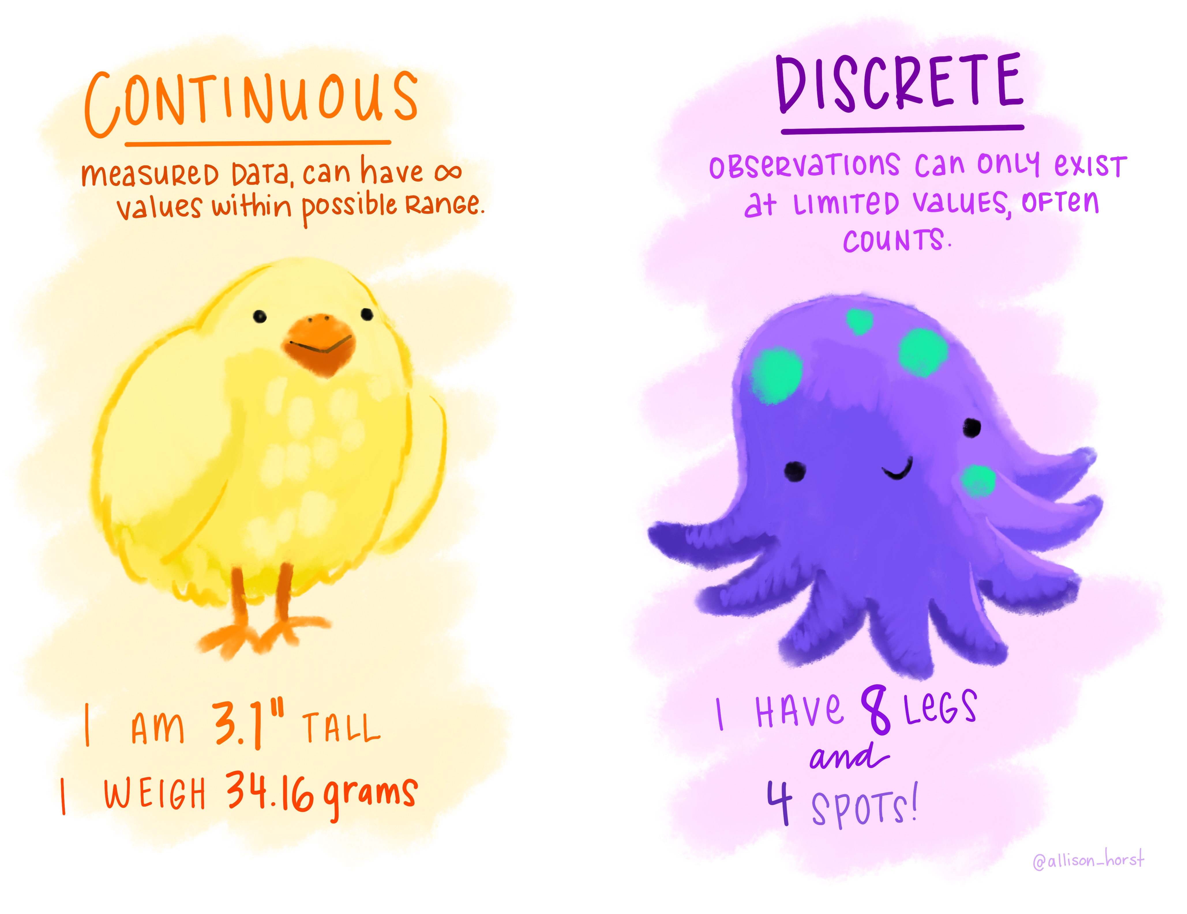
Quantitative data
They take numerical values (units of measurement)
Discrete: obtained by counting
  Example: number of students in a class
  values vary by finite specific steps
or continuous: obtained by measuring
  Example: height of students in a class
  any values
They can be described by a series of parameters:
  Mean, variance, standard deviation, standard error and confidence interval
https://github.com/allisonhorst/stats-illustrations#other-stats-artwork
Notes:
Discrete numb pups in a litter ; continous height, weight, different scale
Data can be messy so then you go back to qualitative data.
Describe them: Mean, variance, standard deviation, standard error and confidence interval

Slide 4
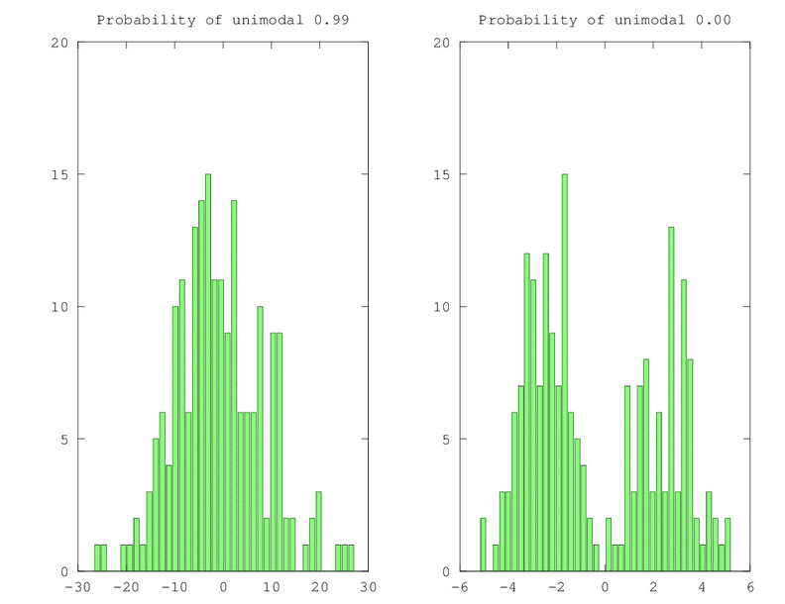

Measures of central tendency
Mode and Median
Mode: most commonly occurring value in a distribution
Median: value exactly in the middle of an ordered set of numbers
Notes:
Discrete numb pups in a litter continous hight, weitght, different scale
Data can be messy so then you go back to qualitative data.
Describe them: Mean, variance, standard deviation, standard error and confidence interval

Slide 5
Measures of central tendency
Mean
Definition: average of all values in a column.
Example: mean of: 1, 2, 3, 3 and 4
  (1+2+3+3+4)/5 = 2.6
The mean is a model because it summaries the data.
How do we know that it is an accurate model?
  Difference between the real data and the model created

Slide 6

Measures of dispersion
Calculate the magnitude of the differences between each data and the mean
Total error = sum of differences
  $=Σ(x_{i}−\overline{x}$) = -1.6 - 0.6 + 0.4 + 0.4 + 1.4 = 0
  No errors !
    Positive and negative: they cancel each other out.

Slide 7
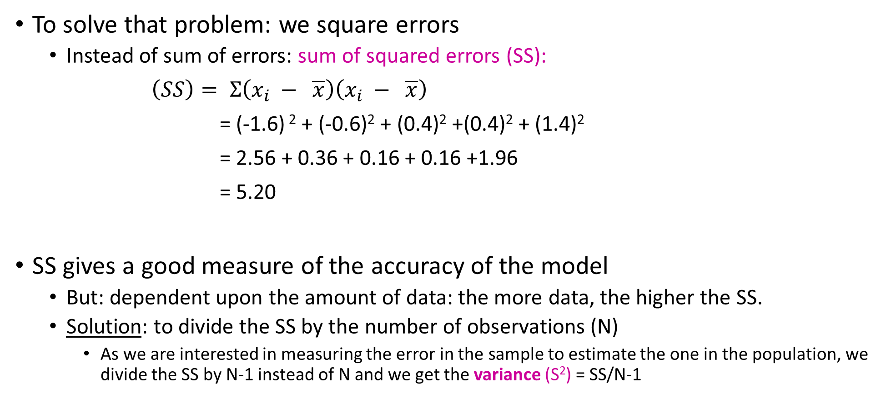
Sum of Squared errors (SS)
To solve that problem: we square errors
  Instead of sum of errors: sum of squared errors (SS):
$\left(SS\right)= Σ\left(x_{i} − \overline{x}\right)\left(x_{i} − \overline{x}\right)$
= (-1.6) ² + (-0.6)² + (0.4)² +(0.4)² + (1.4)²
= 2.56 + 0.36 + 0.16 + 0.16 +1.96
= 5.20
SS gives a good measure of the accuracy of the model
  But: dependent upon the amount of data: the more data, the higher the SS.
  Solution: to divide the SS by the number of observations (N)
    As we are interested in measuring the error in the sample to estimate the one in the population, we divide the SS by N-1 instead of N and we get the variance (S²) = SS/N-1

Slide 8
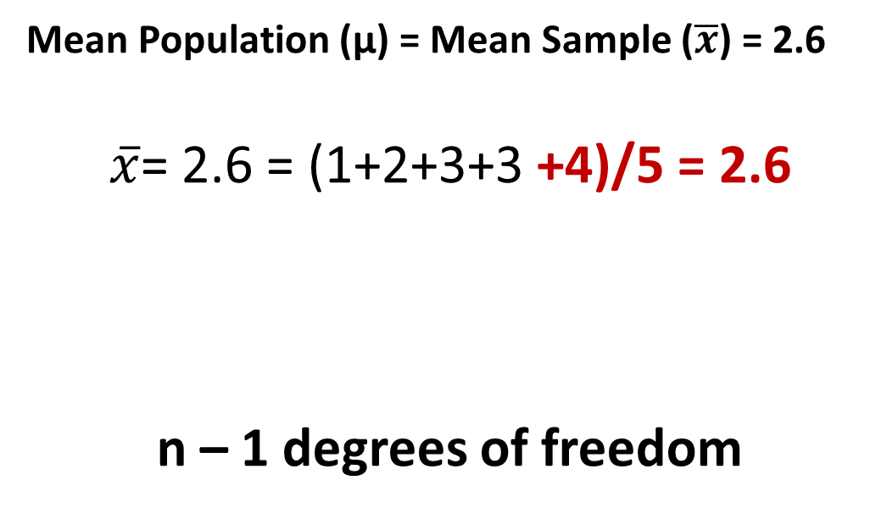
Degrees of freedom
Mean Population (µ) = Mean Sample ($\overline{x}$) = 2.6
$\overline{x}$= 2.6 = (1+2+3+3 +4)/5 = 2.6
n – 1 degrees of freedom
Sample
n^{th} value: fixed
First (n-1) values: whatever

Slide 9
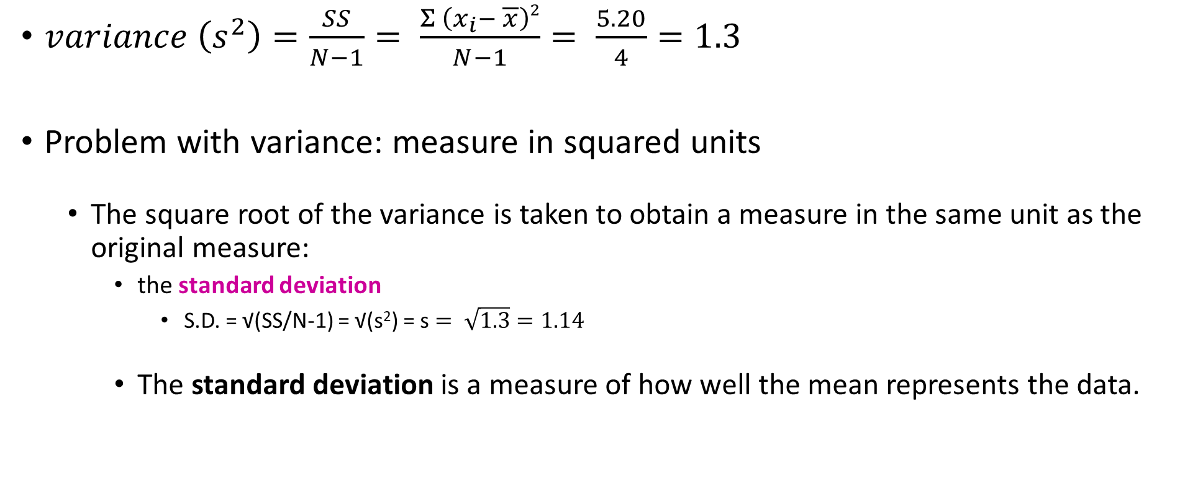
Variance and standard deviation
$variance \left(s^{2}\right)=\frac{SS}{N−1}= \frac{Σ \left(x_{i}− \overline{x}\right)2}{N−1}= \frac{5.20}{4}=1.3$
Problem with variance: measure in squared units
  The square root of the variance is taken to obtain a measure in the same unit as the original measure:
    the standard deviation
      S.D. = √(SS/N-1) = √(s²) = s $= \sqrt{1.3}=1.14$
    The standard deviation is a measure of how well the mean represents the data.

Slide 10
Standard deviation
S.D.=0.5
S.D.=3.5
Small S.D.:
data close to the mean:
mean is a good fit of the data
Large S.D.:
data distant from the mean:
mean is not an accurate representation

Slide 11
Standard Deviation (SD) or Standard Error Mean (SEM)?
Smaller error bars!
SD
SEM

Slide 12
Standard Deviation
The SD quantifies how much the values vary from one another
  scatter or spread
  The SD does not change predictably as you acquire more data.

Slide 13
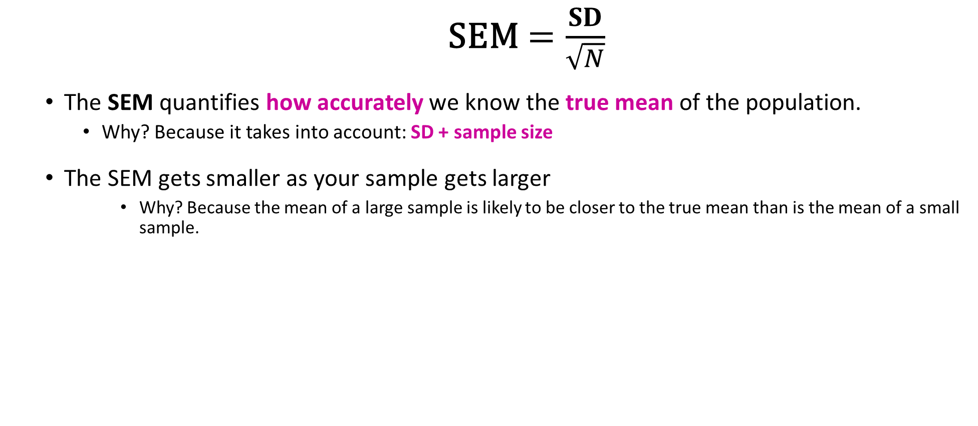
Standard Error Mean
    SEM$=\frac{SD}{\sqrt{N}}$
  The SEM quantifies how accurately we know the true mean of the population.
    Why? Because it takes into account: SD + sample size
  The SEM gets smaller as your sample gets larger
      Why? Because the mean of a large sample is likely to be closer to the true mean than is the mean of a small sample.

Slide 14
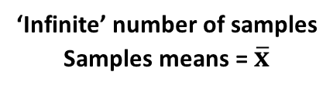
The SEM and the sample size
n=3
Small samples (n=3)
‘Infinite’ number of samples
Samples means = $\overline{x}$
Sample
n=30
Big samples (n=30)
Population
Sample

Slide 15
SD or SEM ?
If the scatter is caused by biological variability, it is important to show the variation.
  Report the SD rather than the SEM.
    Better even: show a graph of all data points.
If you are using an in vitro system with no biological variability, the scatter is about experimental imprecision (no biological meaning).
  Report the SEM to show how well you have determined the mean.
Notes:
SD how much data differ from one to another. Scattered.
SEM how accurately you know the real mean of the true population
SD is the biological variability meaningful? If you have meaningful biological variability you have to put SD

Slide 16
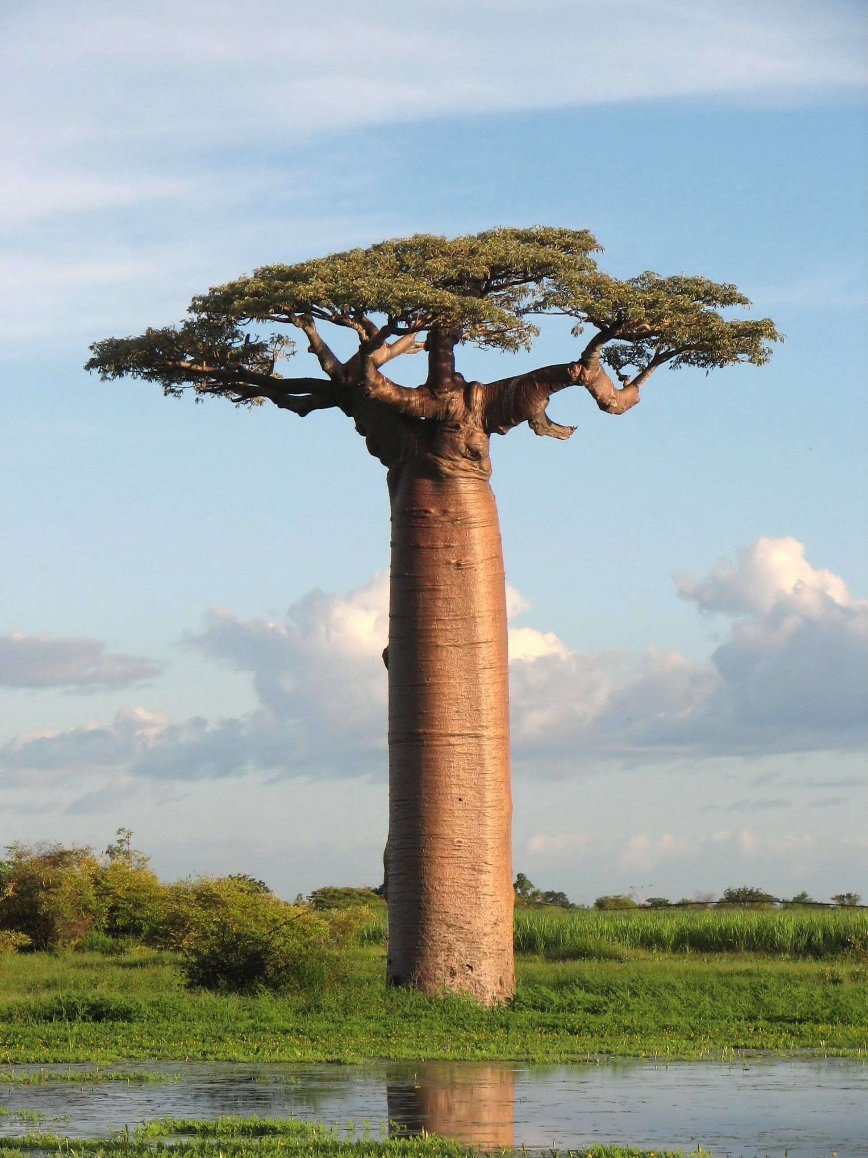
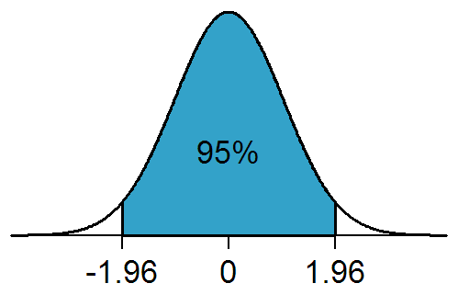
Confidence interval
Range of values that we can be 95% confident contains the true mean of the population.
  - Limits of 95% CI: [Mean - 1.96 SEM; Mean + 1.96 SEM] (SEM = SD/√N)
A distribution is not something made, it is something observed.
Leaves
Proportion of values
Branches
-1.96*SD 0 +1.96*SD
Trunk
On either side of the mean
This is a tree
This is a normal distribution
Notes:
If you polt that it tells you that 95% of the time the SD will be in this interval if you have a small overlap you can still have significance it’s the best to use

Slide 17
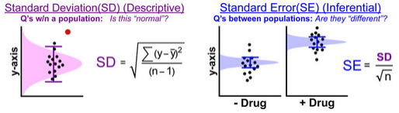
To recapitulate
The Standard Deviation is descriptive
  Just about the sample.
The Standard Error and the Confidence Interval are inferential
  Sample General Population
Notes:
If you polt that it tells you that 95% of the time the SD will be in this interval if you have a small overlap you can still have significance it’s the best to use

Slide 18
Graphical exploration of data

Slide 19
Question
Data Collection/Storage
Data Exploration
Data Analysis
Results
Experiment
Sample Size
Choice of statistical tests
Experimental design

Slide 20
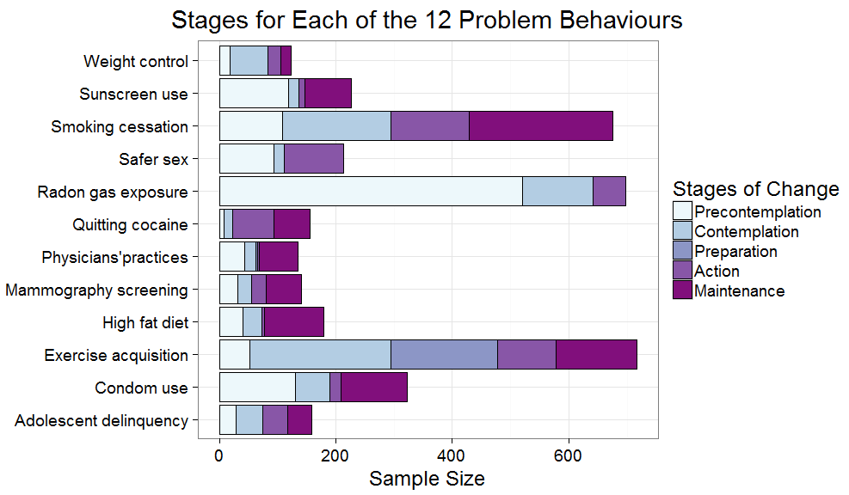
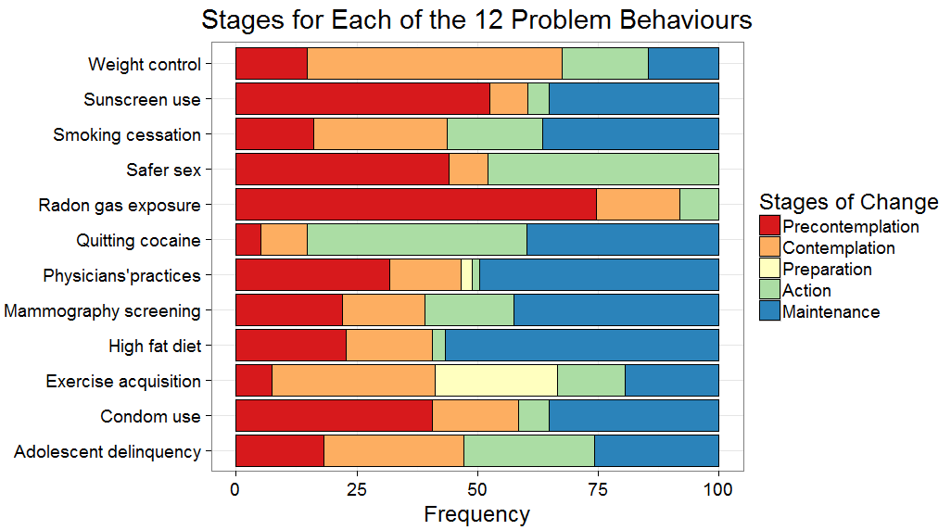
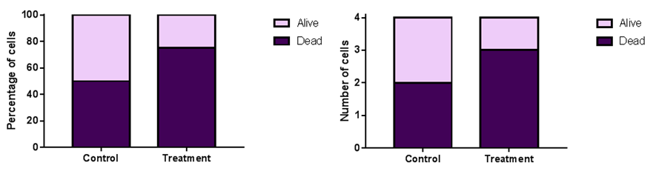
Data Exploration
Categorical data

Slide 21
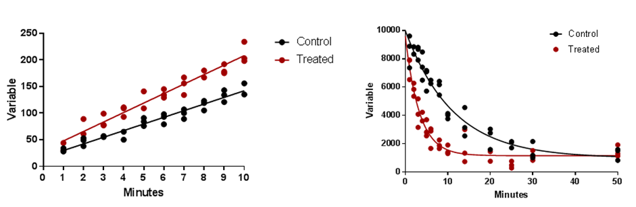
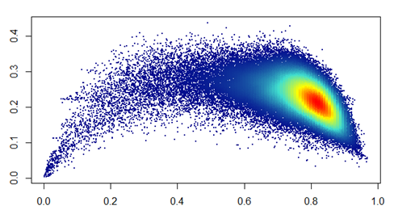
Data Exploration
Quantitative data: Scatterplot

Slide 22
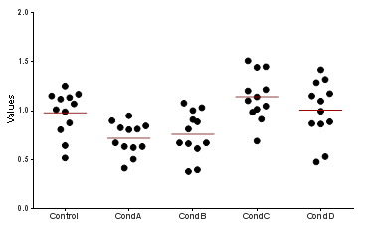
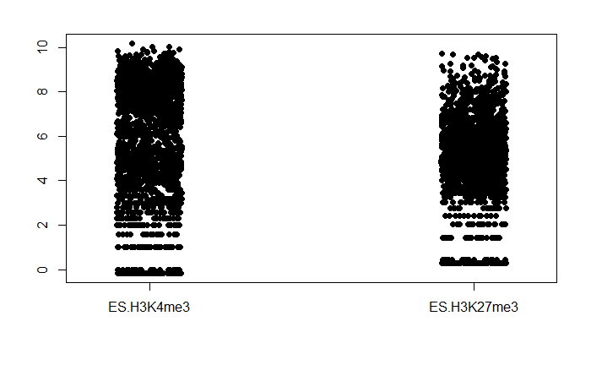
Data Exploration
Quantitative data:
Scatterplot/stripchart
Small sample
Big sample

Slide 23
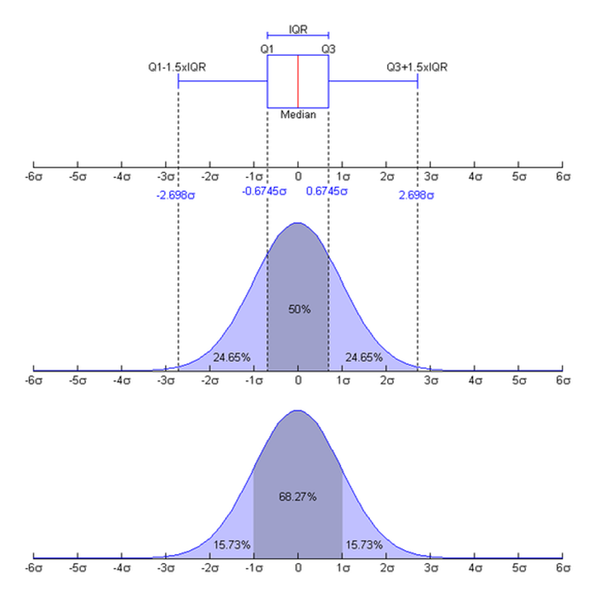
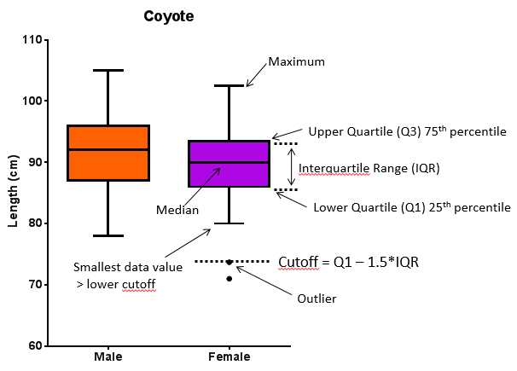
Data Exploration
Quantitative data: Boxplot

Slide 24
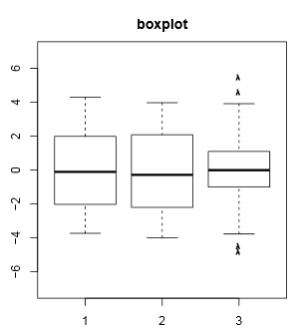
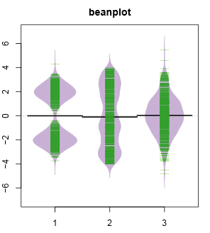
Data Exploration
Quantitative data:
Boxplot or Beanplot
Scatterplot shows individual data
A bean= a ‘batch’ of data
Bimodal
Uniform
Normal
Distributions
Data density mirrored by the shape of the polygon

Slide 25
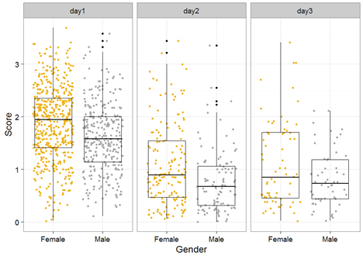
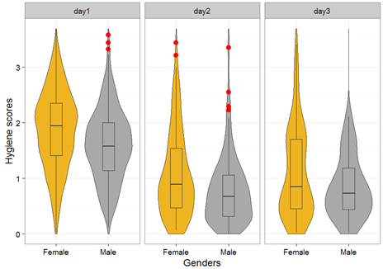
Data Exploration
Quantitative data:
Boxplot and Beanplot and Scatterplot

Slide 26
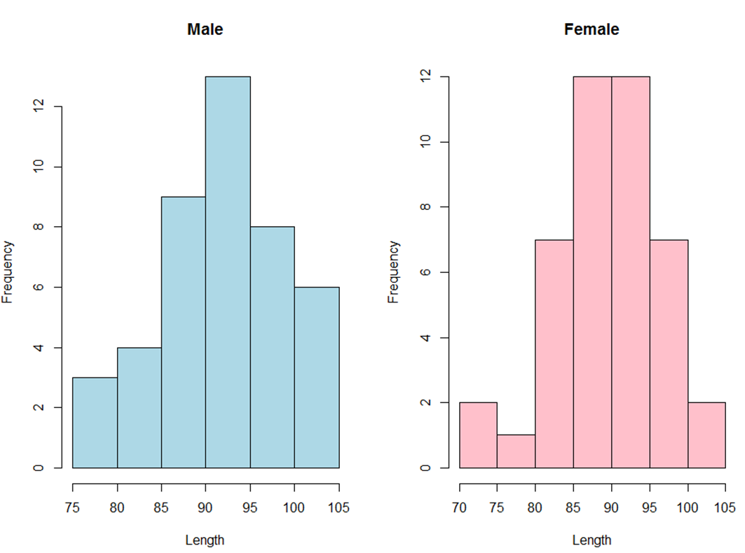
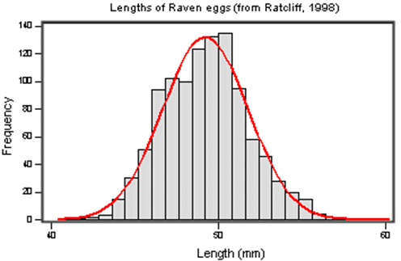
Data Exploration
Quantitative data: Histogram
Big sample
Small sample

Slide 27
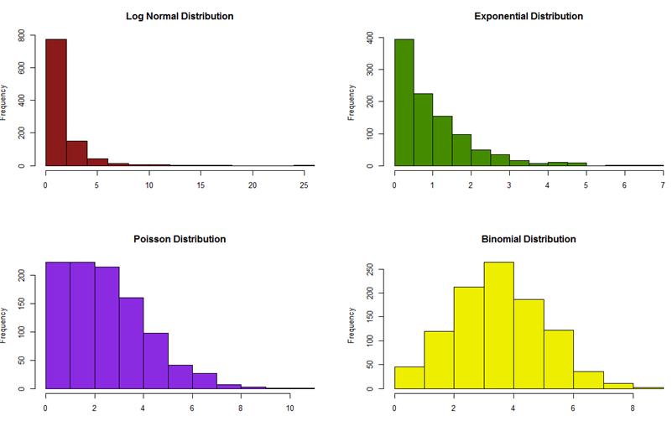
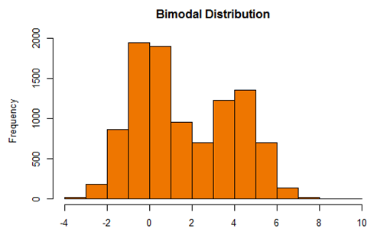
Data Exploration
Quantitative data: Histogram (distribution)

Slide 28
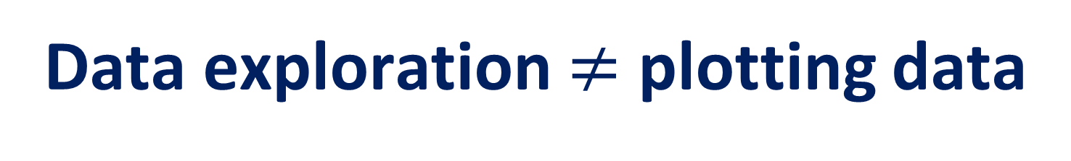
Data exploration $≠$ plotting data

Slide 29
Data Exploration
Plotting is not the same thing as exploring
One experiment: change in the variable of interest between CondA to CondB.
  Data plotted as a bar chart.
The truth
The fiction

Slide 30
Data Exploration
Plotting (and summarising) is (so) not
the same thing as exploring
Five experiments: change in the variable of interest between 3 treatments and a control.
  Data plotted as a bar chart.
The truth (if you are into bar charts)
Comparisons:
Treatments vs. Control
p=0.001
p=0.04
Exp5
Exp4
p=0.32
Exp3
Exp1
Exp2

Slide 31
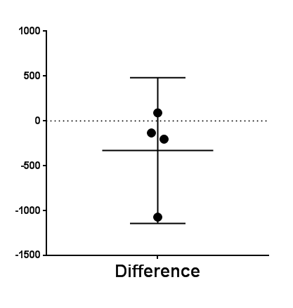
Data Exploration
Plotting (and summarising and choosing the wrong graph)
is (definitely) not the same thing as exploring
Four experiments: Before-After treatment effect on a variable of interest.
Hypothesis: Applying a treatment will decrease the levels of the variable of interest.
    Data plotted as a bar chart.
The truth
The fiction
Exp2
Exp1
Exp3
Exp4

