Slide 1


Experimental design
Hayley Carr & Anne Segonds-Pichon v2025-01

Slide 2
Question
Data Collection/Storage
Data Exploration
Data Analysis
Results
Experiment
Experimental Design
Sample Size

Slide 3






Statistical Analysis
Common Sense
Experimental Design
Type of Design
Technical vs. Biological

Slide 4
Experimental design
Independent versus matched design

Slide 5


Experimental design
Independent design
  2 or more groups in an experiment with independent subjects
  Example: 3 groups with n=4 in the control group and n=4 in each treated group
Control
Treatment 1
Treatment 2
One experiment
4 different mice
4 different mice
4 different mice

Slide 6


Experimental design
Matched design
  Also called repeated = dependent = paired (2 groups)
    Design 1: ≥2 measures per animal/subject/petri dish
Example 1: before/after treatment measures
Example 2: 3 time points
Time 1
Time 2
Time 3
Same mouse
Before
After
Paired/Matched values
Difference or ratio possible
for each mouse
Mouse 1
Mouse 1
Mouse 2
Same mouse
Mouse 2
Matched/Repeated values
Ex: Difference or ratio vs. Time 1
for each mouse
Mouse 3
Mouse 3

Slide 7
Experimental design
Matched design
    Design 2: experiment repeated independently
Example 1: 3 independent experiments
2 mice within each: WT and KO
Example 2: 3 independent experiments
3 mice within each: control and 2 treatments
2 different mice
Matched/Paired values
Each KO mouse is matched with a WT
Difference or ratio possible
for each experiment
WT
KO
Ctrl
Treat 1
Treat 2
Experiment 1
Experiment 1
Experiment 2
Matched values
Ex: Difference or ratio vs. Time 1
for each experiment
Experiment 2
3 different
mice
Experiment 3
Experiment 3
Notes:
Matched designs preferable – account for variation, without ignoring it!

Slide 8




Experimental design
Other design considerations: bias
The lack of bias-reducing measures such as randomisation and blinding can contribute to as much as 30-45% inflation of effect sizes
Simple randomisation or randomisation within blocks
Example nuisance variables for blocking:
  Time or day of experiment
  Litter, cage, etc.
  Person carrying out experiment
  Sex, age, body weight, etc.
  Another related measure (e.g. starting cell numbers, level of cytokine, or similar)
Use random number generator, flip a coin, roll a dice
Blinding should be thought about:
When allocating groups
When doing the experiment
The ARRIVE guidelines 2.0
Study design
Sample size
Inclusion and exclusion criteria
Randomisation
Blinding/Masking
Outcome measures
Statistical methods
Experimental animals
Results
When measuring outcomes
When doing the analysis
https://arriveguidelines.org/arrive-guidelines

Slide 9




Statistical Analysis
Common Sense
Experimental Design
Type of Design
Technical vs. Biological

Slide 10
Technical/biological replicates
Not always easy

Slide 11

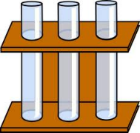
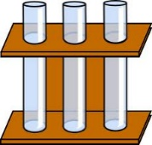
Technical versus biological replicates
Technical: repeated measures of the same sample → variability in the protocol
Biological: measures of biologically distinct samples → biological variation
Average of technical replicates = 1 biological replicate → ↓measurement error
n=1
n=3
Technical
Biological
Technical & Biological
n=3

Slide 12
Technical versus biological replicates
Not always easy to tell the difference
Definition of technical and biological depends on the model
Mouse, human, plant, or other complex organism
  One value per individual organism = biological replicate
n=1
n=3
Technical
Biological

Slide 13
Technical versus biological replicates
Not always easy to tell the difference
The model: mouse or other complex organism
  >1 value per individual, e.g. axon degeneration
What to do? Not one good answer
  In this case: mouse = experiment unit, nerve segments = biological replicates, axons = technical replicates
  But how generalisable to a wider population is this?
One measure or more
…
…
One mouse
Several segments
per mouse
Several axons
per segment
Tens of values
(per mouse)

Slide 14


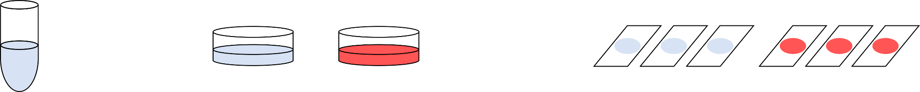

Technical versus biological replicates
Not always easy to tell the difference
Cells, worms, etc. = many ‘individuals’:
    What is ‘n’ in cell culture experiments?
Control
Treatment
Glass slides, microarrays,
lanes in gel, wells in plate,
…
Point of Measurements
Vial of frozen cells
Dishes, flasks, wells, …
Cells in culture
Point of Treatment

Slide 15
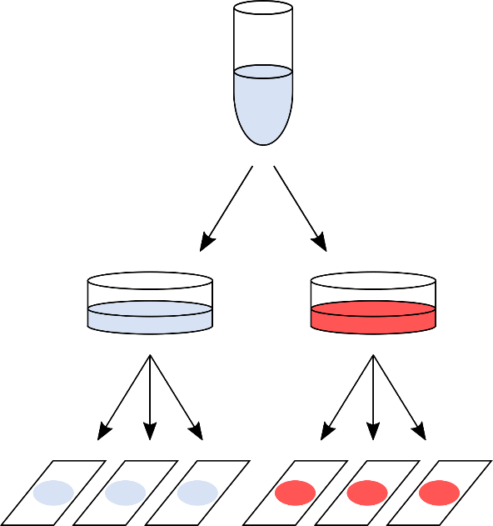
Technical versus biological replicates
Not always easy to tell the difference
Design 1:
One value per glass slide
e.g. cell count
After quantification: 6 values
  Sample size: n = 1
      no independence between slides
      variability = pipetting/measurement error

Slide 16
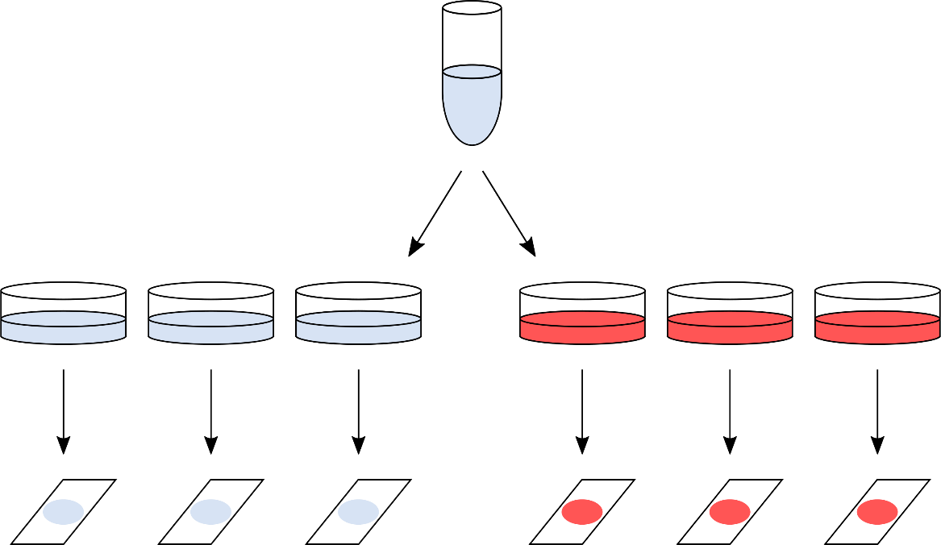
Technical versus biological replicates
Not always easy to tell the difference
Design 2:
Everything processed
on the same day
After quantification: 6 values
  Sample size: n = 1
      no independence between plates
      variability = bit better as sample split higher up in the hierarchy
Notes:
measuring a person's weight in the morning, afternoon, and evening on the same day, rather than taking measurements a few minutes apart. The three measurements are likely to be a bit more variable, but still highly correlated.

Slide 17
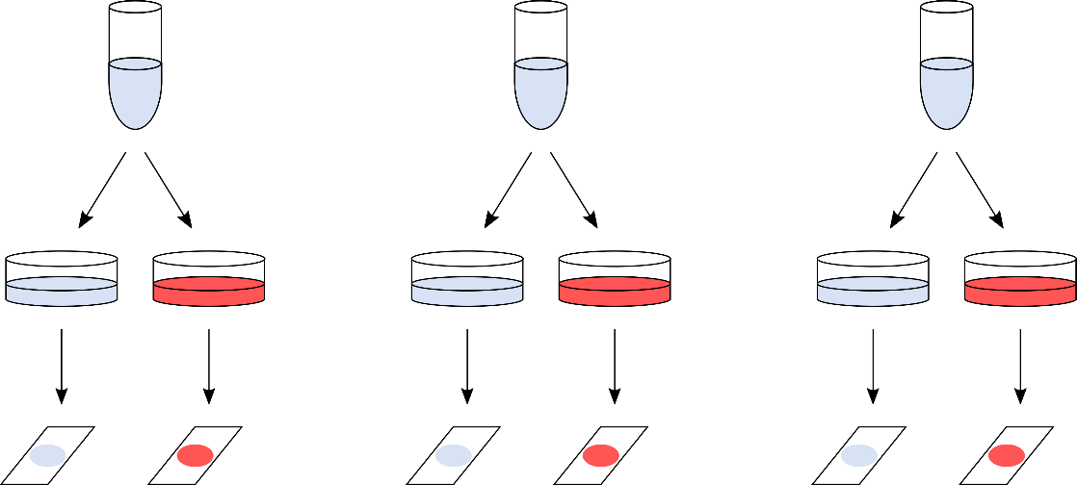
Technical versus biological replicates
Not always easy to tell the difference
Design 3: Often, as good as it can get
Day 1
Day 2
Day 3
After quantification: 6 values
  Sample size: n = 3
      Whole procedure repeated 3 separate times
        3 days are (mostly) independent
      Technical variability but at the highest hierarchical level
      2 glass slides = paired observations

Slide 18
Technical versus biological replicates
Not always easy to tell the difference
Design 4: The ideal design
person/animal/plant 1
person/animal/plant 2
person/animal/plant 3
After quantification: 6 values
  Sample size: n = 3
      Real biological replicates

Slide 19



Technical versus biological replicates
Never mix technical and biological replicates
Do not generalise your results beyond what you are able to show
Identify technical and biological replicates
Make the replicates as independent as possible
Consider wider factors, e.g. rarity of samples, cost and accuracy of measurements
How ‘good’ your biological replicates are determines how generalisable your results are
↑ confidence if true biological replicates
↓ confidence if single cell line

Slide 20


Statistical Analysis
Common Sense
Experimental Design
Type of Design
Technical vs. Biological

Slide 21






Experimental Design
Statistical analysis
Think about the statistical analyses before you collect any data
  Translate the hypothesis into statistical questions
What data will I collect?
Will I have access to the raw data?
I have been told to do this test/use that template, is that right?
How will it be recorded/produced?
Do I know enough stats to analyse my data?
If not: ask for help!

Slide 22
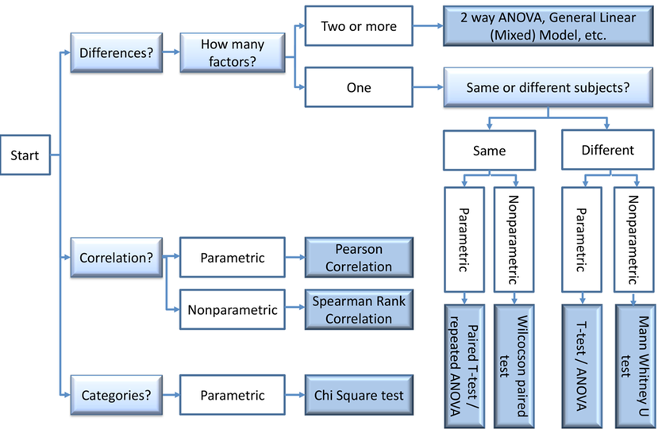
Experimental Design
Statistical analysis

Slide 23

Experimental Design
Exploratory data analysis (EDA)
Purpose of EDA = discovery
Less confidence in results so follow up with confirmatory tests
Confirmatory approaches (hypothesis testing) provide stronger statistical evidence
EDA ≠ “p-hacking” but could be if reported as if confirmatory
Be clear about approach taken – harm comes from misrepresenting processes

Slide 24
Statistical Analysis
Common Sense
Experimental Design
Type of Design
Technical vs. Biological

Slide 25

Experimental Design
Common sense
Design your experiment to be analysable
Imagine how your results will look
Imagine what could go wrong at each step
Accept limitations and account for them (be prepared for follow up experiments, if required)
The gathering of results or carrying out of a procedure is not the end goal
Don’t get fixated on being able to perform a cool technique or experimental protocol
Don’t overcomplicate
Don’t get overwhelmed (ask for help)
Will these results address your hypothesis?

Slide 26
Power Analysis
Hayley Carr & Anne Segonds-Pichon v2023-09

Slide 27
Power analysis
Power analysis is about estimating the appropriate sample size.
Question
Data Collection/Storage
Data Exploration
Data Analysis
Results
Experiment
Sample Size
Experimental Design
Power Analysis

Slide 28
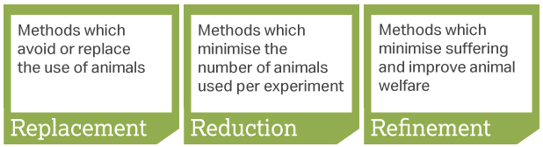
Sample size
  Too big: waste of resources
  Too small: may miss the effect (p>0.05) + waste of resources
  Grants: justification of sample size
  Publications: reviewers ask for power calculation evidence
  Home office (UK): the 3 Rs: Replacement, Reduction and Refinement
To estimate an appropriate sample size, we need to do a power analysis

Slide 29


Statistical power
In a nutshell: the bigger the experiment (bigger sample size), the bigger the power (more likely to pick up a difference)
Power = probability of detecting an effect, given that the effect is really there
  = the probability that a statistical test will reject a false null hypothesis (H0)
    To really understand power, we first need to understand some statistical concepts…

Slide 30
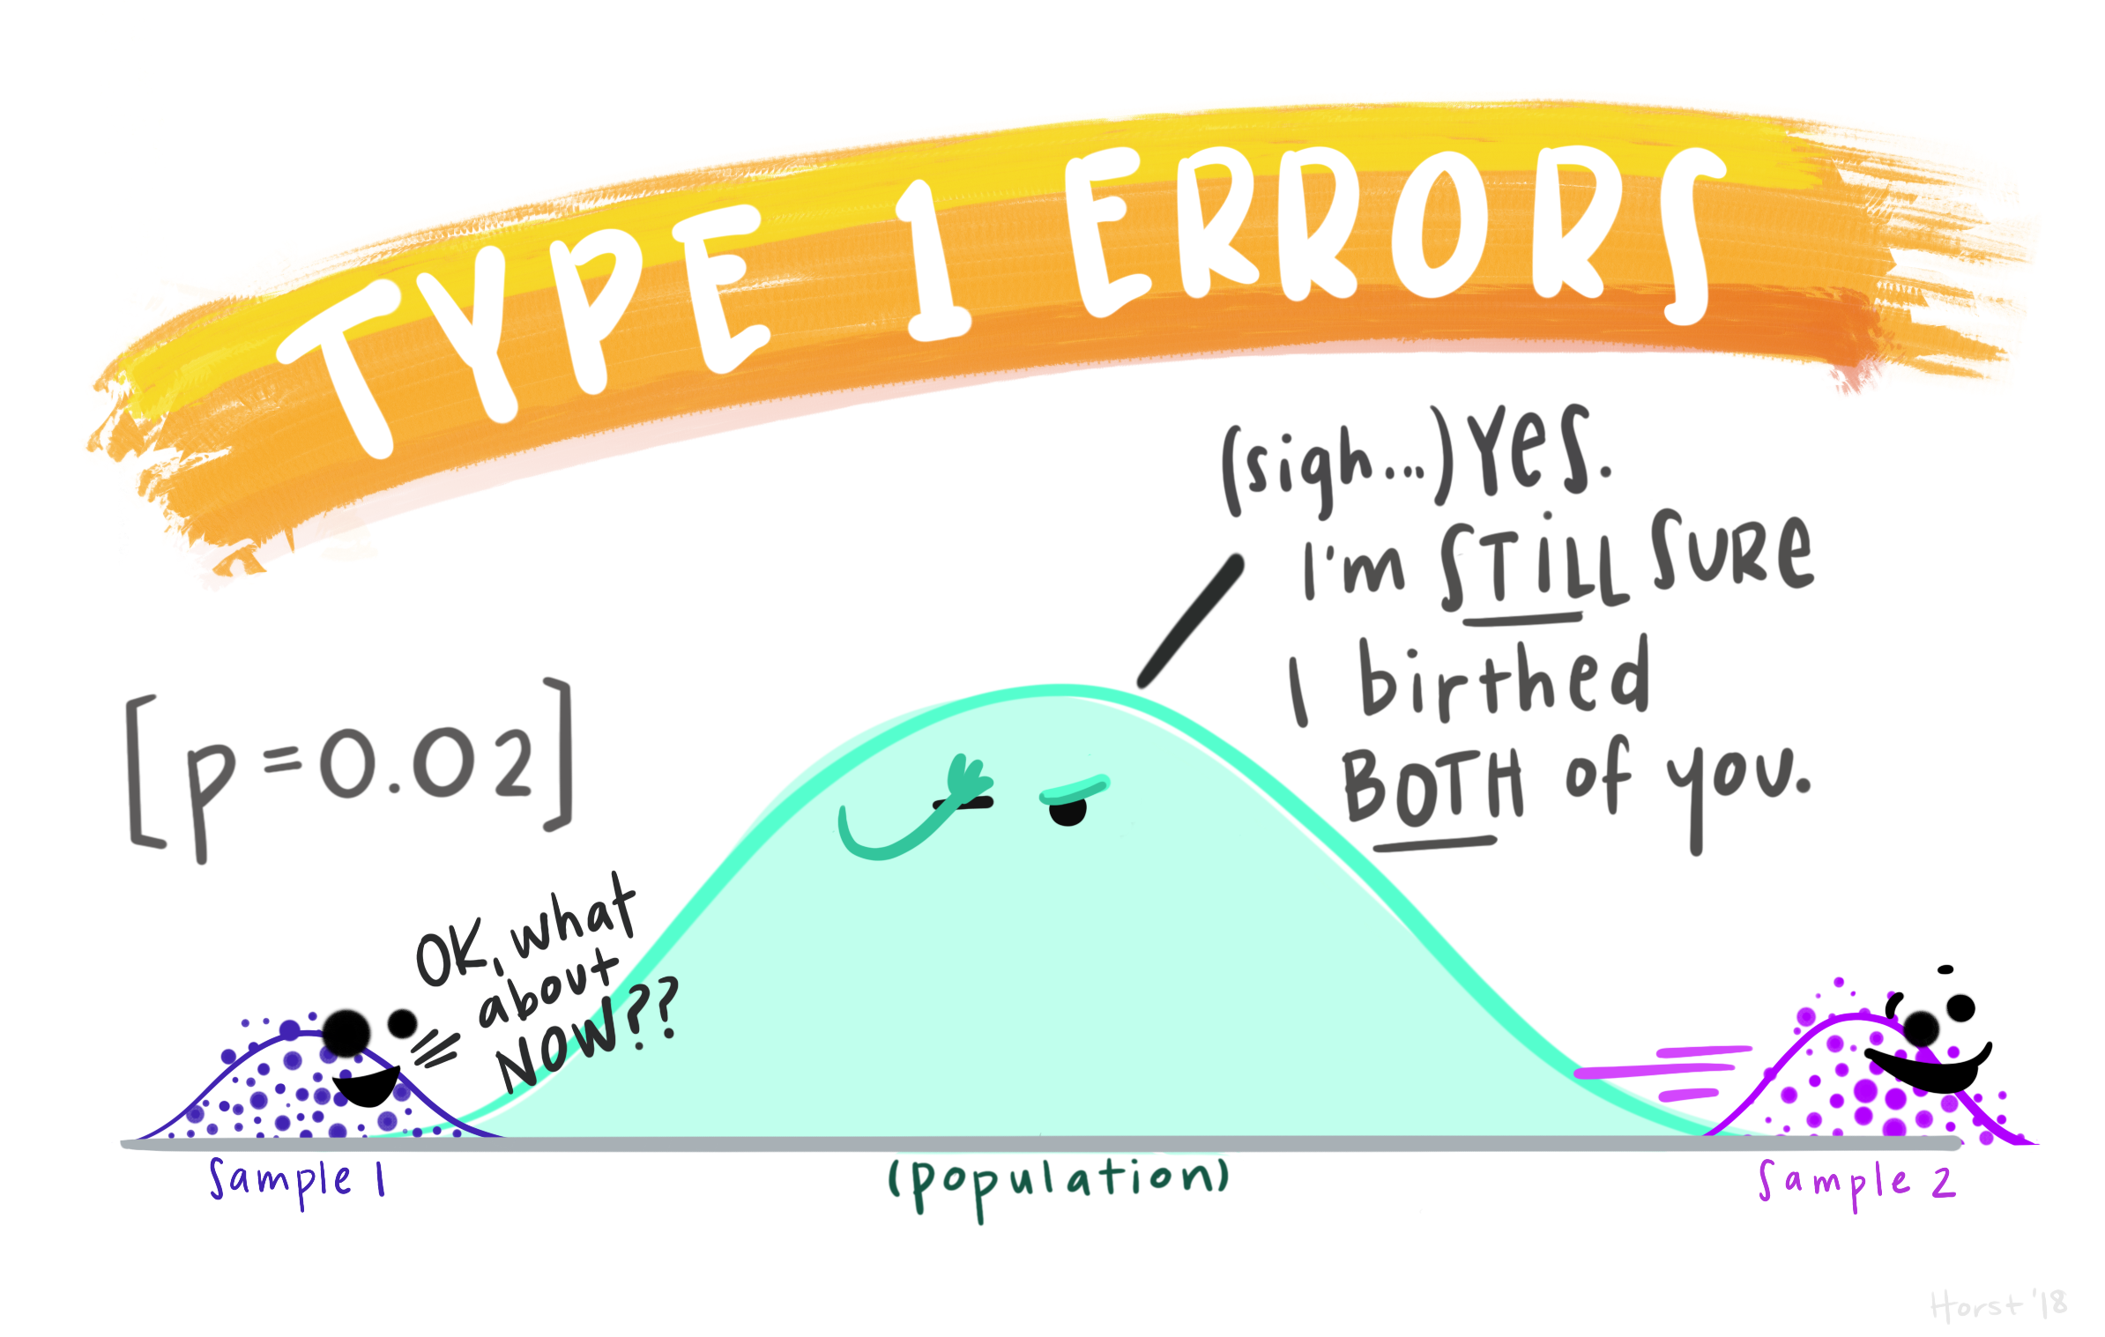
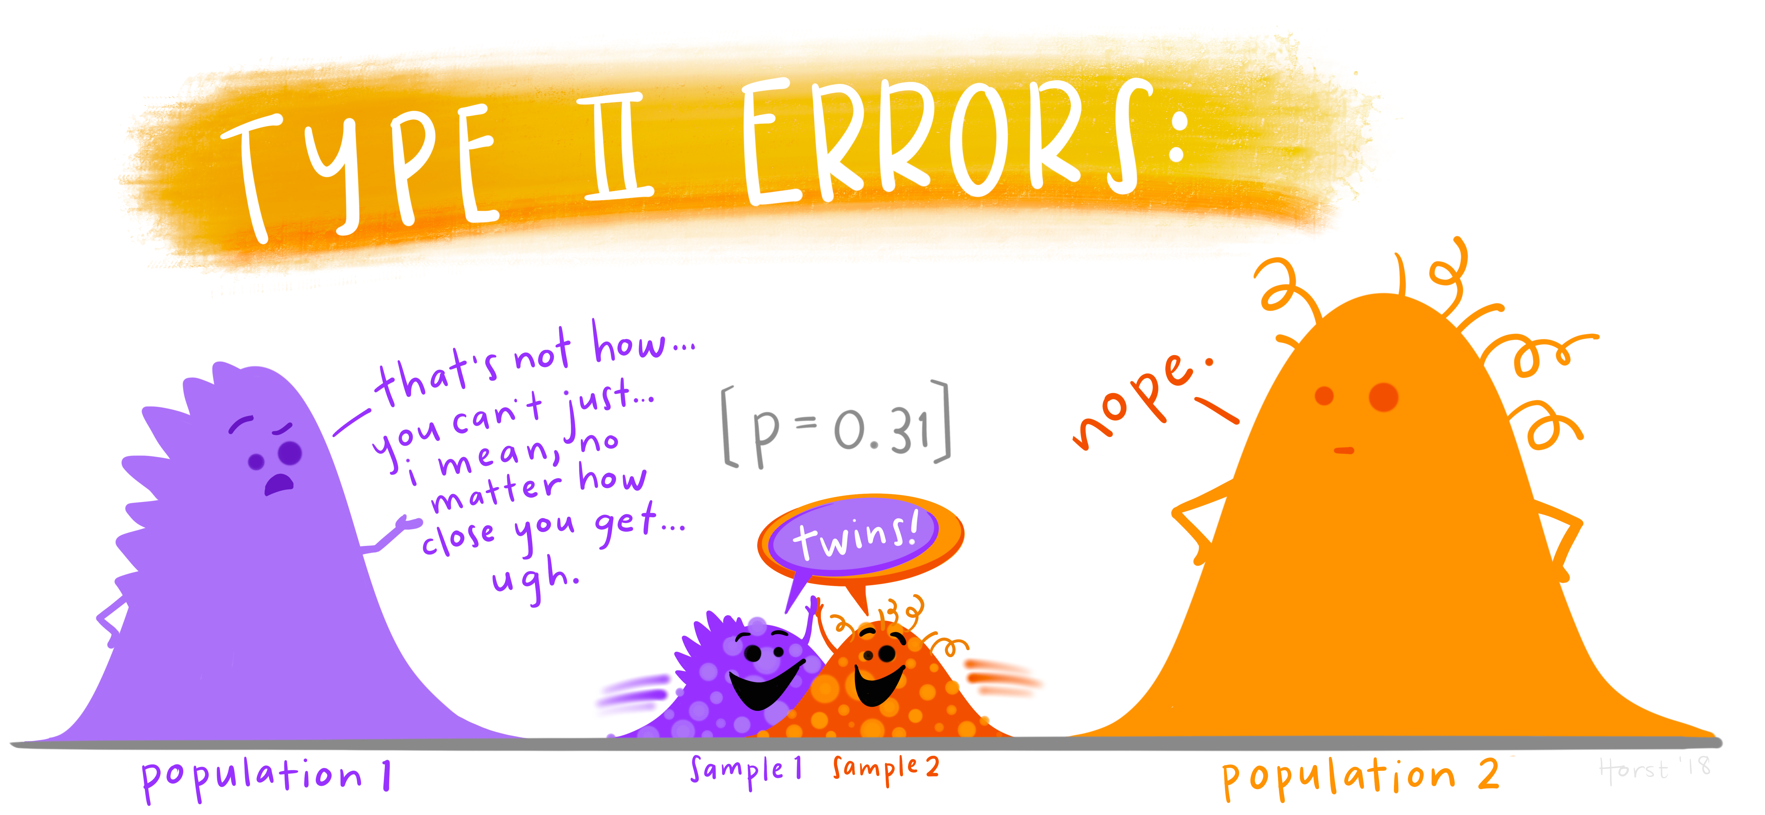
Hypothesis testing
The null hypothesis: H₀ = no effect
The aim of a statistical test is to reject or not H_{0.}
Statistical decision | True state of H₀
 | H₀ True (no effect) | H₀ False (effect)
Reject H₀ | Type I error α False Positive | Correct True Positive
Do not reject H₀ | Correct True Negative | Type II error β False Negative
Properly powered studies minimise this
https://github.com/allisonhorst/stats-illustrations#other-stats-artwork

Slide 31
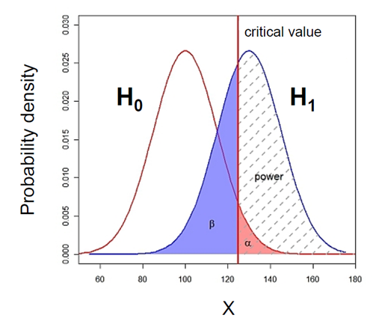
What does Power look like?

Slide 32
What does Power look like? Null and alternative hypotheses
Control
Treatment
Probability that the observed result occurs if H₀ is true
  H₀ : Null hypothesis = absence of effect
  H₁: Alternative hypothesis = presence of an effect
    Statistics is all about rejecting the Null or not.

Slide 33
What does Power look like? Type I error (α)
Type I error is the failure to reject a true H₀
  Claiming an effect which is not there.
  α : probability of making a Type I error
α : the significance level, usually set at 0.05 or 5%

Slide 34
What does Power look like? Type I error (α) and the p-value
p-value: probability that the observed statistic occurred by chance alone
  probability that a difference as big as the one observed could be found even if there is no effect.
Statistical significance: comparison between α (=0.05) and the p-value
  p-value < 0.05: there is a significant difference ☺ (reject H₀)
  p-value > 0.05: there is no significant difference ☹ (fail to reject H₀)

Slide 35
What does Power look like? Type II error (β) and Power
Area = 1
Power = 1 – β
Type II error (β) is the failure to reject a false H₀
  Missing an effect which is really there
  β : probability of making a Type II error
Power: Probability of detecting an effect which is really there.
    = Probability of rejecting a false H₀
  Direct relationship between Power and Type II error: Power = 1 – β

Slide 36

What does Power look like? Power = 80%
General convention: 80% but could be more
Means a true difference will be missed 20% of the time
    If power = 0.8 then β = 1- power = 0.2 (20%)
Jacob Cohen (1962):
    Type I errors are 4x more serious than Type II errors:
      0.05 * 4 = 0.2
Compromise between power and sample size, e.g. for 2 group comparisons:
    90% power = +30% sample size
    95% power = +60% sample size

Slide 37
The critical value
Critical value
Small difference
Big difference
Not significant: p>0.05
Significant: p<0.05
Critical value = size of difference + sample size + significance level

Slide 38
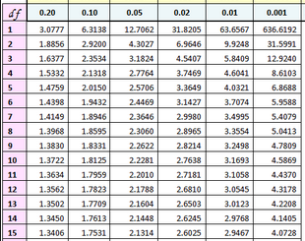
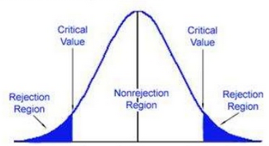
The critical value: size of difference + sample size + significance
Example with the t-test
Significance level
~ Difference
T Distribution
0.95
Diff “big enough”
Degrees of freedom
0.025
0.025
0
t=-2.1448
t=2.1448
Difference “too small”
Example: 2-tailed t-test with n=15 (df=14)
In hypothesis testing:
  critical value is compared to the test statistic to determine significance
  Example of test statistic: t-value
If test statistic > critical value: statistical significance and rejection of the null hypothesis
  Example: t-value > critical t-value

Slide 39
To recap:
The null hypothesis: H₀ = no effect
The aim of a statistical test is to reject or not H_{0.}
Statistical decision | True state of H₀
 | H₀ True (no effect) | H₀ False (effect)
Reject H₀ | Type I error α False Positive | Correct True Positive
Do not reject H₀ | Correct True Negative | Type II error β False Negative
https://github.com/allisonhorst/stats-illustrations#other-stats-artwork

Slide 40
Power analysis
The power analysis depends on the relationship between 6 variables:
the significance level (5%)
the desired power of the experiment (80%)
the alternative hypothesis (i.e. one or two-sided test)
the difference of biological interest
the variability in the data (standard deviation)
the sample size
Effect size

Slide 41
Power analysis
The power analysis depends on the relationship between 6 variables:
the significance level (5%)
the desired power of the experiment (80%)
the alternative hypothesis (i.e. one or two-sided test)
the difference of biological interest
the variability in the data (standard deviation)
the sample size
Effect size

Slide 42
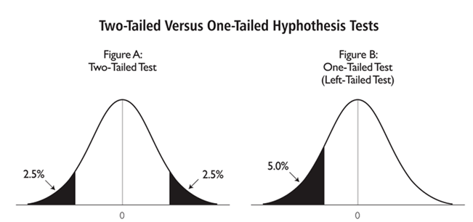
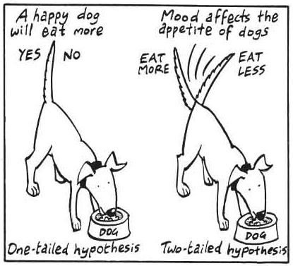
The alternative hypothesis: what is it?
One-tailed or two-tailed test? One-sided or two-sided tests?
Is the question:
  Is the there a difference? → Two-tailed
  Is it larger than or smaller than? → One-tailed
Can rarely justify the use of a one-tailed test
Two times easier to reach significance with one-tailed than two-tailed → suspicious reviewer!

Slide 43
Power analysis
The power analysis depends on the relationship between 6 variables:
the significance level (5%)
the desired power of the experiment (80%)
the alternative hypothesis (i.e. one or two-sided test)
the difference of biological interest
the variability in the data (standard deviation)
the sample size
Effect size

Slide 44
The difference of biological interest
Determined scientifically (not statistically)
  Minimum meaningful effect of biological relevance (Minimum Effect of Interest, MEI)
How to determine it?
  Previous research, pilot study
The variability
We need to have an idea of the standard deviation before we start the experiment
How to determine it?
  Data from previous research on WT, control or baseline
Effect size
Combination of absolute effect and variability

Slide 45

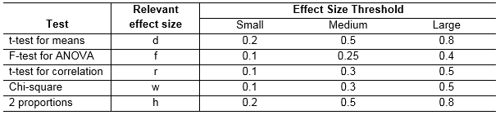
The effect size: how is it calculated?
Depends on the type of difference and the data
  Easy example: comparison between 2 means
Jacob Cohen defined small, medium and large effects for different tests – but not recommended
Absolute difference
Variability

Slide 46
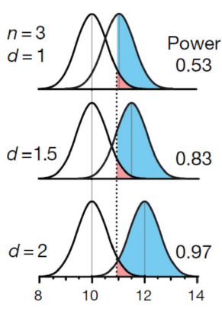
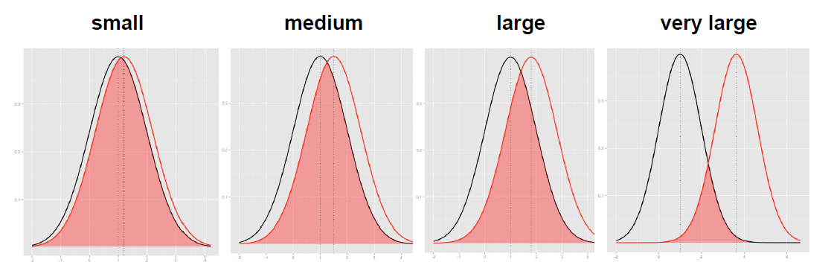
The effect size: how is it calculated?
The absolute difference
The bigger the effect (the absolute difference), the bigger the power
  = the bigger the probability of picking up the difference
Absolute difference
http://rpsychologist.com/d3/cohend/

Slide 47
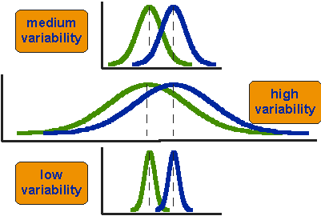
The effect size: how is it calculated?
The standard deviation
The bigger the variability of the data, the smaller the power
Variability
critical value
H₀
H₁

Slide 48
Power analysis
The power analysis depends on the relationship between 6 variables:
the significance level (5%)
the desired power of the experiment (80%)
the alternative hypothesis (i.e. one or two-sided test)
the difference of biological interest
the variability in the data (standard deviation)
the sample size
Effect size

Slide 49
The sample size
Most of the time, the output of a power calculation
In reality it is difficult to reduce the variability in data, or the contrast between means
  most effective way of improving power:
    increase the sample size
The bigger the sample, the bigger the power
  but how does it actually work?

Slide 50

Samples and population
  We want to know about whole population
    All people, all patients, all mice, all cells…
  Not possible to measure whole population
  So take a representative sample
  Make inferences about the population
  Larger samples more likely to be representative of the population

Slide 51
The sample size
‘Infinite’ number of experiments
Samples means = $\overline{x}$
n=3
Small samples (n=3)
Example with 10 experiments
Usually only do one experiment
Sample
n=30
Big samples (n=30)
Population
Sample

Slide 52


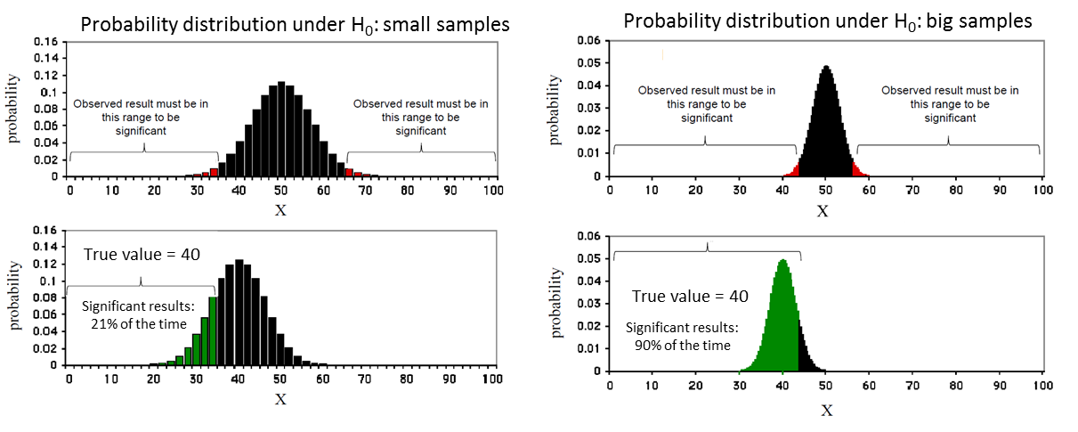
The sample size
Control
Treatment

Slide 53
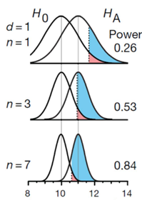
The sample size
Control
Treatment

Slide 54
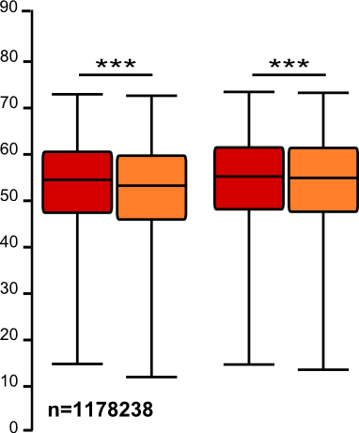
The sample size: the bigger the better?
It takes huge samples to detect tiny differences but tiny samples to detect huge differences
What if the tiny difference is meaningless?
  Beware of overpower
  Nothing wrong with the stats: it is all about interpretation of the results of the test
Remember the important first step of power analysis:
  What is the effect size of biological interest?

Slide 55
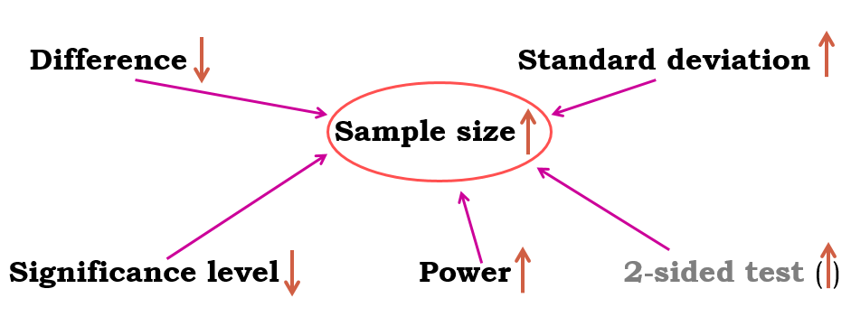
Power analysis
Typical question
What sample size do I need to have a 80% probability (power) to detect this particular effect (difference and standard deviation) at a 5% significance level using a 2-sided test?

Slide 56
Power analysis
Fix any five of the variables, a mathematical relationship is used to estimate the sixth
Difference of biological interest
+ Variability in the data (standard deviation)
+ Desired power of the experiment (80%)
+ Significance level (5%)
+ Alternative hypothesis (i.e. one or two-sided test)
Appropriate sample size

Slide 57
Power analysis
Use R Help to find out how to use the functions
  e.g. ?power.prop.test in the console
Good news:
there are packages that can do the power analysis for you, providing you have some prior knowledge of the key parameters!
  R
  G*Power
power.prop.test(n=NULL, p1=NULL, p2=NULL,
sig.level=NULL, power=NULL,
alternative=c("two.sided", "one.sided"))
power.t.test(n=NULL, delta=NULL, sd=1, sig.level=NULL,
power=NULL,
type=c("two.sample", "one.sample", "paired"),
alternative=c("two.sided", "one.sided"))

Slide 58
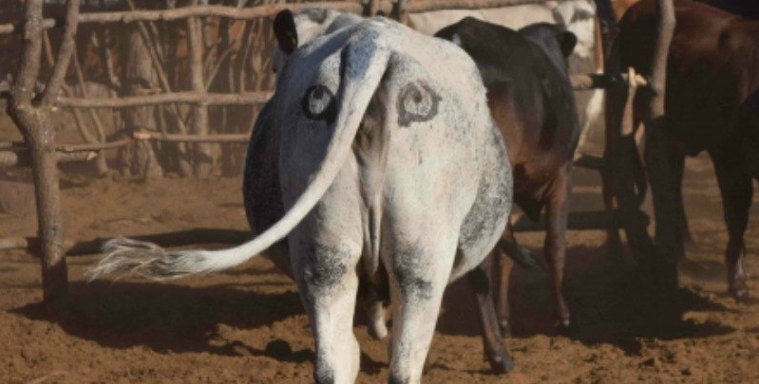
Power Analysis
Comparing 2 proportions (Fisher’s exact test)
Exercise:
Scientists have come up with a solution that may reduce the number of lions being shot by farmers in Africa:
  Painting eyes on cows’ bottoms.
Early trials suggest that lions are less likely to attack livestock when they think they’re being watched
  Fewer livestock attacks could help farmers and lions co-exist more peacefully.
Pilot study over 6 weeks:
  3 out of 39 unpainted cows were killed by lions, none of the 23 painted cows from the same herd were killed.
Tasks:
  Do you think the observed effect is meaningful to the extent that such a ‘treatment’ should be applied?
Consider ethics, economics, conservation …
  Run a power calculation to find out how many cows should be included in the study.
    Clue 1: power.prop.test()
    Clue 2: exactly one of the parameters must be passed as NULL, and that parameter is determined by the others
http://www.sciencealert.com/scientists-are-painting-eyes-on-cows-butts-to-stop-lions-getting-shot

Slide 59
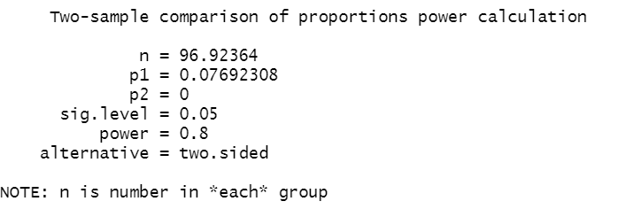
Power Analysis
Comparing 2 proportions
Exercise 1: Answer
Pilot study over 6 weeks:
  3 out of 39 unpainted cows were killed by lions, none of the 23 painted cows from the same herd were killed.
power.prop.test(n=NULL,
p1=3/39,
p2=0,
sig.level=0.05,
power=0.8,
alternative="two.sided")
Providing the preliminary results are to be trusted, to be able to pick up such a difference between the 2 groups, with a power of 80% and a significance level of 5%, we will need at least 97 cows in each group.

Slide 60
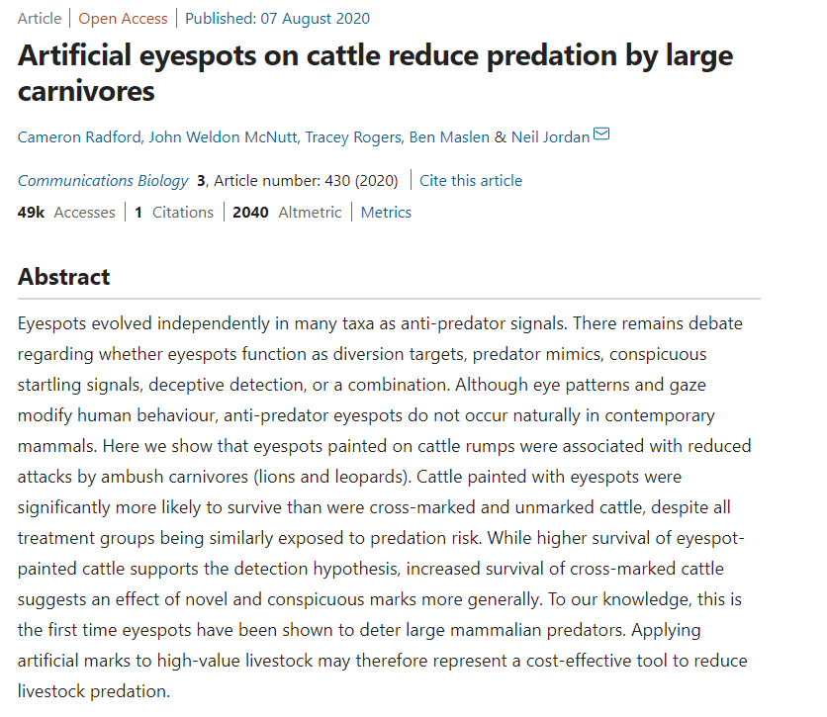
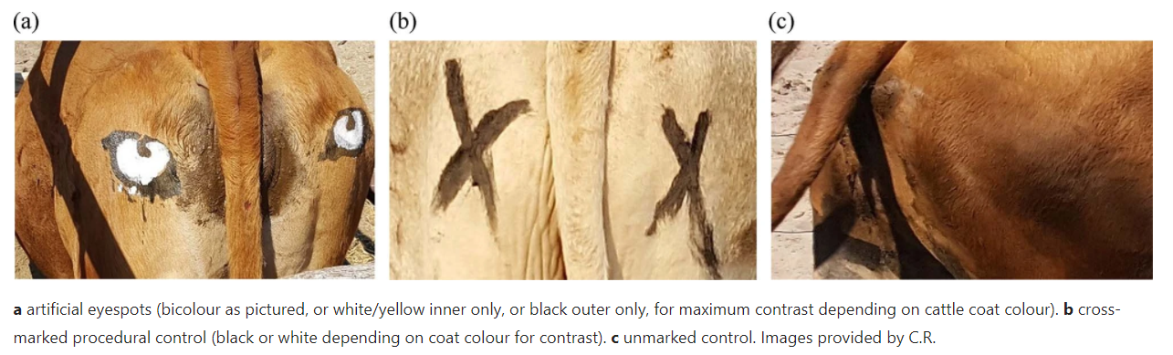
https://www.nature.com/articles/s42003-020-01156-0.pdf

Slide 61
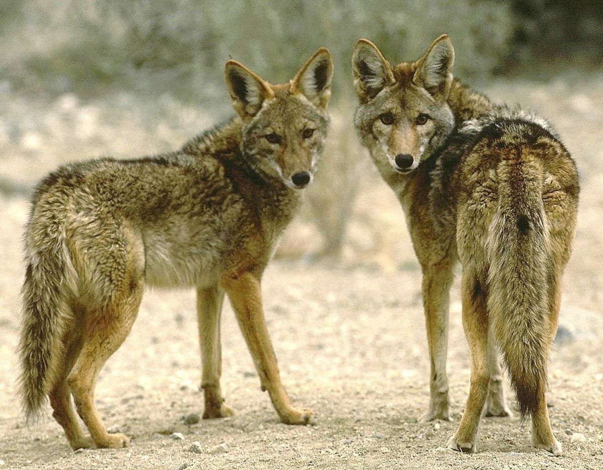
Power Analysis
Comparing 2 means (t-test)
Exercise:
We want to know whether male and female coyotes differ in size
No data from a pilot study but we have found some information in the literature:
  In a study run in similar conditions as in the one we intend to run, male coyotes were found to measure: 92cm +/- 7cm (SD)
We expect a 5% difference between sexes
= smallest biologically meaningful difference
Task:
  Run a power calculation to find out how many coyotes should be included in the study
  Using power.t.test()

Slide 62
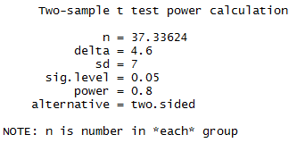
Power Analysis
Comparing 2 means (t-test)
Independent t-test
A priori Power analysis
Example case:
From a similar study, male coyotes were found to measure:
92cm+/- 7cm (SD)
You expect a 5% difference between sexes with similar variability in the female sample
power.t.test(
n = NULL, delta = NULL, sd = NULL,
sig.level = NULL, power = NULL,
type = "two.sample" or "one.sample" or "paired",
alternative = "two.sided" or "one.sided")
power.t.test(delta = 92-87.4, sd = 7, sig.level = 0.05, power = 0.8)
You need a sample size of n=76 (2*38)

Slide 63
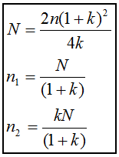
Unequal sample sizes
No simple trade-off – if need 2 groups of 30 → 20 and 40 = decreased power
  Unbalanced design = bigger total sample
Solution 1 (old school):
  Step 1: power calculation for equal sample size
  Step 2: adjustment
Cow example:
Balanced design: n = 97
If unpainted group is 2 times bigger than painted (k=0.5):
$$N=\frac{2×97×{(1+0.5)}^{2}}{4×0.5}=218.25≈219$$
Unpainted butts (n₁)=146 Painted butts (n₂)=73
Balanced design: n = 2*97 = 194
Unbalanced design: n= 73+146 = 219
Where:
N = total sample size in unbalanced design
n = total sample size in balanced design
n₁ = group 1 size
n₂ = group 2 size
k = ratio n₂/n₁

Slide 64
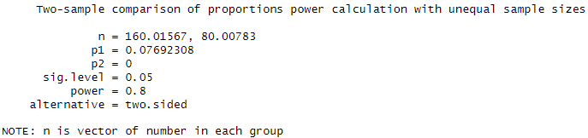
Unequal sample sizes
Solution 2: Use R
In practice with R, # MESS package #
  Comparing 2 proportions with unequal n: power_prop_test()
  Comparing 2 means with unequal n: power_t_test()
power_prop_test(n=NULL,
p1=3/39, p2=0, sig.level=0.05, power =0.8, ratio = 0.5)
Also consider anything else that might impact final numbers, e.g. if likely to lose some samples during experiment
Different methods give slightly different sample sizes:
Using adjustment
  Unpainted (n₁) = 146
  Painted (n₂) = 73
  Total sample = 219
Using R:
  Unpainted (n₁) = 161
  Painted (n₂) = 81
  Total sample = 242

Slide 65
Non-parametric tests
Do not assume data come from a Gaussian/normal distribution
  Based on ranking values from low to high
  Almost always less powerful
Proper power calculations need to specify which kind of distribution we are dealing with – not easy
Non-parametric usually do not require more than 15% additional subjects compared to parametric
Crude rule of thumb:
  Compute sample size required for a parametric test and add 15%

Slide 66
What happens if we ignore the power of a test?
Misinterpretation of the results
Never ever interpret p-values without context!
  Significant p-value (<0.05): but what is the difference?
    >= smallest meaningful difference: exciting effect
    < smallest meaningful difference: essentially a false positive/type 1 error
      Too big sample, overpowered – difference has no biological relevance
  Not significant p-value (>0.05): but how big was the sample?
    Big enough = enough power: no effect
    Not big enough = underpowered: potentially a false negative/type 2 error
      Too small sample – potentially miss a meaningful difference

Slide 67
Exercise 1

Slide 68
Descriptive Stats and Data Exploration
Hayley Carr & Anne Segonds-Pichon v2024-05

Slide 69
Question
Data Collection/Storage
Data Exploration
Data Analysis
Results
Experiment
Sample Size
Experimental Design

Slide 70
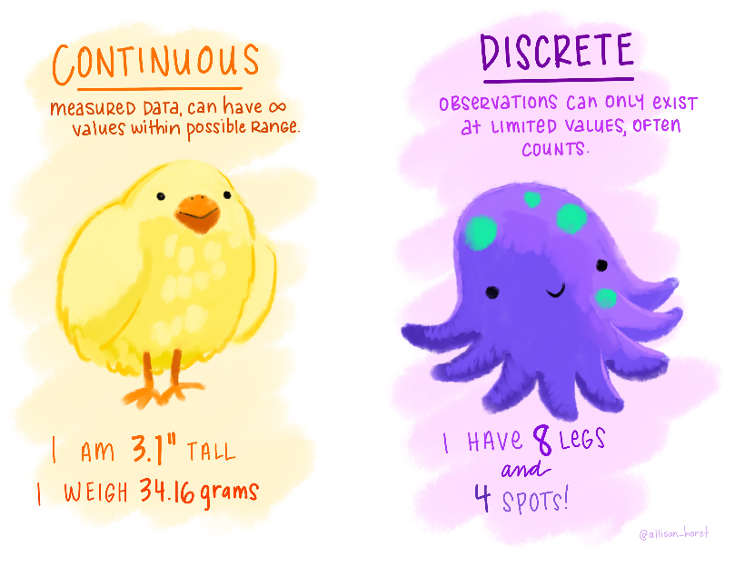
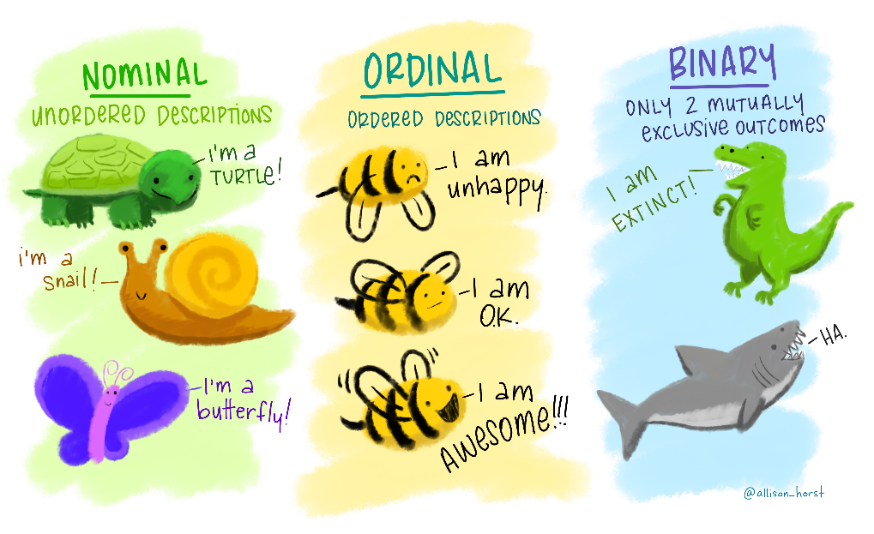
Variable
Quantitative
Qualitative
Nominal
Continuous
Discrete
Ordinal
Binary
https://github.com/allisonhorst/stats-illustrations#other-stats-artwork

Slide 71
Variable
Quantitative
Qualitative
Nominal
Continuous
Discrete
Ordinal
Binary
https://github.com/allisonhorst/stats-illustrations#other-stats-artwork

Slide 72

Quantitative data
They take numerical values (units of measurement)
Discrete: obtained by counting
  Example: number of students in a class
  values vary by finite specific steps
Continuous: obtained by measuring
  Example: height of students in a class
  any values – can have decimal places
They can be described by a series of parameters:
  Mean, variance, standard deviation, standard error and confidence interval
https://github.com/allisonhorst/stats-illustrations#other-stats-artwork

Slide 73
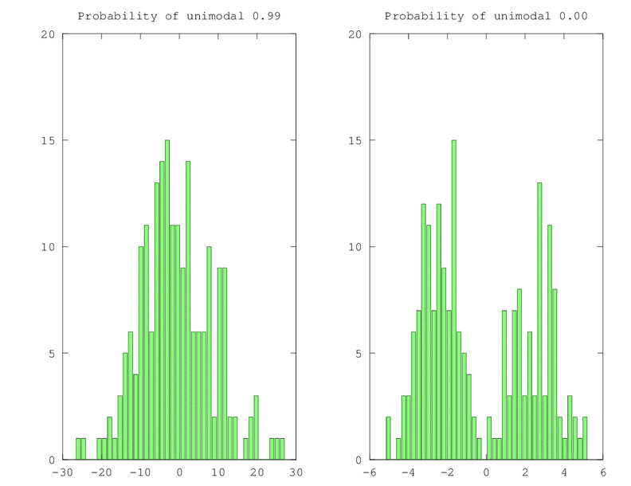

Measures of central tendency
Mode and Median
Mode: most commonly occurring value in a distribution
Median: value exactly in the middle of an ordered set of numbers

Slide 74
Measures of central tendency
Mean
Definition: average of all values in a column
Example: mean of: 1, 2, 3, 3 and 4 = (1+2+3+3+4)/5 = 2.6
The mean is a model because it summaries the data
How do we know that it is an accurate model?
  Difference between the real data and the model created

Slide 75
Measures of dispersion
Calculate the magnitude of the differences between each data and the mean
Total error = sum of differences
  $=Σ(x_{i}−\overline{x}$) = -1.6 - 0.6 + 0.4 + 0.4 + 1.4 = 0
  No errors: positive and negative cancel each other out
To solve that problem we square the errors
→ Sum of squared errors (SS)

Slide 76
Sum of Squared errors (SS)
Sum of squared errors = $\left(SS\right)=Σ\left(x_{i}− \overline{x}\right)2$
= (-1.6) ² + (-0.6)² + (0.4)² +(0.4)² + (1.4)²
= 5.20
Good measure of the accuracy of the model
Depends on amount of data: larger sample → larger SS
  Account for number of observations (N) by dividing SS by N-1 (degrees of freedom)
  → the variance (S²) = SS/N-1

Slide 77
Degrees of freedom
$$variance \left(s^{2}\right)=\frac{SS}{N−1}= \frac{Σ \left(x_{i}− \overline{x}\right)2}{N−1}$$
To calculate the variance, we need the mean
If we know the mean, we do not need all the values in the sample to calculate the variance
Example: Sample: n = 5, Mean ($\overline{x}$) = 2.6
  2.6 x 5 – (1+2+3+3) = 4
Once we know the mean, we only need to know the first 4 numbers (N-1) and we can calculate the last number
$\frac{1+2+3+3 +4}{5}$=2.6

Slide 78
Degrees of freedom
The last (n^{th}) value in the sample is no longer independent, is not free.
Because we know the mean, the variance does not depend on all of the values of the sample, only on n-1 of the values
$$variance \left(s^{2}\right)=\frac{SS}{N−1}= \frac{Σ \left(x_{i}− \overline{x}\right)2}{N−1}$$
n – 1 degrees of freedom

Slide 79
Variance and standard deviation
$variance \left(s^{2}\right)=\frac{SS}{N−1}= \frac{Σ \left(x_{i}− \overline{x}\right)2}{N−1}= \frac{5.20}{4}=1.3$
Problem with variance: in squared units
  Take the square root to get the same unit as the original measure
  → the standard deviation
    S.D. = √(SS/N-1) = √(s²) = s $= \sqrt{1.3}=1.14$
SD = a measure of how well the mean represents the data.

Slide 80
Standard deviation
S.D.=0.5
S.D.=3.5
Small S.D.
data close to the mean:
good fit of the data
Large S.D.
data distant from the mean:
not an accurate representation

Slide 81
Standard Deviation (SD) or Standard Error Mean (SEM)?
Smaller error bars
SD
SEM

Slide 82
Standard Deviation
  The SD quantifies how much the values vary from one another
    → scatter or spread
  Does not change predictably as you acquire more data

Slide 83
Standard Error of the Mean
SEM$=\frac{SD}{\sqrt{N}}$
  The SEM quantifies how accurately we know the true mean of the population
    Takes into account: SD + sample size
    Make inferences about the population
  The SEM gets smaller as the sample gets larger
    Mean of a large sample likely closer to true mean than mean of a small sample

Slide 84
The SEM and the sample size
n=3
Small samples (n=3)
Theoretical ‘infinite’ number of experiments
Samples means = $\overline{x}$
Sample
n=30
Big samples (n=30)
Population
Sample

Slide 85
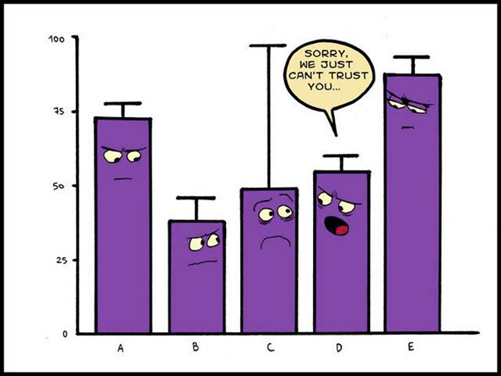
SD or SEM ?
Whichever you choose make sure to report it accurately!
If we want to show the variation among values:
  → Report the SD
If we want to show how precisely we have determined the population mean:
  → Report the SEM
Preferably show all data points and the SEM
  → Both variation and precision
Mean + SEM
https://lymielynn.medium.com/a-little-closer-to-cooks-distance-e8cc923a3250

Slide 86
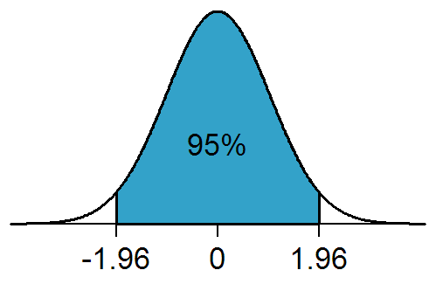
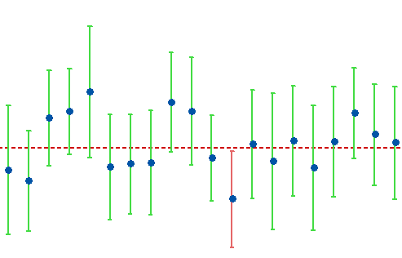
Confidence interval
Range of values that we can be 95% confident contains the true mean of the population
  Limits of 95% CI: [Mean - 1.96*SEM; Mean + 1.96*SEM] (SEM = SD/√N)
On average 19/20 experiments include the population mean
Proportion of values
-1.96*SEM Mean +1.96*SEM
On either side of the mean
https://statisticsbyjim.com/hypothesis-testing/confidence-interval/

Slide 87
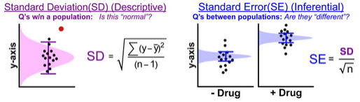
To recap
The Standard Deviation is descriptive
  Just about the sample
The Standard Error and the Confidence Interval are inferential
  Sample → General Population
Statistical tests are also inferential

Slide 88
Question
Data Collection/Storage
Data Exploration
Data Analysis
Results
Experiment
Sample Size
Experimental Design

Slide 89
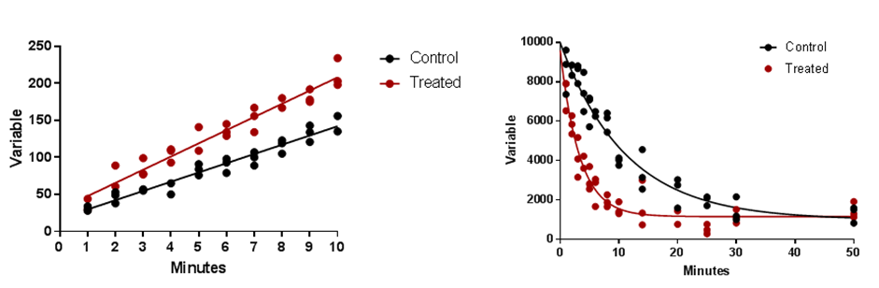
Quantitative data: Scatterplot

Slide 90
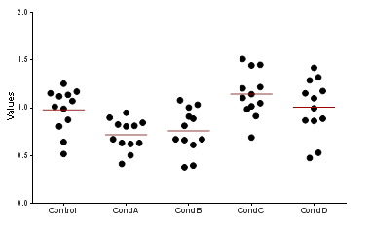
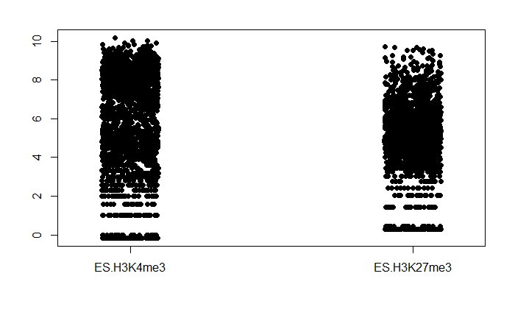
Quantitative data: Scatterplot/stripchart
Small sample
Big sample

Slide 91
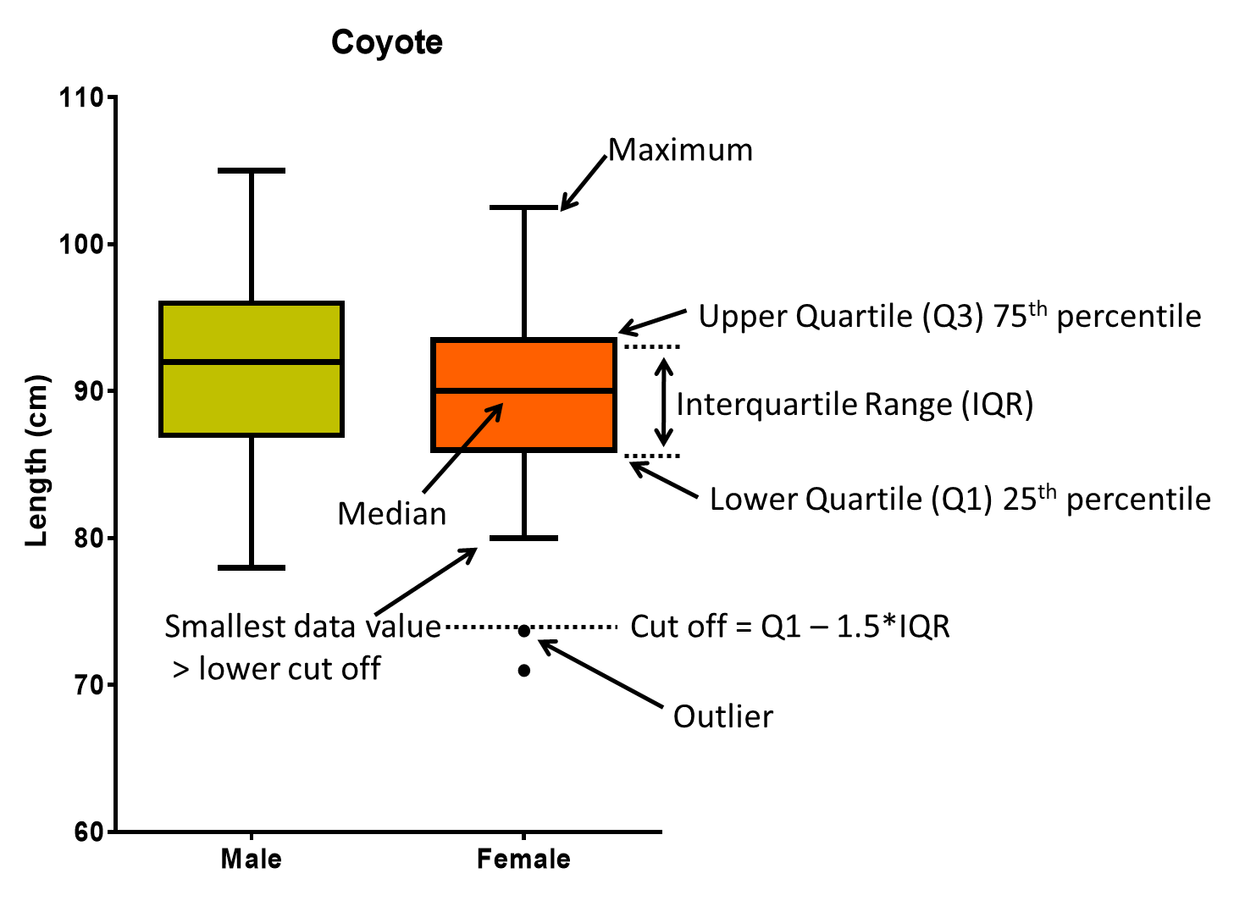
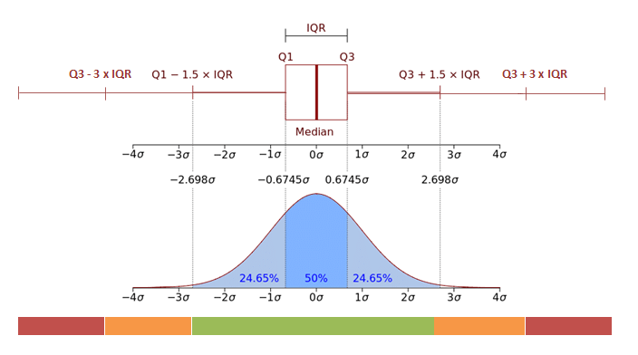
Quantitative data: Boxplot
‘Extreme’ outliers
‘Normal’ outliers
https://www.researchgate.net/publication/328818609_Outcomes_and_features_of_the_inspection_of_receiver_tubes_ITR_system_for_improved_OM_in_parabolic_trough_plants

Slide 92
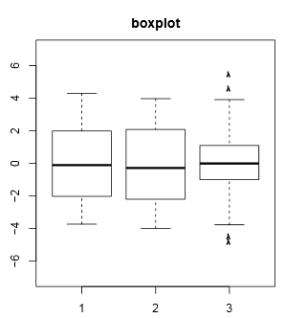
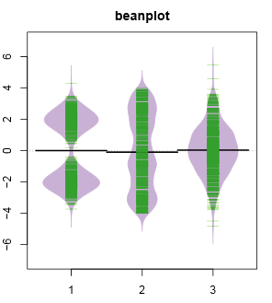
Quantitative data: Boxplot or Beanplot (aka Violinplot)
Scatterplot shows individual data
A bean= a ‘batch’ of data
Bimodal
Uniform
Normal
Distributions
Data density mirrored by the shape of the polygon

Slide 93
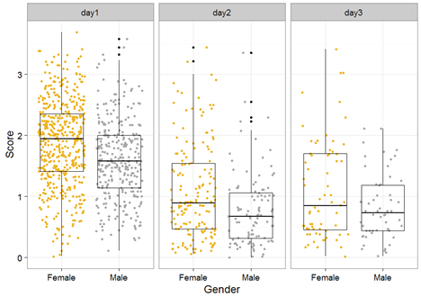
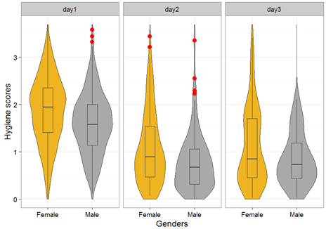
Quantitative data:
Boxplot and Violinplot and Scatterplot

Slide 94
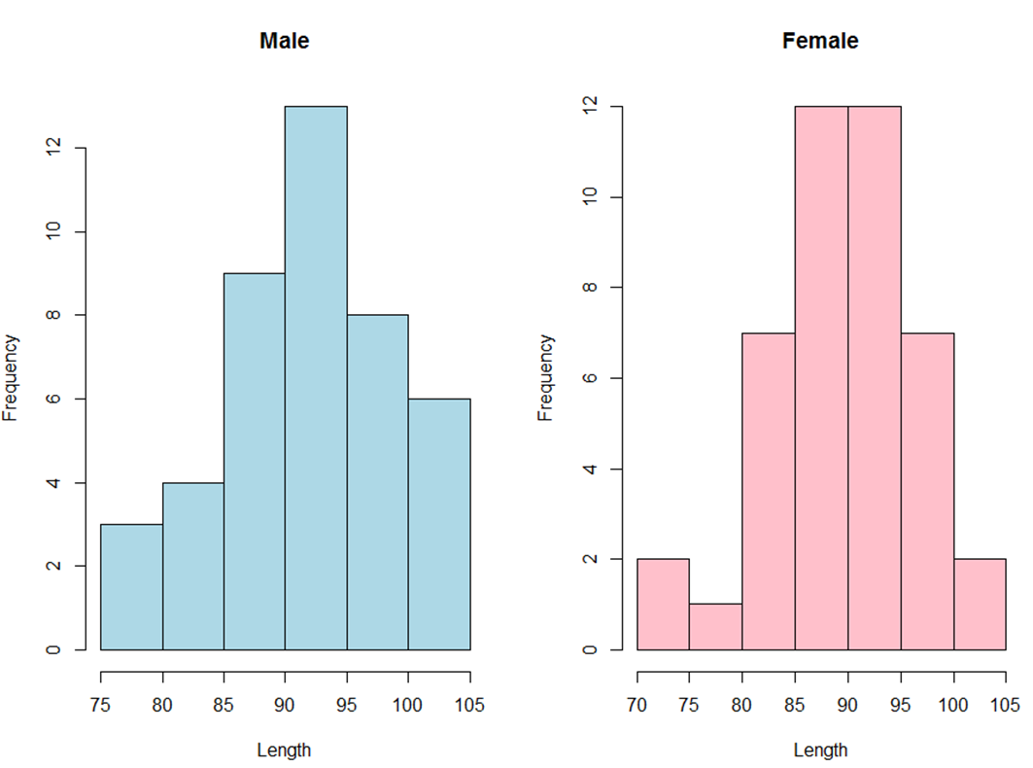
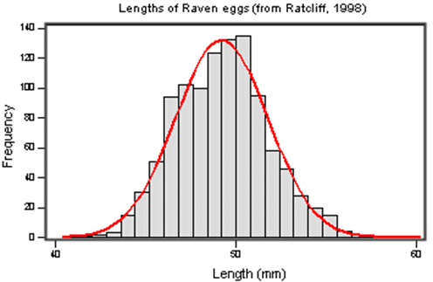
Quantitative data: Histogram
Big sample
Small sample

Slide 95
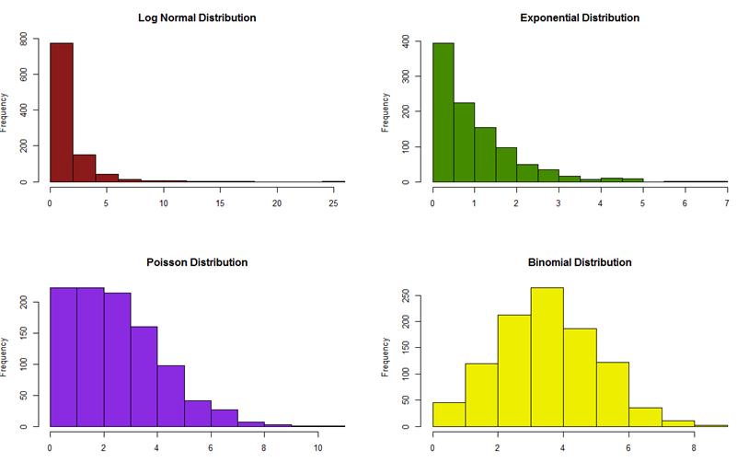

Quantitative data: Histogram (distribution)

Slide 96

Data exploration $≠$ plotting data
https://github.com/allisonhorst/stats-illustrations#other-stats-artwork

Slide 97
Plotting is not inherently the same thing as exploring
One experiment: change in the variable of interest between CondA to CondB.
  Data plotted as a bar chart.

Slide 98
Plotting is not inherently the same thing as exploring
Five experiments: change in the variable of interest between 3 treatments and a control.
  Data plotted as a bar chart.
Comparisons:
Treatments vs. Control
p=0.001
p=0.04
Exp5
Exp4
p=0.32
Exp3
Exp1
Exp2

Slide 99
Plotting is not inherently the same thing as exploring
Five experiments: change in the variable of interest between 3 treatments and a control.
  Data plotted as a bar chart.
Comparisons:
Treatments vs. Control
p=0.001
p=0.04
Exp5
Exp4
p=0.32
Exp3
Exp1
Exp2

Slide 100

Plotting is not inherently the same thing as exploring
Four experiments: Before-After treatment effect on a variable of interest.
Hypothesis: Applying a treatment will decrease the levels of the variable of interest.
    Data plotted as a bar chart.
Exp2
Exp1
Exp3
Exp4

Slide 101
Data exploration $≠$ plotting data
https://github.com/allisonhorst/stats-illustrations#other-stats-artwork

Slide 102
Key concepts and Assumptions
Analysis of Quantitative data
Choice of a statistical test
Hayley Carr & Anne Segonds-Pichon v2024-05

Slide 103
The null hypothesis and error types
The null hypothesis (H₀): H₀ = no effect
The aim of a statistical test is to reject or not H_{0.}
High specificity = low False Positives = low Type I error
High sensitivity = low False Negatives = low Type II error
Statistical decision | True state of H₀
 | H₀ true (no effect) | H₀ false (effect)
Reject H₀ | Type I error α False positive | Correct True positive
Do not reject H₀ | Correct True negative | Type II error β False negative
https://github.com/allisonhorst/stats-illustrations#other-stats-artwork

Slide 104


Sample
Statistical inference
Population
Difference
Is it meaningful?
Is it real?
Statistical test
Difference
Variation
Result
Is difference big enough?
Sample size
Statistic (t, F, …)
Determined scientifically
Significance

Slide 105
Signal-to-noise ratio
Stats are all about understanding and controlling variation
The ratio of signal to noise determines the significance
Statistical test
Difference
Variation
Sample size
Difference (signal)
Variation (noise)
If the noise (interindividual variation) is low then the signal is detectable
→ statistical significance
Signal
Signal
If the noise is large the same signal will not be detected
→ no statistical significance
Noise
Noise

Slide 106
Choice of a statistical test
There are many statistical tests. Which one we use depends on:
What we want to do
  The questions asked
  Correct statistical test to answer our questions
What sort of data we have
  The type and behaviour
  Correct statistical family
    There are 2 families of statistical tests:
      Parametric tests with 4 assumptions to be met
      Non-parametric tests with no or few assumptions and/or for qualitative data

Slide 107

Assumptions of Parametric Data
What sort of data we have
All parametric tests have 4 basic assumptions that must be met for the test to be accurate.
  First assumption: Normality
  Normal shape, bell shape, Gaussian shape

Slide 108



Assumptions of Parametric Data
What sort of data we have
Frequent departures from normality:
  Skewness: lack of symmetry of a distribution
  Kurtosis: measure of the degree of ‘peakedness’
    Same variance and same skew but differ markedly in kurtosis
Skewness < 0
Skewness = 0
Skewness > 0
More peaked distribution:
kurtosis > 0
Flatter distribution:
kurtosis < 0

Slide 109
Assumptions of Parametric Data
What sort of data we have
  Second assumption: Homoscedasticity (Homogeneity in variance)
    The variance should not change systematically throughout the data
  Third assumption: Interval data (linearity)
    The distance between points of the scale should be equal at all parts along the scale
  Fourth assumption: Independence
    Data from different subjects are independent
      Each data point in the sample is independent from all the others = Values corresponding to one subject do not influence the values corresponding to another subject
      Important in repeated measures experiments

Slide 110
Non-parametric tests
General principle: original data are transformed into ranks
Not meeting the assumptions for parametric tests is not enough to switch to a non-parametric approach
Data exploration is key:
  Outliers?
  Possible transformation?
  Parametric with corrections?
If outcome is a rank or a score with limited possible values: often non-parametric approach

Slide 111
Choice of a statistical test
Start
Differences?
Correlation?
Categories?
How many factors?
Two or more
One
Two-way ANOVA, General Linear (Mixed) Model, etc.
Same or different subjects?
Same
Parametric
Paired T test/repeated ANOVA
Non-parametric
Wilcoxon paired test
Different
Parametric
Non-parametric
T-test/ANOVA
Mann-Whitney U test
Parametric
Pearson Correlation
Non-parametric
Spearman Rank Correlation
2x2 table
Fisher’s Exact test
>2x2 table
Chi Square test

Slide 112
Choice of a statistical test
Are the mice in group A heavier than those in group B?
Start
Differences?
Correlation?
Categories?
How many factors?
Two or more
One
Two-way ANOVA, General Linear (Mixed) Model, etc.
Same or different subjects?
Same
Parametric
Paired T test/repeated ANOVA
Non-parametric
Wilcoxon paired test
Different
Parametric
Non-parametric
T-test/ANOVA
Mann-Whitney U test
Parametric
Pearson Correlation
Non-parametric
Spearman Rank Correlation
2x2 table
Fisher’s Exact test
>2x2 table
Chi Square test

Slide 113
Analysis of Quantitative data
Student’s t-test
Hayley Carr & Anne Segonds-Pichon v2025-02

Slide 114

Comparison between 2 groups
Student’s t-test
Basic idea:
  Comparison between 2 means accounting for variability
    Absolute difference vs. variability
Control group mean
Treatment group mean

Slide 115
Variability does matter
Medium variability
High variability
Low variability

Slide 116



Variability does matter

Slide 117


Signal-to-noise ratio
Signal
= statistical significance
Difference (signal)
Noise
Variation (noise)
Signal
= no statistical significance
Noise

Slide 118
Student’s t-test
Signal
=
Difference between group means
Noise
Variability of groups
$$\frac{{\overline{x}}_{1}−{\overline{x}}_{2}}{\sqrt{s^{2}(\frac{1}{n_{1}}+\frac{1}{n_{2}})}}$$
=
Basically the combination of the 2 SEM
=
t-value

Slide 119
Student’s t-test
  3 types, depending on experimental design
  Independent t-test
    Difference between 2 means of one variable for two independent groups
  Paired t-test
    Difference between two measures of one variable for one group
  One-Sample t-test
    Difference between the mean of a single variable and a specified constant
One experiment
Control
Treatment
4 different mice
4 different mice
Before
Same mouse
After
Mouse 1
Mouse 2
Mouse 3

Slide 120
Example: coyotes.csv
Do male and female coyotes differ in size?
The file contains individual body length of male and female coyotes.
Steps:
  Load coyote.csv
  Data exploration
    Plot the data as boxplot, violinplot, histogram and stripchart
  Check the assumptions for parametric test

Slide 121


Example: Load coyote.csv
Read in the data using read_csv after loading tidyverse package
  Use path to where your data is stored
View the data:
library(tidyverse)
coyote <- read_csv("Datasets to use/Coyotes.csv")
coyote
head(coyote)
View(coyote)
Or click on coyotes in Rstudio “Environment” tab

Slide 122




Example: Data exploration
coyote %>%
ggplot(aes(x=sex, y=length))+
geom_...()
Explore data using 4 different representations

Slide 123
Example: Strip chart and line

Slide 124


Example: Strip chart: geom_jitter()
Variation of geom_point(): geom_jitter()
coyote %>%
ggplot(aes(x=sex,y=length))+
geom_point()
coyote %>%
ggplot(aes(x=sex,y=length)) +
geom_jitter(height=0, width=0.2)

Slide 125

Example: Strip chart and line:
stat_summary(geom=, fun=)
  Graphical representation = a line: geom="crossbar"
  Statistical summary, given function: fun = "mean" (or "median")
coyote %>%
ggplot(aes(sex,length)) +
geom_jitter(height=0, width=0.2) +
stat_summary(geom="crossbar",
fun="mean", width=0.6, linewidth=0.3)+

Slide 126

Example: Strip chart and line:
stat_summary(geom=, fun.data=
  Can alternatively add error bars: geom="errorbar"
  Now need function incl. error bars: fun.data="mean_se" (default)
coyote %>%
ggplot(aes(sex,length)) +
geom_jitter(height=0, width=0.2) +
stat_summary(geom="errorbar",
fun.data="mean_se",
width=0.3, linewidth=0.3)

Slide 127


Example: Strip chart: stat_summary()
# ggpubr # has more functions that can be useful:
mean_sd()
mean_ci()
mean_range()
median_iqr()
median_q1q3()
median_range()
stat_summary(geom=,
fun=, fun.min=, fun.max=)
  Can manually add min/max
max fun.max
mean fun
min fun.min
stat_summary(geom="point",
fun=median, colour = "red",size = 3)+
stat_summary(geom="errorbar",
fun=median, fun.min=min,
fun.max=max)

Slide 128
Example: Histogram
geom_histogram() +
facet_grid(rows=vars(row),cols=vars(column))
also works
facet_wrap(~sex)
2 columns: one per sex
One row
facet_grid(cols=vars(sex))

Slide 129

Example: Histogram
geom_histogram() +
facet_grid(rows=vars(row),cols=vars(column))
coyote %>%
ggplot(aes(length)) +
geom_histogram(binwidth = 4.5,
colour="black",
show.legend = FALSE) +
facet_grid(cols=vars(sex))

Slide 130
Example: Data exploration
coyote %>%
ggplot(aes(x=sex, y=length))+
geom_...()
Explore data using 4 different representations:
facet_grid(rows=vars(row),cols=vars(column))
geom_histogram()
geom_jitter()
stat_summary(geom= "crossbar")
geom_boxplot()
geom_violin()

Slide 131
Example: Data exploration - Boxplots and violinplots
coyote %>%
ggplot(aes(x=sex, y=length)) +
geom_boxplot()
coyote %>%
ggplot(aes(x=sex, y=length)) +
geom_violin()

Slide 132


Example: Data exploration - Boxplots and violinplots
coyote %>%
ggplot(aes(x=sex, y=length, fill=sex))+
stat_boxplot(geom="errorbar", width=0.5)+
geom_boxplot(show.legend=FALSE)+
ylab("Length (cm)")+
xlab(NULL)+
scale_fill_manual(values = c("orange","purple"))
coyote %>%
ggplot(aes(x=sex, y=length, fill=sex))+
geom_violin(trim=FALSE, linewidth=1, show.legend=FALSE)+
ylab("Length (cm)")+
scale_fill_brewer(palette="Dark2")+
stat_summary(geom = "point", fun = median, show.legend=FALSE)

Slide 133

Example: Data exploration - Histograms
coyote %>%
ggplot(aes(length, fill=sex))+
geom_histogram(binwidth = 4.5, colour="black", show.legend = FALSE) +
scale_fill_brewer(palette="Dark2")+
facet_grid(cols=vars(sex))

Slide 134

Example: Data exploration - Stripcharts
coyote %>%
ggplot(aes(x=sex,y=length, colour=sex)) +
geom_jitter(height=0, size=4, width=0.2, show.legend = FALSE) +
ylab("Length (cm)")+
scale_colour_brewer(palette="Dark2")+
xlab(NULL)+
stat_summary(geom="crossbar", fun=mean, colour="black", linewidth=0.5, width=0.6)

Slide 135


Example extra: Data exploration - Combinations/overlays
Explore data using 2 different combinations/overlays of graphs

Slide 136

Example extra: Data exploration - Combinations/overlays
coyote %>%
ggplot(aes(x=sex, y=length)) +
geom_violin() +
geom_boxplot(width=0.2)
coyote %>%
ggplot(aes(x=sex,y=length, fill=sex)) +
geom_violin(linewidth=1, trim = FALSE, alpha=0.2, show.legend=FALSE) +
geom_boxplot(width=0.2, outlier.size=5, outlier.colour = "darkred", show.legend=FALSE)+
scale_fill_brewer(palette="Dark2")+
ylab("Length (cm)")+
xlab(NULL)+
scale_x_discrete(labels=c("female"="Female", "male"="Male"), limits =c("male", "female"))

Slide 137

Example extra: Data exploration - Combinations/overlays
coyote %>%
ggplot(aes(x=sex, y=length)) +
geom_boxplot()+
geom_jitter(height=0, width=0.2)
coyote %>%
ggplot(aes(x=sex, y=length)) +
geom_boxplot(outlier.shape=NA)+
stat_boxplot(geom="errorbar", width=0.2)+
geom_jitter(height=0, width=0.1, size=2, alpha=0.5, colour="red")+
ylab("Length (cm)")

Slide 138
Checking the assumptions

Slide 139


Normality assumption: QQ Plot
QQ plot= Quantile – Quantile plot
Our coyotes (residuals)
Poor QQ plot
Normality ☑ (ish)
Theoretical normal distribution
Equivalent dataset
Same sample size
Perfectly normal distribution

Slide 140


Normality assumption: QQ plot
model <- aov(length ~ sex,
data = coyote)
ggqqplot(residuals(model)) + theme_bw()
ggqqplot(coyote, x = "length",
facet.by = “sex") +
theme_bw()

Slide 141




Assumptions of Parametric Data
First assumption: Normality
  Shapiro-Wilk test shapiro_test() # rstatix package #
    Based on the correlation between the data and the corresponding normal scores
model <- aov(length ~ sex,
data = coyote)
shapiro_test(residuals(model))
coyote %>%
group_by(sex) %>%
shapiro_test(length)
Normality ☑
Other options: Core R
Normality
Other classic: D’Agostino-Pearson test
dagoTest() # fBasics package #
Homoscedasticity
More robust: Brown-Forsythe test
bf.test() # onewaytests package #
Other classic: Bartlett test
bartlett.test()
  Second assumption: Homoscedasticity
    Levene test levene_test()
coyote %>%
levene_test(length ~ sex)
Homogeneity in variance ☑

Slide 142

Independent Student’s t-test
To recap
Data exploration and assumptions
Much more important/useful
Student’s t-test # rstatix package #
coyote %>%
t_test(length ~ sex, var.equal = TRUE)

Slide 143



Independent Student’s t-test: results
coyote %>%
t_test(length~sex, var.equal = TRUE)
coyote %>%
t_test(length~sex, var.equal = TRUE, detailed = TRUE)
coyote %>%
group_by(sex) %>%
get_summary_stats(length, type = "mean_se")
t = 89.7 – 92.1/SQRT(0.99²+1.02²)
= -1.64
Answer: Males tend to be longer than females but not significantly so (p=0.1045)

Slide 144


Independent t-test: results
The old-fashion way
t = 1.641 < 1.984: not significant
Critical value

Slide 145


Independent t-test: results
Power!
Power: How many more coyotes to reach significance?
coyote %>%
group_by(sex) %>%
get_summary_stats(length, type = "mean_sd")
With nearly 250 coyotes, we get a star
But does it make sense?

Slide 146


Independent t-test: results
Plotting the data
coyote %>%
ggplot(aes(sex,length, colour=sex)) +
geom_jitter(height=0, width=0.1)+
geom_bar(stat = "summary", fun="mean", width=0.4, alpha=0, colour="black")
Add error bars
coyote %>%
ggplot(aes(sex,length, colour=sex)) +
geom_jitter(height=0, width=0.1)+
geom_bar(stat = "summary", fun="mean", width=0.4, alpha=0, colour="black")+
stat_summary(geom="errorbar", colour="black", width=0.2)

Slide 147

Independent t-test: results
Plotting the data
Prettier version
coyote %>%
ggplot(aes(sex,length, colour=sex, fill=sex)) +
geom_jitter(height=0, width=0.1, show.legend=FALSE, size=3, alpha=0.8)+
geom_bar(stat="summary", fun="mean", width=0.4, alpha=0.2, colour="black", show.legend=FALSE)+
stat_summary(geom="errorbar", colour="black", width=0.2)+
scale_colour_brewer(palette="Dark2")+
scale_fill_brewer(palette="Dark2")+
theme(legend.position = "none")+
scale_x_discrete(limits = c("male", "female"), labels = c("male"="Male", "female"="Female"))+
scale_y_continuous(breaks=c(seq(0,110,10)), limits = c(0, 110))+
xlab(NULL)+
ylab("Length (cm)")

Slide 148


Independent t-test: results
Plotting the data
# ggsignif package #
t_results <- coyote %>%
t_test(length~sex, var.equal = TRUE)
coyote %>%
ggplot(aes(sex, length)) +
stat_boxplot(geom="errorbar", width=0.2)+
geom_boxplot(outlier.shape = NA)+
geom_jitter(height=0, width=0.1, size = 2, alpha = 0.5, colour="red")+
scale_x_discrete(limits = c("male", "female"), labels = c("male"="Male", "female"="Female"))+
ylab("Length (cm)")+
xlab(NULL)+
geom_signif(comparisons = list(c("female", "male")), annotations = t_results$p)

Slide 149

Independent t-test: results
Plotting the data
# ggsignif package #
This also works but there is less control on the test.
coyote %>%
ggplot(aes(sex, length)) +
stat_boxplot(geom="errorbar", width=0.2)+
geom_boxplot(outlier.shape = NA)+
geom_jitter(height=0, width=0.1, size = 2, alpha = 0.5, colour="red")+
scale_x_discrete(limits = c("male", "female"), labels = c("male"="Male", "female"="Female"))+
ylab("Length (cm)")+
xlab(NULL)+
geom_signif(comparisons = list(c("female", "male")), test = "t.test")

Slide 150


Dependent or Paired t-test
For paired t-test there are 2 ways of approaching:
  Calculate differences and use these as input to a one sample t-test
  Using paired version of t_test()on long form data
working.memory <- working.memory %>%
mutate(difference = DA.depletion - placebo)
working.memory %>%
t_test(difference ~ 1, mu=0, detailed = TRUE)
working.memory.long <- working.memory %>%
pivot_longer(cols= 2:3, names_to = "treatment",
values_to = "scores")
working.memory.long %>%
arrange(Subject) %>%
t_test(scores ~ treatment, paired = TRUE)-> stat.test

Slide 151

Dependent or Paired t-test
Means also two ways of plotting – plotting differences or paired plots
working.memory.long %>%
arrange(Subject) %>%
ggplot(aes(x=treatment, y=score, group=Subject))+
geom_line(linewidth=1, colour = "grey")+
geom_point(colour= "black", size = 2) +
scale_y_continuous(breaks=seq(from =0, by=5, to=60),
limits = c(0,60)) +
geom_signif(comparisons = list(c("placebo", "DA.depletion")),
test = "t.test", test.args = list(paired=TRUE),
map_signif_level = TRUE)
# ggpubr package #
ggline()
working.memory.long %>%
ggpaired(x = "treatment", y = "scores",
color = "treatment", id = "Subject",
palette = "Dark2", line.color = "gray",
line.size = 0.4,
xlab = "Treatment", ylab = "Scores")+
scale_y_continuous(breaks=seq(from =0, by=5, to=60),
limits = c(0,60))+
stat_pvalue_manual(stat.test, label="p = {p}",
y.position = 55)

Slide 152
Extra R: changing format
Simon Andrews, Anne Segonds-Pichon v2021-09

Slide 153


Data file format: Example
3 WT mice
Long format
Wide format
3 WT mice
3 KO mice
Gene 1
Gene 1
Gene 2
Gene 2
3 KO mice

Slide 154
Converting between formats: Tidying operations
pivot_longer()
  Takes multiple columns of the same type and puts them into a pair of key-value columns
separate
  Splits a delimited column into multiple columns
pivot_wider()
  Takes a key-value column pair and spreads them out to multiple columns of the same type
unite
  Combines multiple columns into one
Wide to Long
A
B
C
A
A
A
B
B
B
WT_D1
WT
D1
C
C
C
Long to Wide
A
B
C
A
A
A
B
B
B
C
C
C
WT
D1
WT_D1

Slide 155


Converting to ‘tidy’ format
wide to long
working.memory %>%
pivot_longer(cols= 2:3, names_to = "treatment", values_to = "scores")

Slide 156
Exercise 2

Slide 157
Analysis of Quantitative data
One-Way ANOVA
Hayley Carr & Anne Segonds-Pichon v2025-02

Slide 158
Analysis of Quantitative data
One-Way + Two-Way ANOVA
One-way ANOVA
  Independent design
  Repeated measures design
Two-way ANOVA (two factors/predictors)
  Tests each factor and interactions between them
  Independent design
  Repeated measures design (time series)

Slide 159
Comparison between more than 2 groups
One factor = One predictor
One-Way ANOVA

Slide 160
Signal-to-noise ratio
Signal
= statistical significance
Difference (signal)
Noise
Variation (noise)
Signal
= no statistical significance
Noise

Slide 161
Analysis of variance: how does it work?
Signal
=
Difference between the means
Noise
Variability in the groups
=
F ratio
If the variance amongst sample means is greater than the error/random variance, then F>1
  In an ANOVA, we test whether F is significantly higher than 1 or not

Slide 162
One-Way Analysis of variance
Step 1: Omnibus test
It tells us if there is a difference between the means but not which means are significantly different from which other ones
Step 2: Post-hoc tests
Tell us if there are differences between the group means pairwise
A correction for multiple comparisons will be applied on the p-values
Should only be used when the ANOVA finds a significant effect

Slide 163
Analysis of variance: how does it work?
Source of variation | Sum of Squares | df | Mean Square | F | p-value
Between Groups | 18.1 | 4 | 4.5 | 6.32 | 0.0002
Within Groups | 51.8 | 73 | 0.71
Total | 69.9

Slide 164
Analysis of variance: how does it work?
grand mean
78 differences: $\sum_{1}^{78}{\text{(}{value}_{n}\text{ – }\text{grand} \text{mean}\text{)}2 }$
=
Sum of squared errors
Source of variation | Sum of Squares | df | Mean Square | F | p-value
Between Groups
Within Groups
Total | 69.9

Slide 165
Analysis of variance: how does it work?
grand mean
5 differences: $\sum_{1}^{5}{\text{(}{mean}_{n}\text{ – }\text{grand} \text{mean}\text{)}2 }$
=
Sum of squared errors
Between the groups
Source of variation | Sum of Squares | df | Mean Square | F | p-value
Between Groups | 18.1
Within Groups
Total | 69.9

Slide 166
Analysis of variance: how does it work?
grand mean
group mean
78 differences: $\sum_{1}^{78}{\text{(}\text{value}\text{n}\text{ –} \text{group} \text{mean}\text{)}2}$
=
Sum of squared errors
Within the Groups
Source of variation | Sum of Squares | df | Mean Squares | F | p-value
Between Groups | 18.1
Within Groups | 51.8
Total | 69.9

Slide 167
Analysis of variance: how does it work?
Source of variation | Sum of Squares | df | Mean Squares | F ratio | p-value
Between Groups | 18.1 | k-1
Within Groups | 51.8 | n-k
Total | 69.9
Signal
Noise
  df: degree of freedom with df = n-1
  n = number of values, k = number of groups
  Between groups: df = 4 (k-1)
  Within groups: df = 73 (n-k = n₁-1 + … + n₅-1)

Slide 168
Analysis of variance: how does it work?
Source of variation | Sum of Squares | df | Mean Squares | F ratio | p-value
Between Groups | 18.1 | 4 | 4.5
Within Groups | 51.8 | 73 | 0.71
Total | 69.9
Signal
Noise
  df: degree of freedom with df = n-1
  18.2/4 = 4.5 51.8/73 = 0.71
Mean squares = Sum of Squares / n-1 = Variance!

Slide 169
Analysis of variance: how does it work?
Source of variation | Sum of Squares | df | Mean Squares | F ratio | p-value
Between Groups | 18.1 | 4 | 4.5 | 6.34 | 0.0002
Within Groups | 51.8 | 73 | 0.71
Total | 69.9
Mean squares = Sum of Squares / n-1 = Variance
Variance between the groups
Variance within the groups (individual variability)
4.5
0.71
F ratio =
=
= 6.34

Slide 170
One-Way Analysis of variance
Step 1: Omnibus test
It tells us if there is a difference between the means but not which means are significantly different from which other ones
Step 2: Post-hoc tests
Tell us if there are differences between the group means pairwise
A correction for multiple comparisons will be applied on the p-values
Should only be used when the ANOVA finds a significant effect

Slide 171

Comparison of more than 2 means
Running multiple tests on the same data increases the familywise error rate
  = error rate across tests on the same experimental data
One of the basic rules (‘laws’) of probability:
  The Multiplicative Rule: The probability of the joint occurrence of 2 or more independent events is the product of the individual probabilities
P(A,B) = P(A) × P(B)
For example:
P(2 heads) = P(head) × P(head) = 0.5 × 0.5 = 0.25

Slide 172
Familywise error rate
Example: All pairwise comparisons between 3 groups A, B and C:
  = A-B, A-C and B-C
Probability of making the Type I Error: 5%
  → probability of not making the Type I Error is 95% (= 1 – 0.05)
Multiplicative Rule:
  Overall probability of no Type I errors = 0.95*0.95*0.95 = 0.857
Probability of making at least one Type I Error = 1 – 0.857 = 0.143 or 14.3%
  Probability has increased from 5% → 14.3%
For comparisons between 5 groups, the familywise error rate is 40% (=1-(0.95)^{n})

Slide 173
Familywise error rate
Solution to increased familywise error rate = correction for multiple comparisons
→ post-hoc tests
Many different approaches:
  Different statisticians addressed different issues
    e.g. unbalanced design, heterogeneity of variance, liberal vs conservative
Two main ways to address the multiple testing problem:
  Familywise Error Rate (FWER) and False Discovery Rate (FDR)
In all cases:
  More tests → higher familywise error rate → more stringent correction

Slide 174
Multiple testing problem
Difference between FWER and FDR:
  FWER: a p-value of 0.05 implies that 5% of all tests will result in false positives
  FDR: an adjusted p-value (or q-value) of 0.05 implies that 5% of significant tests will result in false positives
FWER: Bonferroni: α_{adjust} = 0.05/n comparisons, e.g. 3 comparisons: 0.05/3=0.016
  Problem: very conservative leading to loss of power (lots of false negative)
  10 comparisons: threshold for significance = 0.05/10 = 0.005
  Pairwise comparisons across 20,000 genes = 0.05/20,000 = 2.5x10⁻⁶
FDR: Benjamini-Hochberg: controls the expected proportion of “discoveries” (significant tests) that are false (false positive)
  Correction applied only on the significant tests
  More power but increased Type I Errors

Slide 175
Repeated measures One-Way ANOVA
A new assumption:
  That the variances of the differences between all combinations of related conditions (or group levels) are equal – known as the assumption of sphericity
  The Mauchly’s test of sphericity is used to assess whether the assumption of sphericity is met
  If the assumption of sphericity is not met, a correction is applied
    Often the default as the assumption is seldom met
  Most common correction: Greenhouse-Geisser correction

Slide 176
Exercise: One-way ANOVA: Data Exploration
protein.expression.csv
Question: is there a difference in protein expression between the 5 cell lines?
  Load protein.expression.csv
  Plot the data using at least 2 types of graph
    geom_boxplot(), geom_jitter(), geom_violin()
  Draw a QQplot
    ggqqplot() #ggpubr package#
  Check the first 2 assumptions with formal tests
    shapiro_test() levene_test() # rstatix package #

Slide 177


Exercise: One-way ANOVA: Data Exploration
protein %>%
ggplot(aes(x=line, y=expression, colour=line))+
geom_boxplot(outlier.shape = NA)+
geom_jitter(height=0, width=0.25, alpha=0.5, size=5)
protein %>%
ggplot(aes(x=line, y=expression, colour=line))+
geom_jitter(height=0, width=0.3, alpha=0.5, size=5)+
stat_summary(geom="crossbar", fun=mean, colour="black", linewidth=0.5)

Slide 178


Exercise: One-way ANOVA: Data Exploration
Histograms & density plots
protein %>%
ggplot(aes(x=expression))+
geom_histogram(binwidth = 0.45, colour="black")
protein %>%
ggplot(aes(x=expression))+
geom_histogram(aes(y=after_stat(density)), colour="black", fill="white")+
geom_density(alpha=0.2, fill="#FF6666")

Slide 179

Exercise: One-way ANOVA: Data Exploration
QQ plot
Build an anova model so can extract residuals
model <- aov(expression ~ line, data = protein)
Then draw the QQ plot
ggqqplot(residuals(model)) + theme_bw()
#ggpubr package#

Slide 180

Exercise: One-way ANOVA: Data Exploration
QQ plot
Or can look at groups individually
ggqqplot(protein, x = "expression", facet.by = "line")

Slide 181

Exercise: One-way ANOVA: Data Exploration
protein %>%
group_by(line) %>%
identify_outliers(expression)

Slide 182



Exercise: One-way ANOVA: Data Exploration
model <- aov(expression ~ line,
data = protein)
protein %>%
shapiro_test(residuals(model))
protein %>%
levene_test(expression ~ line)
protein %>%
group_by(line) %>%
shapiro_test(expression)
What do we do now?

Slide 183


One-way ANOVA
Change of scale
protein %>%
ggplot(aes(x=line, y=expression, colour=line))+
geom_jitter(height=0, width=0.2, size=3, show.legend=FALSE)+
stat_summary(geom="crossbar", fun=mean, colour="black", linewidth=0.5) +
scale_y_log10()
+ scale_y_log10()
Linear scale
Log scale
protein %>%
mutate(log10.expression=log10(expression)) -> protein

Slide 184


One-way ANOVA
Log-transformed values
protein %>%
ggplot(aes(x=line, y=log10.expression, colour=line))+
geom_boxplot()+
geom_jitter(height=0, width=0.25, alpha=0.5, size=5)
protein %>%
ggplot(aes(x=line, y=log10.expression, colour=line))+
geom_jitter(height=0, width=0.25, alpha=0.5, size=5)+
stat_summary(geom="crossbar", fun=mean, linewidth=0.5)

Slide 185

One-way ANOVA
Log-transformed values
model <- aov(log10.expression ~ line, data = protein)
ggqqplot(residuals(model))
Before log-transformation
First assumption ü

Slide 186




Assumptions of Parametric Data
Formal tests
protein %>%
group_by(line) %>%
shapiro_test(log10.expression)
model <- aov(log10.expression ~ line,
data = protein)
protein %>%
shapiro_test(residuals(model))
First assumption üish
protein %>%
levene_test(log10.expression ~ line)
Second assumption ü

Slide 187

Analysis of variance
Let’s do it
Task 1: omnibus test
Task 2: post-hoc tests
data %>%
anova_test(y~x)
Default
Tukey correction
Bonferroni correction
# emmeans package #
data %>%
tukey_hsd(y~x)
data %>%
emmeans_test(y~x, p.adjust.method="bonferroni")
Extra task: Plot confidence intervals

Slide 188



Analysis of variance
protein %>%
anova_test(log10.expression~line)
Not the p-value!
generalised effect size (Eta squared η²) = R² ish
protein %>%
tukey_hsd(log10.expression~line)
Tukey correction

Slide 189


Analysis of variance
protein %>%
anova_test(log10.expression~line)
generalised effect size (Eta squared η²) = R² ish
protein %>%
emmeans_test(log10.expression ~ line, p.adjust.method = "bonferroni") # emmeans package #
Bonferroni correction

Slide 190

Analysis of variance
Plot confidence intervals (forest plots)
protein %>%
tukey_hsd(log10.expression~line)%>%
mutate(comparison = paste(group1, sep=".", group2)) -> tukey.conf
tukey.conf %>%
ggplot(aes(x=comparison, y=estimate, ymin=conf.low, ymax=conf.high)) +
geom_errorbar(colour="black", linewidth=1)+
geom_point(size=3, colour="darkred")+
coord_flip()+
geom_hline(yintercept=0, linetype="dashed", color = "red")+

Slide 191

Analysis of variance
Stripchart
protein %>%
ggplot(aes(x=line, y=expression, colour=line))+
geom_jitter(height = 0, width=0.2, size=6, show.legend=FALSE, alpha=0.5)+
stat_summary(geom="errorbar",fun=mean,fun.min=mean,fun.max = mean, colour="black",
linewidth=1)+
scale_y_log10()

Slide 192

Analysis of variance
Overlay: stripchart and barchart
protein %>%
ggplot(aes(x=line, y=expression, fill=line)) +
geom_bar(stat="summary", fun="mean", colour="black", show.legend=FALSE)+
stat_summary(geom="errorbar", colour="black", width=0.4)+
geom_jitter(height=0, width=0.1, alpha=0.5, size=4, show.legend=FALSE)

Slide 193

Analysis of variance
Overlay: boxplot and stripchart (log10 data)
protein %>%
ggplot(aes(x=line, y=log10.expression, fill=line)) +
geom_boxplot(show.legend=FALSE)+
geom_jitter(height=0, width=0.1, alpha=0.5, size=4, show.legend=FALSE)

Slide 194

Analysis of variance
Overlay: boxplot and stripchart (log scale)
protein %>%
ggplot(aes(x=line, y=expression, fill=line)) +
geom_boxplot(show.legend=FALSE)+
geom_jitter(height=0, width=0.1, alpha=0.5, size=4, show.legend=FALSE)+
scale_y_log10()

Slide 195

Analysis of variance
Graphical presentation with p-values
Approach 1: ggpubr
proteins.tukey <- protein %>%
tukey_hsd(log10.expression~line) %>%
add_xy_position()
protein %>%
ggplot(aes(x=line, y=log10.expression, colour=line)) +
geom_boxplot(show.legend = FALSE)+
geom_jitter(height=0, width=0.1, alpha=0.5,
size=5, show.legend = FALSE)+
stat_pvalue_manual(proteins.tukey,label="p = {p.adj}",
label.size=4,tip.length=0.02,step.increase=0.02)+
xlab("Cell lines")+
ylab("Log10 Protein Expression")

Slide 196


Analysis of variance
Graphical presentation with p-values
Approach 2: also ggpubr
protein %>%
ggplot(aes(x=line, y=log10.expression, colour=line))+
geom_boxplot(show.legend = FALSE)+
geom_jitter(height=0, width=0.1, alpha=0.5,
size=5, show.legend = FALSE)+
stat_pwc(method = "tukey_hsd", label = "p.adj",
hide.ns = TRUE, show.legend = FALSE)+
xlab("Cell lines")+
ylab("Log10 Protein Expression")
OR
protein %>%
ggplot(aes(x=line, y=log10.expression, colour=line))+
geom_boxplot(show.legend = FALSE)+
geom_jitter(height=0, width=0.1, alpha=0.5,
size=5, show.legend = FALSE)+
stat_pwc(method = "tukey_hsd", label = "p.adj.signif",
hide.ns = TRUE, show.legend = FALSE)+
xlab("Cell lines")+
ylab("Log10 Protein Expression")

Slide 197

Analysis of variance
Graphical presentation with p-values
Approach 3: ggsignif
sig.comp <- proteins.tukey %>%
filter(p.adj<0.05)
protein %>%
ggplot(aes(x=line, y=log10.expression, colour=line))+
geom_boxplot(show.legend = FALSE)+
geom_jitter(height=0, width=0.1, alpha=0.5,
size=5, show.legend = FALSE)+
geom_signif(comparisons = list(c("A","D"), c("B","D"),
c("B","E"), c("C","D")),
annotations = sig.comp$p.adj,
y_position = c(1, 1.1, 1.2, 1.3), colour = "black",
show.legend = FALSE)+
xlab("Cell lines")+
ylab("Log10 Protein Expression")

Slide 198


Analysis of variance
Matched/repeated measures
For repeated measures ANOVA and post-hoc tests need to specify matching:
Experiment identifier
anova_test(dv =, wid =, within =) -> res.aov
get_anova_table(res.aov)
pairwise_t_test(p.adjust.method =)
To choose the Reference group and
account for the matched design
neutrophils.long %>%
anova_test(dv = Values, wid = Experiment,
within = Condition) -> res.aov
get_anova_table(res.aov)
# post-hoc test
neutrophils.long %>%
pairwise_t_test(Values~Condition, paired=TRUE,
ref.group = "WT", p.adjust.method = "holm")

Slide 199


Analysis of variance: Matched/repeated measures
Again, when plotting want to show matching
neutrophils.long %>%
mutate(Condition=factor(Condition,
levels = c("WT", "KO", "KO+T1", "KO+T2")))
neutrophils.long %>%
ggplot(aes(x=Condition, y=Values, group=Experiment,
colour=Experiment, fill=Experiment))+
geom_line(linewidth=2)+
geom_point(size=4, shape=21,
colour="black", stroke=2)
neutrophils.long %>%
ggplot(aes(x=Condition, y=Values, colour=Experiment))+
geom_boxplot(outlier.shape = NA, colour="black")+
geom_jitter(height=0, width=0.2,
size=6, alpha=0.7)

Slide 200
Exercise 3

Slide 201
Analysis of Quantitative data
Two-way ANOVA
Hayley Carr & Anne Segonds-Pichon v2025-02

Slide 202
Comparison between more than 2 groups
Two factors = Two predictors
Two-Way ANOVA

Slide 203
Two-way Analysis of Variance
(Factorial ANOVA)
Source of variation | Sum of Squares | Df | Mean Square | F | p-value
Variable A * Variable B | 1978 | 2 | 989.1 | F (2, 42) = 11.91 | P < 0.0001
Variable B (Between groups) | 3332 | 2 | 1666 | F (2, 42) = 20.07 | P < 0.0001
Variable A (Between groups) | 168.8 | 1 | 168.8 | F (1, 42) = 2.032 | P = 0.1614
Residuals | 3488 | 42 | 83.04
Source of variation | Sum of Squares | Df | Mean Square | F | p-value
Variable A (Between Groups) | 2.665 | 4 | 0.6663 | 8.42 | <0.0001
Within Groups (Residual) | 5.775 | 73 | 0.0791
Total | 8.44 | 77
One-way ANOVA= 1 predictor variable
2-way ANOVA= 2 predictor variables: A and B
SST
Total variance in the Data
SST
Total variance in the Data
Total
SSM
Variance Explained by the Model
SSR
Unexplained Variance
SSM
Variance Explained by the Model
Between Groups
SSR
Unexplained Variance
Within Groups
SSA
Variance Explained by Variable A
SSB
Variance Explained by Variable B
SSAxB
Variance Explained by the Interaction of A and B

Slide 204
Two-way Analysis of Variance
Interaction plots: Examples
  Fake dataset:
    2 factors: Genotype (2 levels) and Condition (2 levels)

Slide 205


Two-way Analysis of Variance
Interaction plots: Examples
  2 factors: Genotype (2 levels) and Condition (2 levels)
Single Effect
Genotype Effect
Condition Effect

Slide 206


Two-way Analysis of Variance
Interaction plots: Examples
  2 factors: Genotype (2 levels) and Condition (2 levels)
Zero or Both Effect
Zero Effect
Both Effect

Slide 207


Two-way Analysis of Variance
Interaction plots: Examples
  2 factors: Genotype (2 levels) and Condition (2 levels)
Interaction

Slide 208
Two-way Analysis of Variance
Example: crop.density.csv
  Want to know if planting density (1=low density, 2=high density) or fertiliser type (1, 2, or 3) have an impact on crop yield
  Three null hypotheses:
    No difference in yield for any fertiliser type
    No difference in yield for either planting density
    Effect of fertiliser type or density on yield does not depend on the effect of the other variable
https://www.scribbr.com/statistics/two-way-anova/

Slide 209
Exercise: One-way ANOVA: Data Exploration
crop.density.csv
Want to know if planting density (1=low density, 2=high density) or fertiliser type (1, 2, or 3) have an impact on crop yield
Graphically explore the data
  effect of density only
  effect of fertiliser only
  effect of both
Check the assumptions visually (plot+qqplot) and formally (test)
crop <- crop %>%
mutate(density= factor(density),
fertilizer = factor(fertilizer))

Slide 210


Two-way Analysis of Variance
As always, first step: get to know the data
crop %>%
ggplot(aes(density, yield))+
geom_boxplot(outlier.shape = NA)+
geom_jitter(height=0, width=0.1))
crop %>%
ggplot(aes(fertilizer, yield))+
geom_boxplot(outlier.shape = NA)+
geom_jitter(height=0, width=0.1)

Slide 211


Two-way Analysis of Variance
As always, first step: get to know the data
crop %>% ggplot(aes(density, yield))+
geom_boxplot(outlier.shape = NA)+
geom_jitter(aes(density, yield, colour=fertilizer),
height=0, width=0.1, size=4)
crop %>% ggplot(aes(fertilizer, yield))+
geom_boxplot(outlier.shape = NA)+
geom_jitter(aes(fertilizer, yield, colour=density),
height=0, width=0.1, size=4)

Slide 212

Two-way Analysis of Variance
crop %>% ggplot(aes(x=fertilizer, y=yield, fill=fertilizer))+
geom_boxplot(show.legend = FALSE, outlier.shape = NA)+
geom_jitter(height=0, width=0.2, size=5, alpha=0.5, show.legend = FALSE)+
facet_grid(cols=vars(density))+
scale_fill_brewer(palette="Dark2")

Slide 213

Two-way Analysis of Variance
crop %>% ggplot(aes(x=density, y=yield, fill=density))+
geom_boxplot(show.legend = FALSE, outlier.shape = NA)+
geom_jitter(height=0, width=0.1, size=5, alpha=0.5, show.legend = FALSE)+
facet_grid(cols=vars(fertilizer))+
scale_fill_brewer(palette="PuOr")

Slide 214

Two-way Analysis of Variance
Checking the assumptions
model <- aov(yield ~ fertilizer*density, data = crop)
ggqqplot(residuals(model)) + theme_bw()
First assumption ü

Slide 215



Two-way Analysis of Variance
Checking the assumptions
model <-
aov(yield ~ fertilizer*density,
data = crop)
shapiro_test(residuals(model))
crop %>%
group_by(fertilizer, density) %>%
shapiro_test(yield)
First assumption ü
crop %>%
levene_test(yield ~ fertilizer*density)
Second assumption ü

Slide 216
Two-way Analysis of variance
Let’s do it
Run the first step of the ANOVA
Run the second step (post-hoc tests)
data %>%
anova_test(y ~ factor1 + factor2 + factor1*factor2)
data %>%
tukey_hsd(y ~ factor1*factor2)
Run post-hoc tests by fertiliser and density
Extra task: plot the stats results on the graphs

Slide 217

Two-way Analysis of Variance
Omnibus test
crop %>%
anova_test(yield ~ density + fertilizer + density*fertilizer)
Gives same results as density*fertilizer but explicitly specifies

Slide 218

Two-way Analysis of Variance
Post-hoc tests
crop %>%
tukey_hsd(yield ~ fertilizer*density)
Gives all comparisons, can be too much: overcorrecting!

Slide 219

Two-way Analysis of Variance
Post-hoc tests by density level
More specific – fewer unnecessary comparisons
crop %>%
group_by(density) %>%
emmeans_test(yield ~ fertilizer,
p.adjust.method = "bonferroni")

Slide 220

Two-way Analysis of Variance
Post-hoc tests by density level: with p-values on graph
crop %>%
group_by(density) %>%
emmeans_test(yield ~ fertilizer,
p.adjust.method = "bonferroni")%>%
add_xy_position(x = “fertilizer") %>%
ungroup()-> results.density
crop %>%
ggplot(aes(x=fertilizer, y=yield))+
geom_boxplot(linewidth=1, aes(fill = fertilizer, alpha=0.5), show.legend = FALSE,
outlier.shape = NA)+
geom_jitter(height=0, width=0.2, size=5, alpha=0.5, show.legend = FALSE)+
facet_grid(cols=vars(density))+
scale_fill_brewer(palette="Dark2")+
stat_pvalue_manual(results.density, label = "p = {round(p.adj, digits=4)}")
# ggpubr package #

Slide 221

Two-way Analysis of Variance
Post-hoc tests by fertilizer
crop %>%
group_by(fertilizer) %>%
emmeans_test(yield ~ density, p.adjust.method = "bonferroni")

Slide 222

Two-way Analysis of Variance
Post-hoc tests by fertilizer with p-values on graph
crop %>%
group_by(fertilizer) %>%
emmeans_test(yield ~ density, p.adjust.method = "bonferroni")%>%
add_xy_position(x = "density") %>%
ungroup()-> results.fertilizer
crop %>%
ggplot(aes(x=density, y=yield))+
geom_boxplot(show.legend = FALSE, outlier.shape = NA, aes(fill=density))+
geom_jitter(height=0, width=0.1, size=5, alpha=0.5, show.legend = FALSE)+
facet_grid(cols=vars(fertilizer))+
scale_fill_brewer(palette="PuOr")+
stat_pvalue_manual(results.fertilizer, label = "p = {round(p.adj, digits=4)}")
# ggpubr package #

Slide 223


Two-way Analysis of Variance
Now a quick way to have a look at the interaction
crop %>%
group_by(fertilizer, density)%>%
summarise(mean=mean(yield))
-> crop.summary
crop.summary %>%
ggplot(aes(x=fertilizer, y= mean,
colour=density, group=density))+
geom_line(size = 1)+
geom_point(size = 3)

Slide 224
Analysis of Quantitative data
Correlation & linear regression
Hayley Carr & Anne Segonds-Pichon v2025-02

Slide 225
Association between 2 continuous variables
One variable X and One variable Y
Linear relationship
Correlation and Regression

Slide 226
Signal-to-noise ratio
Signal
= statistical significance
Difference (signal)
Noise
Variation (noise)
Signal
= no statistical significance
Noise

Slide 227
Signal-to-noise ratio and Correlation
Difference (signal)
Variation (noise)
For correlation, signal is similarity of behaviour between variable x and variable y
Similarity
Signal
Coefficient of correlation: r =
=
Variability
Noise
Covariance
Similarity
$$\frac{COV_{xy}}{SD_{x}SD_{y}}$$
r
Variability
Standard Deviation

Slide 228

Correlation
Most widely-used correlation coefficient:
  Pearson product-moment correlation coefficient: r
    The magnitude and the direction of the relation between 2 variables
    Designed to range in value between -1 and +1
    Often look for >|0.6|
  Coefficient of determination: r²
    Gives the proportion of variance in Y that can be explained by X
      Helps with the interpretation of r
      Basically the effect size
Coefficient (+ve or –ve) | Strength of relationship
0.0 to 0.2 | Negligible
0.2 to 0.4 | Weak
0.4 to 0.7 | Moderate
0.7 to 0.9 | Strong
0.9 to 1.0 | Very strong

Slide 229




Correlation
p = 0.0002
p = 0.04
r = 0.34
r = - 0.83
r² = 0.12
r² = 0.68
Power!!

Slide 230
Correlation: Assumptions
Pearson correlation is a parametric test for linear relationships
First assumption for parametric test: Normality
Correlation: bivariate Gaussian distribution
Symmetry of the values on either side of the line of best fit.

Slide 231
Correlation and regression
Line of best fit comes from a regression
Correlation: nature and strength of the association
Regression: nature and strength of the association and prediction
Y
x
Correlation = Association
Regression = Prediction
Y = A*X + B

Slide 232

Correlation
treelight.csv
Amount of light in a tree

Slide 233

Correlation: treelight.csv
Question:
  What is the nature and the strength of the relationship between depth and light?
Read in the data and create initial plot
read_csv("treelight.csv") -> treelight
treelight %>% ggplot(aes(Depth, Light))+
geom_point(size=3, colour="green4")

Slide 234

Correlation: treelight.csv
Question:
  What is the nature and the strength of the relationship between depth and light?
# rstatix package #
treelight %>%
cor_test(Depth, Light)

Slide 235

Correlation: treelight.csv
Next we want to add a line of best-fit: Y = A + B*X
Y=intercept + slope*X

Slide 236

Correlation: treelight.csv
For the line of best-fit: 3 new functions
lm(y~x, data=) -> fit
coefficients(fit) -> coef.fit (vector of 2 values)
geom_abline(intercept=coef.fit[1], slope=coef.fit[2])
Core R
With the tree data:
lm(Light ~ Depth, data=treelight)-> fit.treelight
coefficients(fit.treelight) -> coef.treelight
coef.treelight
coef.treelight[1]
(Intercept)
5013.982
intercept slope

Slide 237
Correlation: treelight.csv
treelight %>%
ggplot(aes(x=Depth, y=Light)) +
geom_point(size=4, colour=“green4") +
geom_abline(intercept = coef.treelight[1], slope = coef.treelight[2])

Slide 238

Correlation: treelight.csv
summary(fit.treelight)
Line of best fit: Y=5013.98 – 292.16*X
treelight %>%
cor_test(Depth, Light)
sqrt(0.7165)

Slide 239

Correlation: Other considerations
Outliers and High leverage points
If have outlying points and/or you are interested in fitting the best line for your data overall, there are more considerations
Outliers: the observed value for the point is very different from that predicted by the model.

Slide 240

Correlation
Error a.k.a. Distance a.k.a. Residual
Outliers: the observed value for the point is very different from that predicted by the model = big residual
Residual
=
Distance
=
Error

Slide 241
Correlation
Outliers and High leverage points
Leverage points: A leverage point is defined as an observation that has a value of x that is far away from the mean of x. A point with high leverage has the potential to dramatically impact the model.
Outlier: high discrepancy: a point has an unusual y-value given its x-value

Slide 242
Correlation
Outliers and High leverage points
All good

Slide 243
Correlation
Outliers and High leverage points
Outlier
unusual y-value given its x-value
Outlier but not influential value

Slide 244
Correlation
Outliers and High leverage points
High leverage
value of x far away from the mean of x
High leverage but not influential value

Slide 245
Correlation
Outliers and High leverage points
Outlier + high leverage
Outlier and High leverage: Influential value

Slide 246

Correlation
Outliers and High leverage points = Influential observation
One way to identify influential observations: the Cook’s distance:
Combination of each observation’s leverage and residual values
Higher leverage and residuals → higher Cook’s distance = more likely an influential observation
  Summarizes how much all the values in the regression model change when the i_{th} observation is removed.
prediction for observation j, when the fit does not include observation i
prediction for observation j from full model
Sum of squared differences
the number of regression coefficients (predictors)
the estimated variance from the fit, based on all observations, i.e. Mean Squared Error

Slide 247
Correlation
Outliers and High leverage points = Influential observation
Consensus: Cook’s distance D > 1 (0.5): likely to be an influential value
  “Observation which deviates so much from other observations as to arouse suspicion it was generated by a different mechanism” — Hawkins (1980)
Classic method to find influential points is to compare the fit of the model with and without the outlying point
https://lymilynn.medium.com/a-little-closer-to-cooks-distance-e8cc923a3250

Slide 248
Correlation
Residuals to deal with dodgy values
Consensus: standardised residual > 3: likely to be an outlier
Classical way to identify outliers is to look at the residuals
A value with a big residual is poorly fitted by the model
Residual
=
Distance
=
Error

Slide 249

Correlation: correlation.csv
Questions:
  What is the nature and the strength of the relationship between X and Y?
  Are there any dodgy points?

Slide 250


Correlation: correlation.csv
Question: are there any dodgy points?
read_csv("correlation.csv") -> correlation
correlation %>%
ggplot(aes(x=variable.x, y=variable.y)) +
geom_point(size=5, colour="sienna2")

Slide 251

Correlation: correlation.csv
lm(variable.y ~ variable.x,
data=correlation)-> fit.correlation
coefficients(fit.correlation) ->
coef.correlation
correlation %>%
ggplot(aes(x=variable.x, y=variable.y, label = ID)) +
geom_point(size=3, colour="sienna2") +
geom_abline(intercept = coef.correlation[1], slope = coef.correlation[2])+
geom_text(vjust = 1.3, nudge_x = 0.2)

Slide 252

Correlation: correlation.csv
correlation %>%
ggplot(aes(x=variable.x, y=variable.y, label = ID)) +
geom_point(size=5, colour="sienna2") +
geom_abline(intercept = coef.correlation[1], slope = coef.correlation[2])+
geom_text(vjust = 1.3, nudge_x = 0.2)
How good is the fit?
summary(fit.correlation)
Correlation?
correlation %>%
cor_test(variable.x, variable.y)

Slide 253

Correlation: correlation.csv
How good is the fit?
summary(fit.correlation)
Line of best fit: Y=8.38 + 3.59*X
Correlation?
correlation %>%
cor_test(variable.x, variable.y)

Slide 254

Correlation: correlation.csv
Assumptions, outliers and influential cases
gglm(fit.correlation, theme = theme_bw(base_size = 16))
Linearity, homoscedasticity and outlier
Normality and outlier
# gglm package #
Homoscedasticity
Influential cases

Slide 255


Correlation: correlation.csv
Assumptions, outliers and influential cases
Linearity, homoscedasticity and outlier
Normality and outlier
par(mfrow=c(2,2))
plot(fit.correlation)
Core R
Homoscedasticity
Influential cases

Slide 256

Correlation: correlation.csv
Have a go: Remove ID 23, then re-run the model and plot the graph again.
Hint: you may need cooks.distance() rstandard() and filter()

Slide 257



Correlation: correlation.csv
cooks.distance(fit.correlation)-> cook
rstandard(fit.correlation)-> residual
correlation %>%
add_column(cook) %>%
add_column(residual) -> correlation
correlation %>%
filter(cook<1) -> correlation.23
lm(variable.y ~ variable.x, correlation.23)-> fit.correlation.23
summary(fit.correlation.23)
From r² = 0.6128

Slide 258

Correlation: correlation.csv
cooks.distance(fit.correlation)-> cook
rstandard(fit.correlation)-> residual
correlation %>%
add_column(cook) %>%
add_column(residual) -> correlation
correlation %>%
filter(cook<1) -> correlation.23
lm(variable.y ~ variable.x, correlation.23)-> fit.correlation.23
summary(fit.correlation.23)
From r² = 0.6128

Slide 259
Correlation: correlation.csv
coefficients(fit.correlation.23) -> coef.correlation.23
correlation.23 %>%
ggplot(aes(x=variable.x, y=variable.y, label = ID)) +
geom_point(size=, colour="sienna2") +
geom_abline(intercept = coef.correlation.23[1], slope = coef.correlation.23[2])+
geom_text(vjust = 1.3, nudge_x = 0.2)
From r = 0.78
correlation.23 %>%
cor_test(variable.x, variable.y)

Slide 260
Correlation: correlation.csv
Let’s add confidence bands to the graph
Confidence interval → how well we have determined a particular parameter e.g. mean or coefficient of regression

Slide 261

Correlation: correlation.csv
Let’s add confidence bands to the graph
correlation.23 %>%
ggplot(aes(x=variable.x, y=variable.y, label = ID)) +
geom_point(size=4, colour="sienna2") +
geom_abline(intercept = coef.correlation.23[1], slope = coef.correlation.23[2])+
geom_text(vjust = 1.3, nudge_x = 0.2)+
geom_smooth(method=lm, fill="red", alpha=0.1)+
scale_x_continuous(breaks=seq(from=0, by=2, to=20))+
scale_y_continuous(breaks=seq(from=0, by=10, to=80))
21 falls well outside confidence bands

Slide 262

Correlation: correlation.csv
Let’s take care of ID 21
gglm(fit.correlation.23, theme = theme_bw(base_size = 16))

Slide 263

Correlation: correlation.csv
Let’s take care of ID 21
par(mfrow=c(2,2))
plot(fit.correlation.23)

Slide 264
Correlation
Residuals to deal with dodgy values
Consensus: standardised residual > 3: likely to be an outlier
Classical way to identify outliers is to look at the residuals
A value with a big residual is poorly fitted by the model
Residuals can be positive or negative – look at absolute
Residual
=
Distance
=
Error

Slide 265

Correlation: correlation.csv
Let’s take care of ID 21
rstandard(fit.correlation.23) -> residual23
cooks.distance(fit.correlation.23) -> cook23
correlation.23 %>%
select(-cook, -residual) %>%
add_column(cook23) %>%
add_column(residual23) %>%
filter(abs(residual23) < 3) -> correlation.23.21

Slide 266

Correlation: correlation.csv
Let’s remove ID 21 as well
lm(variable.y ~ variable.x, correlation.23.21) -> fit.correlation.23.21
summary(fit.correlation.23.21)
correlation.23.21 %>%
cor_test(variable.x, variable.y)
From r = 0.96
From r² = 0.93

Slide 267

Correlation: correlation.csv
Finally

Slide 268
Correlation: correlation.csv
Final code for pretty graph
correlation.23.21%>%
ggplot(aes(x=variable.x, y=variable.y, label = ID)) +
geom_point(size=4, colour="sienna2") +
geom_abline(intercept = coef.correlation.23.21[1], slope = coef.correlation.23.21[2])+
geom_text(vjust = 1.3, nudge_x = 0.2)+
geom_smooth(method=lm, se=TRUE, level=0.95, fill="red", alpha=0.1)+
scale_x_continuous(breaks=seq(from=0, by=2, to=20))+
scale_y_continuous(breaks=seq(from=0, by=10, to=80))+
annotate(geom="text", label="r = 0.99, p = 4.23e-17, r2 = 98%", x=10, y=6, size=10,colour="darkblue")
Depends on what your aim is:
If want to predict, want the best model
If want to best represent your data, might not want to exclude
Beware of overfitting

Slide 269
Exercise 4

Slide 270
Analysis of Quantitative data
Introduction to Linear Modelling
Hayley Carr & Anne Segonds-Pichon v2025-02

Slide 271

Linear modelling is about language
Is there a difference between the cell lines?
Can cell line predict expression?
Model(line) = expression

Slide 272
Simple linear model
Linear regression
Correlation: is there an association between 2 variables?
Regression: is there an association and
can one variable be used to predict the values of the other?
Y
x
Correlation = Association
Regression = Prediction
Y = A*X + B

Slide 273


Simple linear model
Linear regression models the dependence between 2 variables:
a dependent y and a independent x
        Model(x) = y
In R:
Linear regression: lm()
predictor
response
Model

Slide 274


Linear regression
Example: treelight.csv
treelight<-read_csv("treelight.csv")
Question: how is light affected by the depth at which it is measured?
light = β₀ + β₁*depth
treelight %>%
ggplot(aes(x=Depth, y=Light))+
geom_point(colour="forestgreen", size=3)

Slide 275
Linear regression
coefficients(fit.treelight) -> coef.treelight
treelight %>%
ggplot(aes(x=Depth, y=Light)) +
geom_point(size=4, colour=“green4") +
geom_abline(intercept = coef.treelight[1], slope = coef.treelight[2])
light = 5014 - 292*depth

Slide 276


The linear model perspective
Continuous predictor
Categorical predictor
Coyotes body length
Is there a difference between the 2 sexes?
becomes
Does sex predict coyote body length?

Slide 277

The linear model perspective
Coyotes = Body length~sex
Protein = Expression~Cell line
Crop = Yield~Fertiliser and Density

Slide 278

Example: coyotes
Questions: do male and female coyotes differ in size?
  Does sex predict coyote body length?
  How much of body length is predicted by sex?

Slide 279
Exercises: coyotes
coyote.csv coyote <- read_csv("coyote.csv")
  Run the t-test again t_test()
  Run the same analysis using a linear model approach lm()
  Compare the outputs and understand the coefficients from lm()
  Use summary() and anova() to explore further
  Work out R² from the anova() output
  Don’t forget to check the assumptions

Slide 280
The linear model perspective
Comparing 2 groups
read_csv("coyote.csv") -> coyote
coyote %>%
ggplot(aes(x=sex, y=length, colour=sex)) +
geom_jitter(height=0, size=4, width=0.2) +
theme(legend.position = "none")+
ylab("Length (cm)")+
scale_colour_brewer(palette="Dark2")+
xlab(NULL)+
stat_summary(fun=mean, fun.min=mean, fun.max=mean, geom="errorbar",colour="black", linewidth=1.2,
width=0.6)

Slide 281

The linear model perspective
Comparing 2 groups
coyote %>%
t_test(length~sex, var.equal=T)
lm(length~sex, data=coyote)
Females=89.71 cm, Males=89.71 + 2.34=92.05

Slide 282



The linear model perspective
Comparing 2 groups
lm(length~sex, data=coyote)
Body length = β₀ + β₁*sex
Model
Body length = 89.712 + 2.344*sex

Slide 283
The linear model perspective
Comparing 2 groups
y = β₀ + β₁*x
continuous
treelight.csv
light = 5014 - 292*depth
categorical
coyote.csv
Body length = 89.712 + 2.344*sex
vector
y = β₀ + β₁*x

Slide 284


The linear model perspective
Comparing 2 groups
Model
Residuals

Slide 285




The linear model perspective
Comparing 2 groups
linear.coyote<-lm(length~sex, data=coyote)
linear.coyote
86 coyotes
Female 1: 89.71 + 3.29 = 93 cm

Slide 286

The linear model perspective
Comparing 2 groups
coyote %>%
t_test(length~sex, var.equal=T)
summary(linear.coyote)

Slide 287

The linear model perspective
Comparing 2 groups
anova(linear.coyote)
About 3% of the variability
in body length is explained
by sex
118.1 + 3684.9 = 3803: total amount of variance in the data
Proportion explained by sex: 118.1/3803 = 0.031
summary(linear.coyote)
R² = coefficient of determination
Same as in correlation/linear regression
= Variability in y explained by x

Slide 288


Coefficient of determination
An illustration: change in variability
variability R² p-value

Slide 289



Coefficient of determination
An illustration: change in variability
variability R² p-value

Slide 290






Coefficient of determination
An illustration: change in sample size
ns
*
**
n=86
n=172
n=258
t-test
t-test
t-test

Slide 291



Coefficient of determination
An illustration: change in sample size
Sample = Power R² does not change but p-value
ns
*
**
n=86
n=172
n=258

Slide 292


The linear model perspective
Comparing 2 groups
linear.coyote
Assumptions
gglm(linear.coyote, theme = theme_bw(base_size = 16))

Slide 293
Example: coyote.csv
Questions: do male and female coyotes differ in size?
  Does sex predict body length?
    Answer: Quite unlikely: p = 0.105
  How much of body length is predicted by sex?
    Answer: About 3% (R²=0.031)

Slide 294

protein.expression.csv
The linear model perspective
One factor with more than 2 levels
Questions: is there a difference in protein expression between the 5 cell lines?
  Does cell line predict protein expression?
  How much of the protein expression is predicted by the cell line?

Slide 295
Exercise: protein expression
protein.expression.csv protein<-read_csv("protein.expression.csv")
  Log-transformed the expression log10()
  Run the ANOVA again using anova_test()
  Use lm() and summary() for the linear model approach
  Compare the 2 outputs
  Work out the means log10.expression for the 5 cell lines
  Compare the outputs and understand the coefficients from lm()
  Work out R² from the anova() output
  Don’t forget to check out the assumptions

Slide 296
Analysis of variance
protein %>%
anova_test(log10.expression~line)
protein %>%
tukey_hsd(log10.expression~line)
Tukey correction

Slide 297



Analysis of variance: The Linear model perspective
linear.protein<-lm(log10.expression~line, data=protein)
anova(linear.protein)
protein %>%
anova_test(log10.expression~line)
summary(linear.protein)
lm(log10.expression~line,data=protein)

Slide 298



Analysis of variance: The Linear model perspective
protein %>%
group_by(line) %>%
summarise(mean=mean(log10.expression))
Model
lm(log10.expression~line,data=protein)
Expression= β₀ + β₁*Line
Example:
Line B = -0.03-0.25 = -0.28

Slide 299

Analysis of variance: The Linear model perspective
gglm(linear.protein, theme = theme_bw(base_size = 16))

Slide 300


Analysis of variance: The Linear model perspective
linear.protein<-lm(log10.expression~line,data=protein)
summary(linear.protein)
Proportion of variance explained
by cell lines: 31%
protein %>%
anova_test(log10.expression~line, detailed = TRUE)
SSn
+
SSd
2.691 + 6.046 = 8.737: total amount of variance in the data
Proportion explained by cell line: 2.691/8.737 = 0.308

Slide 301
Analysis of variance: The Linear model perspective
Questions: is there a difference in protein expression between the 5 cell lines?
  Does cell line predict protein expression?
    Answer: Yes p=1.78e-05
  How much of the protein expression is predicted by the cell line?
    Answer: About 31% (R²=0.308)

Slide 302
Linear model: Additional customisation
Default reference group/level
linear.protein<-lm(log10.expression~line, data=protein)
summary(linear.protein)
Intercept =
Reference level = Line A

Slide 303

Linear model: Additional customisation
Choosing the reference group/level
protein %>%
mutate(line = factor(line)) %>%
mutate(line = relevel(line, ref = "B")) -> protein
linear.protein<-lm(log10.expression~line, data=protein)
summary(linear.protein)
Intercept =
Reference level = Line B

Slide 304
Linear model
Simplest
y = β₀ + β₁*x
With 2 factors
y = β₀ + β₁*x₁ + β₂*x₂ + β₃*x₁x₂
With n factors
y = β₀ + β₁*x₁ + β₂*x₂ + β₃*x₁x₂ + … + β_{n}*x_{n}
Let’s not forget the error
y_{i} = (β₀ + β₁*x_{i}) + Ɛ_{i}
General formula
y_{i} = (model) + error_{i}

Slide 305




One-way ANOVA
Two-way ANOVA
Linear model
y_{i} = (model) + error_{i}
t-test
Correlation
ANCOVA

Slide 306
Analysis of Quantitative data
Non parametric statistics
Hayley Carr & Anne Segonds-Pichon v2025-02

Slide 307
Non-parametric tests
General principle: original data are transformed into ranks
Not meeting the assumptions for parametric tests is not enough to switch to a non-parametric approach
Data exploration is key:
  Outliers?
  Possible transformation?
  Parametric with corrections?
If outcome is a rank or a score with limited possible values: often non-parametric approach

Slide 308
Non-parametric tests
General principle: original data are transformed into ranks
Beware of misinterpretation: distribution of the data
  Distributions = symmetrical and similar → compares means
  Distributions = similar → compares medians
  Distributions = not similar → compares distributions (though not always)
A correction is applied when there are ties

Slide 309
Comparison between 2 groups
Non-Parametric data

Slide 310
Comparison between 2 independent groups
Mann-Whitney U test
Non-parametric equivalent of the t-test (and not)
In the case of inequality of variance (violation of the homoscedasticity assumption), the ‘unequal’ version of the t-test is a possibility: Welch’s t-test
For a correct interpretation of the test: Data exploration!
Mann-Whitney U test (Mann–Whitney–Wilcoxon,
Wilcoxon rank-sum test or Wilcoxon–Mann–Whitney)
  Wilcoxon: equal sample size
  Mann and Whitney: different sample size
Control
Treatment 1
4 different mice
4 different mice

Slide 311

Comparison between 2 independent groups
Mann-Whitney U test
How does the Mann-Whitney U test work?
Real values | Ranks
3 | 1
5 | 2
6 | 3
7 | 4
8 | 5
9 | 6
 | Group 1 | Group 2
 | 2 | 5
 | 4 | 6
 | 1 | 3
Sum | R₁=7 | R₂=14
Group 1 | Group 2
5 | 8
7 | 9
3 | 6
Where:
R = sum of ranks
n = sample size
Statistic of the Mann-Whitney test: U (W)
  U₁ = 7-6 = 1 and U₂ = 14-6 = 8
  Smallest of the 2 Us: U₁
  U1 comparison to critical value + sample size p-value
Control
Treatment 1
R tidyverse: wilcox_test(y~x)
4 different mice
4 different mice

Slide 312
Comparison between 2 paired groups
Wilcoxon’s signed-rank test
Same mouse
Before
After
Mouse 1
Non-parametric equivalent of the paired t-test (ish)
Information about the Mann-Whitney test also applies
How does the Wilcoxon’s signed-rank test work?
Mouse 2
2+3=5/2=2.5: average rank
Mouse 3
Before | After | Differences
9 | 3 | -6
7 | 4 | -3
10 | 4 | -6
8 | 5 | -3
5 | 6 | 1
8 | 2 | -6
7 | 7 | 0
9 | 4 | -5
10 | 5 | -5
Abs. Diff. | Ranking | Ranks
0
1 | 1 | 1
3 | 2 | 2.5
3 | 3 | 2.5
5 | 4 | 4.5
5 | 5 | 4.5
6 | 6 | 7
6 | 7 | 7
6 | 8 | 7
 | Negative ranks | Positives ranks
 |  | 1
 | -2.5
 | -2.5
 | -4.5
 | -4.5
 | -7
 | -7
 | -7
Sum | -35 | 1
Statistic of the Wilcoxon’s signed-rank test: Sum of signed ranks = W
  Here: W = -35 + 1 = -34
  Statistic W + sample size p-value
R: wilcox_test(y~x, paired = TRUE)

Slide 313
Comparison between more than 2 groups
One factor
Non-Parametric data

Slide 314
Non-parametric tests
Kruskal-Wallis and Friedman tests
Non-parametric equivalent of the One-Way ANOVA (ish)
  Data replaced by ranks
  Data exploration
    If data represent different distributions: comparison of said distributions
    If original data come from similar distributions: comparison of the medians
Kruskal-Wallis: independent measures
  Statistic = H
Friedman: repeated measures
  Statistic = Q or T1 or FM
Post-hoc test associated with Kruskal-Wallis and Friedman: Dunn’s test
  Works pretty much like the Mann-Whitney test

Slide 315
Comparison between more than 2 groups
Independent: Kruskal-Wallis test
Actual values: n=15
Ranks: 15
No | Once | Twice
63 | 0 | 2239
-261 | -652 | 171
-153 | 4724 | 40
-13 | -2 | 1395
965 | 0
 | -86
No | Once | Twice
10 | 7.5 | 14
2 | 1 | 11
3 | 15 | 9
5 | 6 | 13
12 | 7.5
 | 4
32 | 41 | 47
$$H=\left[\frac{12}{n\left(n+1\right)}\sum_{j=1}^{c}{\frac{T_{j}^{2}}{n_{j}}}\right]−3(n+1)$$
$$H=\left[\frac{12}{15\left(15+1\right)}(\frac{{32}^{2}}{5}+\frac{{41}^{2}}{6}+\frac{{47}^{2}}{4})\right]−3\left(15+1\right)=3.868$$
Where:
n = total sample size across all groups
c = number of groups
T_{j} = sum of ranks in the j^{th} group
n_{j} = size of the j^{th} group
Interpretation of the test: H + degrees of freedom = p-value
kruskal_test(y~x) produces omnibus part of the analysis
dunn_test(y~x) produces pairwise comparisons results
# dunn.test package #

Slide 316
Comparison between more than 2 groups
Matched/repeated: Friedman test
Actual values
Ranks
Matched set of values
Violinists | Violin A | Violin B | Violin C
1 | 9 | 7 | 6
2 | 9.5 | 6.5 | 8
3 | 5 | 7 | 4
4 | 7.5 | 7.5 | 6
5 | 9.5 | 5 | 7
6 | 7.5 | 8 | 6.5
7 | 8 | 6 | 6
8 | 7 | 6.5 | 4
9 | 8.5 | 7 | 6.5
10 | 6 | 7 | 3
Violinists | Violin A | Violin B | Violin C
1 | 3 | 2 | 1
2 | 3 | 1 | 2
3 | 2 | 3 | 1
4 | 2.5 | 2.5 | 1
5 | 3 | 1 | 2
6 | 2 | 3 | 1
7 | 3 | 1.5 | 1.5
8 | 3 | 2 | 1
9 | 3 | 2 | 1
10 | 2 | 3 | 1
Sum | R_{A} = 26.5 | R_{B}=21 | R_{C}=12.5
Basic idea: if the sums are very different (here R_{A} R_{B} and R_{C}) the p-value will be small.
$$Q or T1 or FM or F=\left[\frac{12}{N×k×\left(k+1\right)}\right]×{∑R}^{2}−\left[3×N×\left(k+1\right)\right]$$
Where:
N = the number of subjects (violinists)
k = number of groups (violins)
R = sum of ranks in the group (e.g. R_{A})
friedman_test(y~x|id)
wilcox_test(y~x,
paired = TRUE, p.adjust.method = "bonferroni")
$$F=\left[\frac{12}{10×3×\left(3+1\right)}\right]×\left[{26.5}^{2}+{21}^{2}+{12.5}^{2}\right]−\left[3×10×\left(3+1\right)\right]$$
$$F=\left[\frac{12}{120}\right]×\left[702.25+441+156.25\right]−120=9.95$$
Interpretation of the test: Q or T1 or FM + df= p-value

Slide 317
Association between 2 continuous variables
Linear relationship
Non-Parametric data

Slide 318
Non-parametric tests
Spearman Correlation Coefficient
Similar concepts as for the other non-parametric tests
ρ (rho) is the equivalent of r and calculated in a similar way
Spearman’s ρ is Pearson’s r applied on ranks
Similarity
$$\frac{COV_{R(x)R(y)}}{SD_{R(x)}SD_{R(y)}}$$
ρ = r_{s}
=
=
Variability
cor_test(method = "spearman")

Slide 319
Exercise 5

Slide 320
Analysis of Qualitative data
Hayley Carr & Anne Segonds-Pichon v2025-02

Slide 321
Variable
Quantitative
Qualitative
Nominal
Continuous
Discrete
Ordinal
Binary
https://github.com/allisonhorst/stats-illustrations#other-stats-artwork

Slide 322

Qualitative data
Values taken = usually names (also nominal)
    e.g. genotypes
Can be numbers but not numerical
    e.g. group number = numerical label but not unit of measurement
Qualitative variable with intrinsic order in their categories = ordinal
    e.g. low/medium/high
Particular case: qualitative variable with 2 categories: binary or dichotomous
    e.g. alive/dead or presence/absence
https://github.com/allisonhorst/stats-illustrations#other-stats-artwork

Slide 323
Comparison between 2 groups
Comparison between 2 proportions
Binary outcome

Slide 324
Chi-square and Fisher’s tests
Chi² is an approximation
Chi² test very easy to calculate by hand but Fisher’s very hard
Often software will not perform a Fisher’s test on tables > 2x2
Fisher’s test more accurate than Chi² test on small samples
Chi² test generally preferable on large samples
Chi² test assumptions:
  2x2 table: no expected count <5
  Bigger tables: all expected > 1 and no more than 20% < 5

Slide 325

Chi-square test
In a chi-square test, the observed frequencies for two or more groups are compared with expected frequencies by chance
  O = Observed frequencies
  E = Expected frequencies
$$χ^{2}=\sum{\frac{{(O−E)}^{2}}{E}}$$

Slide 326


  Fisher’s exact and Chi² tests
Example: cats and dogs.xlsx
Cats and dogs trained to line dance
2 different rewards: food or affection
Question: Is there a difference between the rewards?
  Is there a significant relationship between the 2 variables?
  Does the reward significantly affect the likelihood of dancing?
To answer this type of question:
  Contingency table
  Fisher’s exact or Chi² tests
But first: how many animals do we need?
  Power analysis
 | Food | Affection
Dance | ? | ?
No dance | ? | ?

Slide 327
Exercise: Power calculation
Preliminary results from a pilot study: 25% of cats line-danced after having received affection as a reward vs. 70% after having received food
  How many cats do we need?
power.prop.test()

Slide 328

Exercise: Power calculation
Preliminary results from a pilot study: 25% line-danced after having received affection as a reward vs. 70% after having received food.
How many cats do we need?
power.prop.test(p1= 0.25, p2= 0.7, sig.level= 0.05, power= 0.8)
Providing the effect size observed in the experiment is similar to the one observed in the pilot study, based on a significance threshold of 0.05, to achieve 80% power we will need 19 cats per group (38 total) for a Fisher’s exact test

Slide 329


Plot cats data
read_tsv("cats.dat") -> cats
cats
cats %>%
ggplot(aes(x=Training, fill=Dance))+
geom_bar(position="fill", colour="black")+
scale_fill_brewer(palette = 1)+
ylab("Fraction")

Slide 330

  How are the expected frequencies calculated?
$$χ^{2}=\sum{\frac{{(O−E)}^{2}}{E}}$$
Observed frequencies
Example: expected frequency of cats line dancing after
having received food as a reward
Direct counts approach:
Expected frequency
= (row total)*(column total)/grand total
= 32*32/68 = 15.1
Probability approach: The Multiplicative Rule
Probability of line dancing: 32/68
Probability of receiving food: 32/68
Expected frequency:(32/68)*(32/68)=0.22: 22% of 68 = 15.1
 | Food | Affection | Total
Dance | 26 | 6 | 32
No dance | 6 | 30 | 36
Total | 32 | 36 | 68
Expected frequencies
 | Food | Affection
Dance | 15.1 | 16.9
No dance | 16.9 | 19.1

Slide 331

Chi² test
$$χ^{2}=\sum{\frac{{(O−E)}^{2}}{E}}$$
Observed frequencies
Expected frequencies
 | Food | Affection
Dance | 26 | 6
No dance | 6 | 30
 | Food | Affection
Dance | 15.1 | 16.9
No dance | 16.9 | 19.1
Chi² = (26-15.1)²/15.1 + (6-16.9)²/16.9 + (6-16.9)² /16.9 + (30-19.1)²/19.1 = 28.4
Is 28.4 big enough for the test to be significant?

Slide 332


Is 28.4 big enough for the test to be significant?
The old fashion way
Degree of freedom: df
df = (row-1)(col-1)=1
Critical value
χ² = 28.4 > 3.84 so Yes!

Slide 333




Prepare cats data for the stats
chisq_test()
fisher_test()
# rstatix package#
cats %>%
group_by(Training, Dance) %>%
count() %>%
ungroup() %>%
pivot_wider(names_from = Dance, values_from = n)-> cats.summary
cats.summary %>%
select(No,Yes) %>%
fisher_test()

Slide 334


Chi-square and Fisher’s Exact tests
cats.summary %>%
select(No,Yes) %>%
fisher_test()
cats.summary %>%
select(No,Yes) %>%
chisq_test()
cats.summary %>%
select(No,Yes) %>%
chisq_test(correct = FALSE)
Answer: Training significantly affects the likelihood of cats line dancing (p=4.8e-07).

Slide 335

Chi-square and Fisher’s Exact tests
Stats on the graph
ggplot(cats, aes(x=Training, fill=Dance))+
geom_bar(position="fill", colour="black")+
scale_fill_brewer(palette = 1)+
ylab("Fraction")+
scale_y_continuous(breaks=seq(from =0, by=0.1, to=1.05), limits = c(0,1.05))+
annotate("text", label="Fisher's Exact Test: p = 0.00000131", x=1.5, y=1.05, size=6)

Slide 336

Fisher’s exact and Chi² tests
Beyond significance
Important things to remember:
  Qualitative data can be presented as percentages but the tests should always be run on actual counts
    Power!
  A p-value should always be interpreted in the context of the experiment
    Power!

Slide 337
Exercise 6

Slide 338
Decision trees & resources
Hayley Carr v2024-05

Slide 339
Choosing a test: Flow charts

Slide 340

Start
Differences?
Correlation?
Parametric
Categories?
How many factors?
Two or more
One
2 way ANOVA, General Linear (Mixed) Model, etc.
Same or different subjects?
Parametric
Non-Parametric
Pearson Correlation
Spearman Rank Correlation
Chi Squared Fisher’s exact
Same
Different
Non-Parametric
Parametric
Paired t-test / repeated ANOVA
Wilcoxon paired test
Non-Parametric
Parametric
T-test / ANOVA
Mann Whitney U test
Statistics Decision tree
Anne Segonds-Pichon

Slide 341
Statistics Decision tree
Anne Segonds-Pichon
Start
Differences?
Correlation?
Parametric
Categories?
How many factors?
Two or more
One
2 way ANOVA, General Linear (Mixed) Model, etc.
Same or different subjects?
Parametric
Non-Parametric
Pearson Correlation
Spearman Rank Correlation
Chi Squared test
Same
Different
Non-Parametric
Parametric
Paired t-test / repeated ANOVA
Wilcoxon paired test
Non-Parametric
Parametric
Mann Whitney U test
Student t-test
ANOVA
Is there a difference between males and females coyotes in the body length?
Difference between the 2 conditions
One factor: Sex (2 levels)
2 different samples:
Males and Females
Normality
Homogeneity of variance:
Body length (cm)
That’s the one!

Slide 342
Start
Differences?
Correlation?
Categories?
How many factors?
Two or more
One
Two-way ANOVA, General Linear (Mixed) Model, etc.
Same or different subjects?
Same
Parametric
Paired T test/repeated ANOVA
Non-parametric
Wilcoxon paired test
Different
Parametric
Non-parametric
T-test/ANOVA
Mann-Whitney U test
Parametric
Pearson Correlation
Non-parametric
Spearman Rank Correlation
2x2 table
Fisher’s Exact test
>2x2 table
Chi Square test

Slide 343

Choosing a test: Flow charts

Slide 344

Choosing a test: Flow charts
https://statsandr.com/blog/what-statistical-test-should-i-do/

Slide 345






Statistics resources: R
https://rpkgs.datanovia.com/rstatix/
R commander
https://www.datanovia.com/en/lessons/
Core R
https://rcompanion.org/rcompanion/a_02.html

Slide 346



Statistics resources
https://www.nature.com/collections/qghhqm
Not always the friendliest, but covers lots of relevant topics
Hayley Carr (i.e. me!):
hayley.carr@babraham.ac.uk

Slide 347
Exercise 7

