Slide 1
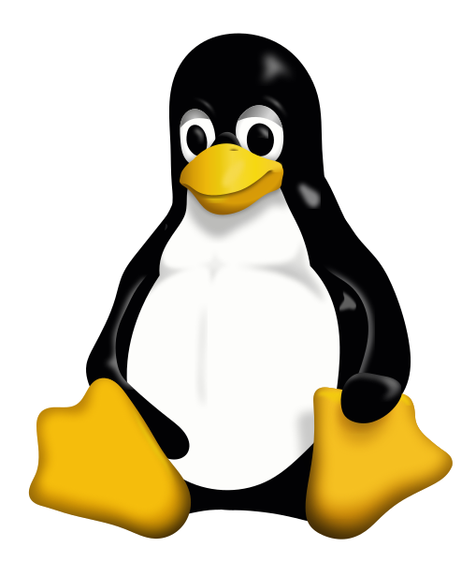
Different types of Linux installation

Slide 2
Types of Linux installation
Bare metal
Physical hardware
CD / DVD / USB / Network installation
Virtual Machine
Runs within another operating system
Portable / disposable
Install from ISO / Network
Cloud
Virtual machine on someone else's hardware
Amazon / Google are the main providers
Range of available hardware and OS images available

Slide 3
Installing bare metal or in a VM
Essentially the same process
Uses an installer provided by the Linux distribution
Two main types
Live image
Boot into a working OS from a CD/DVD/USB
Copy the image to a hard drive and boot from there
Little to no configuration options - need to modify post install
Real installer
Guided installation process in a custom installer
Many options (software, networking, disk partitioning etc)
More flexibility, but more hassle

Slide 4
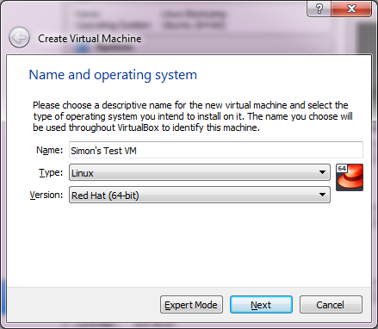
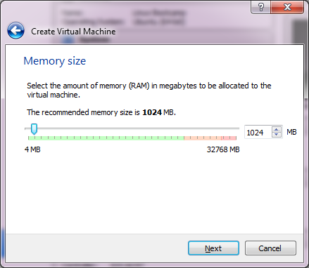
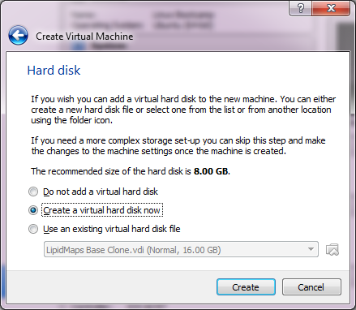
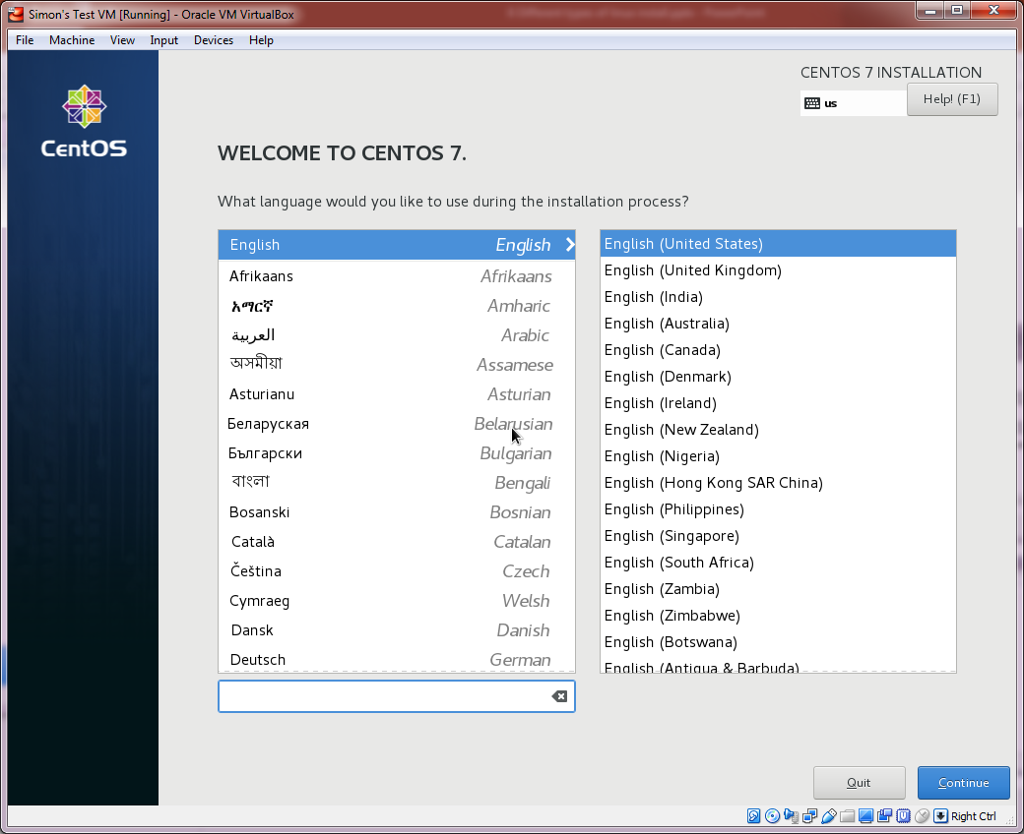
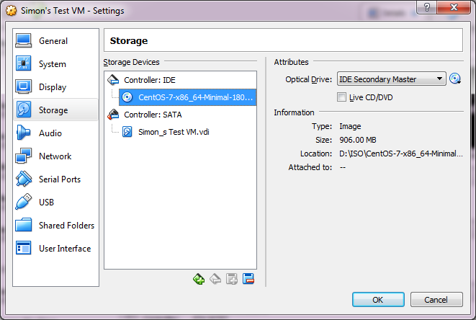
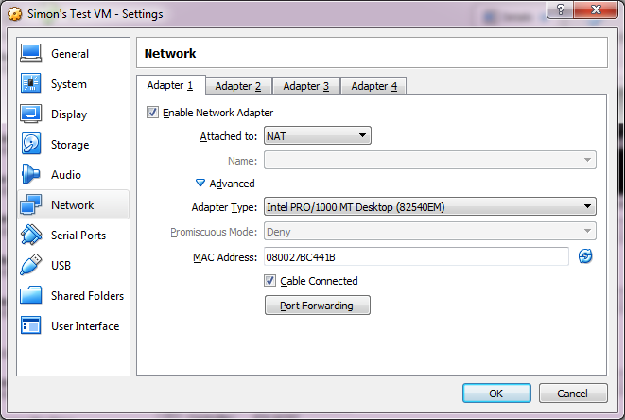
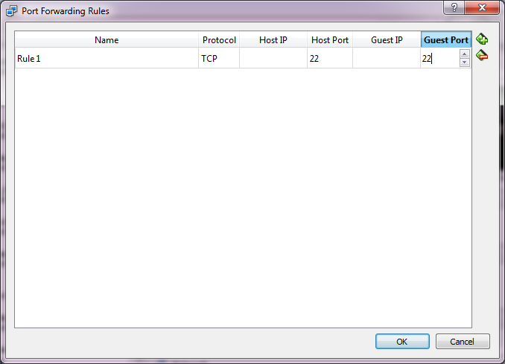
Installing into a VirtualBox VM

Slide 5
Creating an Amazon EC2 server
Create an AWS account (will require a credit card, but test servers can be run for free)
https://aws.amazon.com
Create a key pair
Create an EC2 instance
Connect to the image using the key
Do what you want
Shut it down (so you stop being charged!)

Slide 6
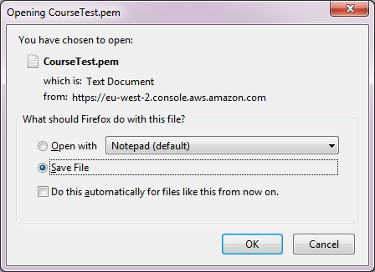
Create a key pair
Key Pairs > Create Key Pair
Give it a name
Download the .pem file which it creates

Slide 7
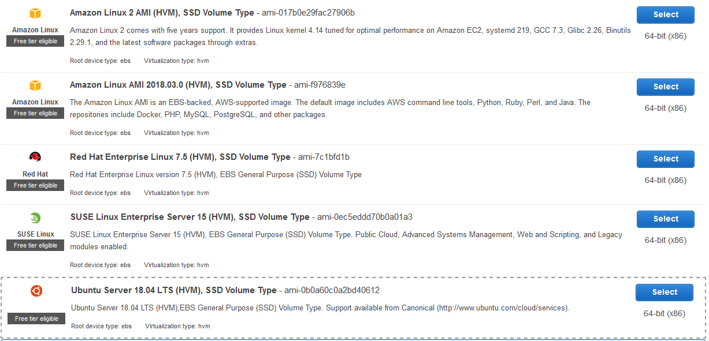
Create an EC2 instance
Instances > Launch Instance
Select hardware and base OS

Slide 8
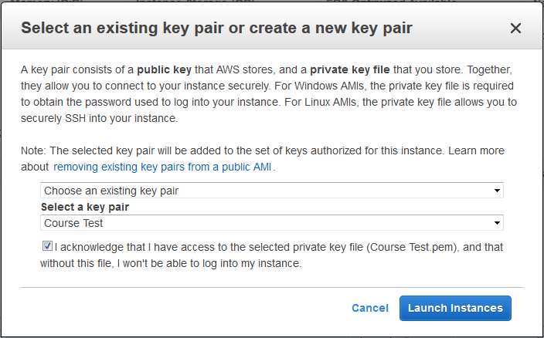
Launch instance and set keys

Slide 9
Find instance details
Under instances
Find username
For Amazon Linux 2 or the Amazon Linux AMI, the user name is ec2-user.
For a Centos AMI, the user name is centos.
For a Debian AMI, the user name is admin or root.
For a Fedora AMI, the user name is ec2-user or fedora.
For a RHEL AMI, the user name is ec2-user or root.
For a SUSE AMI, the user name is ec2-user or root.
For an Ubuntu AMI, the user name is ubuntu.

Slide 10
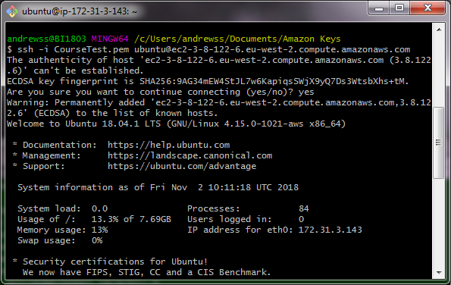
Connect to the instance via SSH using your key
ssh -i [key_file.pem] username@address.from.ec2

Slide 11
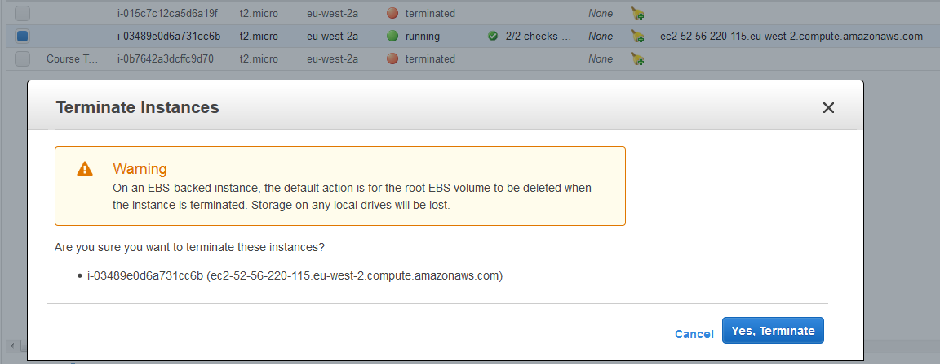
Terminate your instance
Instances > Right click > Terminate
Will be warned about deleting the underlying storage

Slide 12
Storage
Simple instances come with limited, temporary storage
For serious work you want additional storage
Configure storage bins
Add them to one (or more) images
Add data to them
Storage bins exist independently of the compute instances
Simple stores for applications or databases Elastic Block Store (EBS) $$$
File system storage for concurrent access Elastic File System (EFS) $$$$$$
Large data storage and processing/archiving Simple Storage Service (S3) $$
Long term archiving Glacier $

