Slide 1

Extracting Biological Information from Gene Lists
Simon Andrews, Laura Biggins, Boo Virk
simon.andrews@babraham.ac.uk
laura.biggins@babraham.ac.uk
v2023-01

Slide 2
Programme
The theory and practice of gene set enrichment
Gene set enrichment practical
Presenting results
Dealing with artefacts and biases
Motif analysis
Motif analysis practical

Slide 3
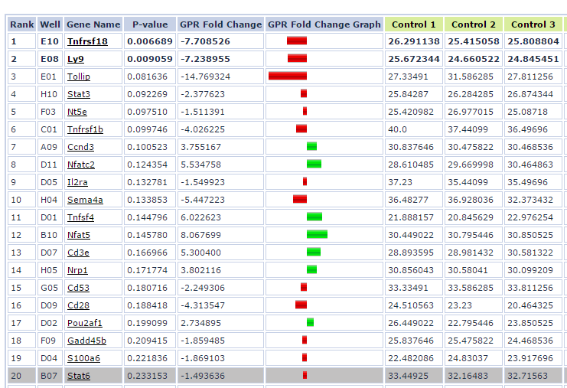
Standard Gene List Output

Slide 4
Descriptions aren’t always informative

Slide 5
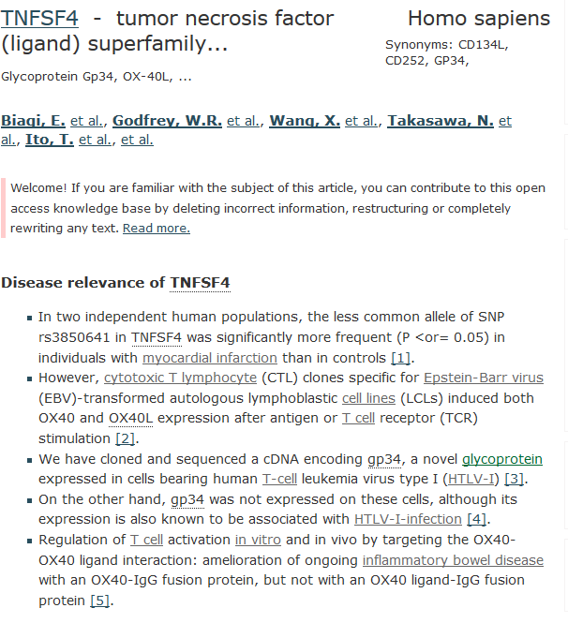
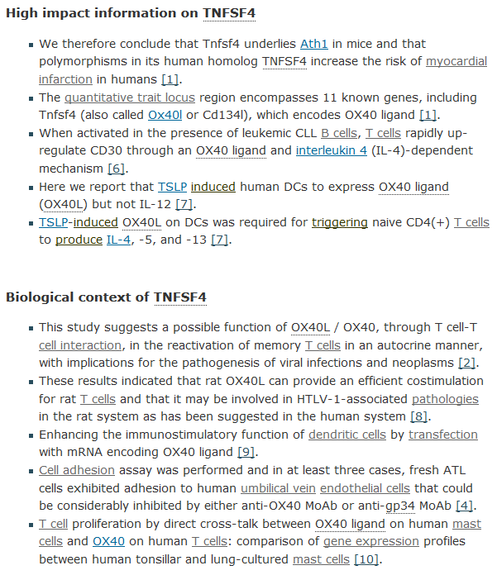



Gene summary sites are useful for single genes

Slide 6
Functional analysis relates hits to existing knowledge
Advantages:
Biological insight
Validation of experiment
Generate new hypotheses
Limitations:
You can only discover what is already known
  Novel functionality will be missing
  Existing annotations may be incorrect
  Many species are poorly supported

Slide 7
Most functional analysis starts from gene lists
Many considerations
  Other start points
    Genomic positions
    Transcripts / Proteins
  Gene nomenclature
  Annotation sources / versions
Types of list
  Categorical (hit or not a hit)
  Ordered
  Quantitative

Slide 8
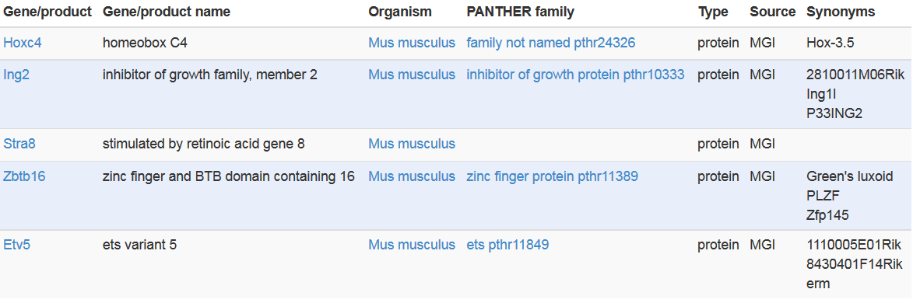
A functional gene set provides a group of genes with a common biological relationship
Germ-line stem cell division
The self-renewing division of a germline stem cell to produce a daughter stem cell and a daughter germ cell, which will divide to form the gametes.

Slide 9
Functional analysis relates your hits to a set of pre-defined functional groups
A4galt
Atl1
Cdk19
Cdon
Cecr2
Etv5
Flywch1
Gnpda2
Hoxc4
Ing2
Iigp1
Map3k9
Mypop
Rnf6
Serinc1
Stra8
Trp73
Zbtb16

Slide 10
Functional analysis relates your hits to a set of pre-defined functional groups
A4galt
Atl1
Cdk19
Cdon
Cecr2
Etv5
Flywch1
Gnpda2
Hoxc4
Ing2
Iigp1
Map3k9
Mypop
Rnf6
Serinc1
Stra8
Trp73
Zbtb16
Germ-line stem cell division
The self-renewing division of a germline stem cell to produce a daughter stem cell and a daughter germ cell, which will divide to form the gametes.

Slide 11
Nothing is ever straight forward…
Best hit: “DNA Methylation” p<2e-10
name: DNA methylation
datasource: reactome
organism: Human
idtype: hgnc symbol
Genes:
Methyltransferases: DNMT1 DNMT3A DNMT3B DNMT3L
Methyltransferase targeting protein: UHRF1
Histones!!! H2AFB1 H2AFJ H2AFV H2AFX H2AFZ H2BFS H3F3A H3F3B HIST1H2AB HIST1H2AC HIST1H2AD HIST1H2AE HIST1H2AJ HIST1H2BA HIST1H2BB HIST1H2BC HIST1H2BD HIST1H2BE HIST1H2BF HIST1H2BG HIST1H2BH HIST1H2BI HIST1H2BJ HIST1H2BK HIST1H2BL HIST1H2BM HIST1H2BN HIST1H2BO HIST1H3A HIST1H3B HIST1H3C HIST1H3D HIST1H3E HIST1H3F HIST1H3G HIST1H3H HIST1H3I HIST1H3J HIST1H4A HIST1H4B HIST1H4C HIST1H4D HIST1H4E HIST1H4F HIST1H4H HIST1H4I HIST1H4J HIST1H4K HIST1H4L HIST2H2AA3 HIST2H2AA4 HIST2H2AC HIST2H2BE HIST2H3A HIST2H3C HIST2H3D HIST2H4A HIST2H4B HIST3H2BB HIST4H4

Slide 12
There are many sources of functional gene lists
Human curated
  Gene Ontology
  Biological Pathways
Domains / Patterns
  Protein functional domains
  Transcription factor regulated
Experimental
  Co-expressed genes
  Interactions
  Hits from other studies

Slide 13
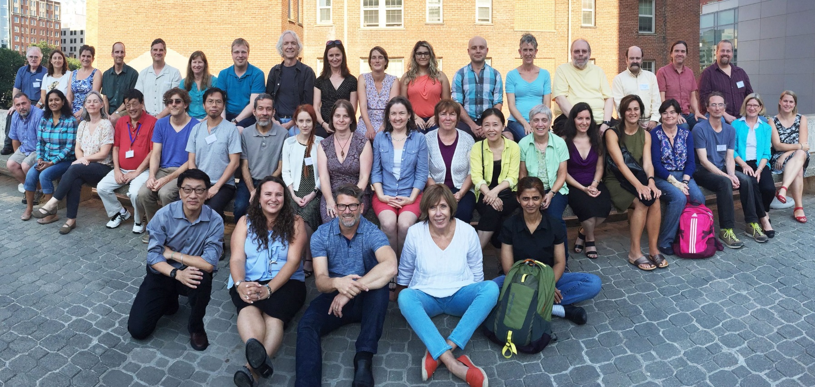

Gene Ontology is a human curated functional database

Slide 14
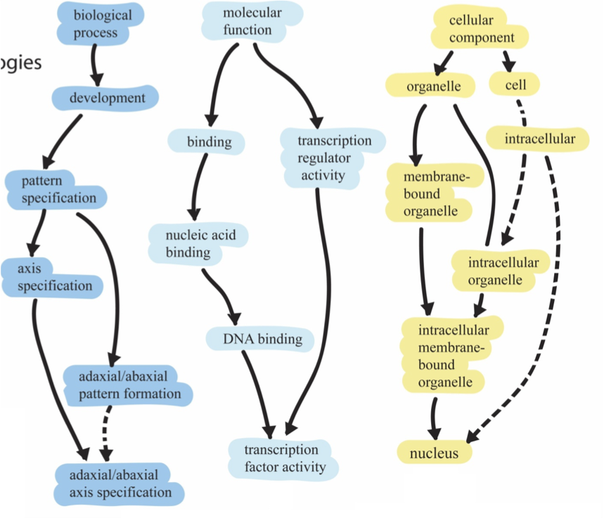
GO has three domains and a hierarchical structure
1
2
3
Root ontology terms
big
general
Parent
small
Child
specific

Slide 15
Genes are placed into each domain as specifically as possible
Nanog homeobox [Source:HGNC Symbol;Acc:HGNC:20857]
Cellular Component
  GO:0005634 nucleus
  GO:0005654 nucleoplasm
  GO:0005730 nucleolus
Molecular Function
  GO:0003677 DNA binding
  GO:0003700 transcription factor activity, sequence-specific DNA binding
  GO:0003714 transcription corepressor activity
  GO:0005515 protein binding
  GO:0043565 sequence-specific DNA binding
Biological Process
  GO:0001714 endodermal cell fate specification
  GO:0006351 transcription, DNA-templated
  GO:0006355 regulation of transcription, DNA- templated
  GO:0007275 multicellular organism development
  GO:0008283 cell proliferation
  GO:0019827 stem cell population maintenance
  GO:0030154 cell differentiation
  GO:0035019 somatic stem cell population maintenance
  GO:0045595 regulation of cell differentiation
  GO:0045944 positive regulation of transcription from RNA polymerase II promoter
  GO:1903507 negative regulation of nucleic acid-templated transcription

Slide 16
Annotations come with evidence
Experimental Evidence
  Inferred from Experiment (EXP)
  Inferred from Direct Assay (IDA)
  Inferred from Physical Interaction (IPI)
  Inferred from Mutant Phenotype (IMP)
  Inferred from Genetic Interaction (IGI)
  Inferred from Expression Pattern (IEP)

Slide 17
Annotations come with evidence
Computational Evidence
  Inferred from Sequence or structural Similarity (ISS)
  Inferred from Sequence Orthology (ISO)
  Inferred from Sequence Alignment (ISA)
  Inferred from Sequence Model (ISM)
  Inferred from Genomic Context (IGC)
  Inferred from Biological aspect of Ancestor (IBA)
  Inferred from Biological aspect of Descendant (IBD)
  Inferred from Key Residues (IKR)
  Inferred from Rapid Divergence(IRD)
  Inferred from Reviewed Computational Analysis (RCA)

Slide 18
Annotations come with evidence
Publications
  Traceable Author Statement (TAS)
  Non-traceable Author Statement (NAS)
Curators
  Inferred by Curator (IC)
  No biological Data available (ND)
Automated assignment
  Inferred from Electronic Annotation (IEA)

Slide 19
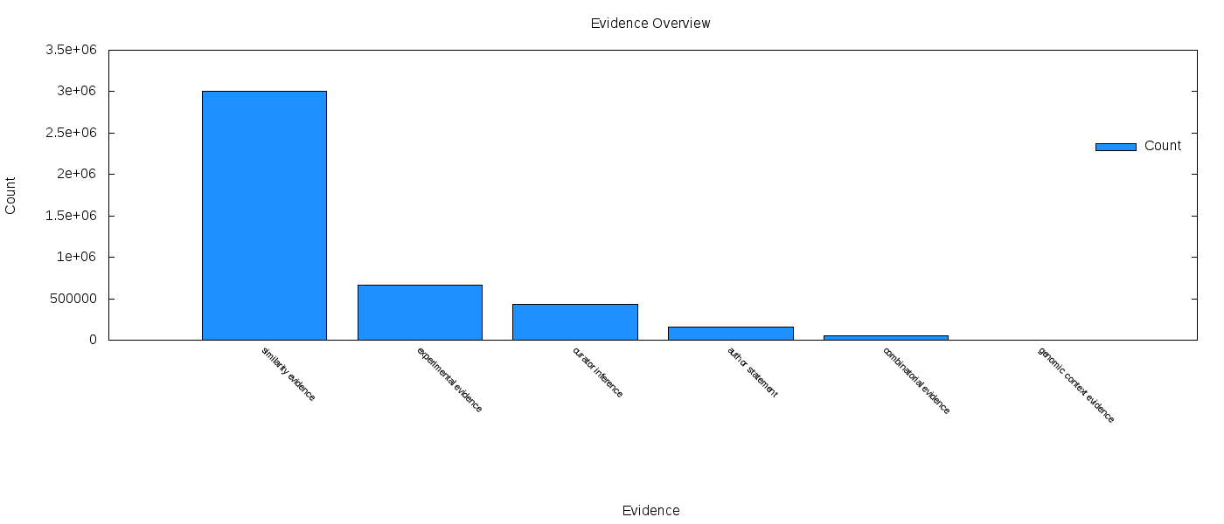
Annotations come with evidence
It looks like something which is annotated
Actual experimental
evidence
Curator
Interpretation
Claimed in a paper
Mixture of sources
Annotated based on where it is in the genome

Slide 20



Pathway databases trace metabolic pathways and their regulation

Slide 21



Protein Domain databases map out functional subdomains within proteins

Slide 22
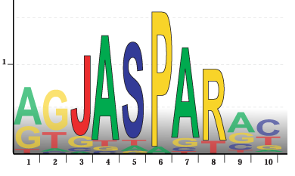
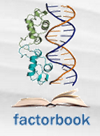



Transcription Factor databases group genes by the motifs in their promoters
SwissRegulon

Slide 23
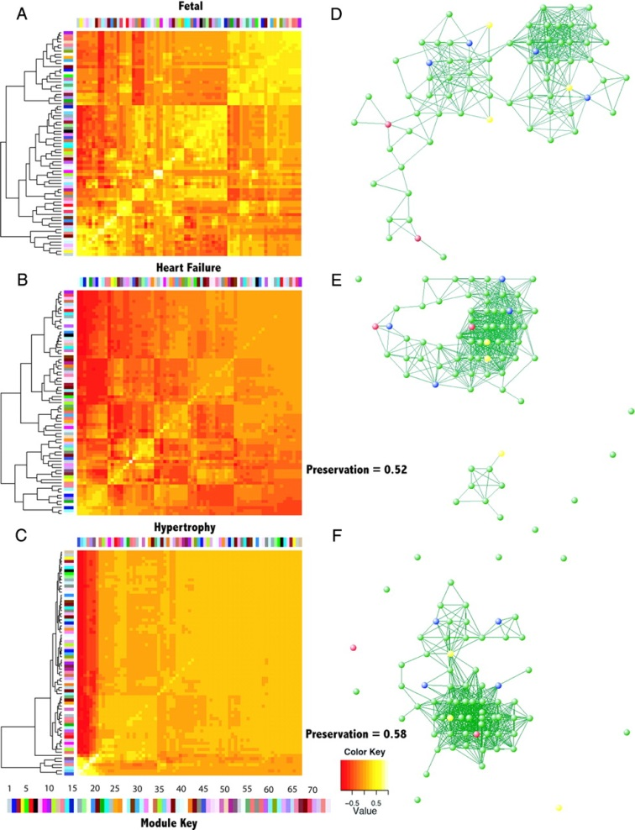



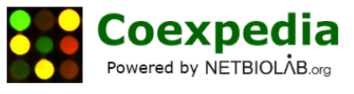
Co-expression databases group genes which are expressed together

Slide 24



Interaction databases map out physical interactions between genes and their products

Slide 25


Some databases collate gene sets from many different sources

Slide 26
Testing for enriched gene sets

Slide 27
There are two basic ways to test for enrichment
Categorical
  Start from a list of hit genes
  Count overlaps between hit list and functional list
  Find Functional lists where the degree of overlap is statistically unlikely
Quantitative
  Start with all genes
  Associate a value with each gene
  Look for functional sets with unusual distributions of values

Slide 28
Categorical Enrichment Analysis

Slide 29
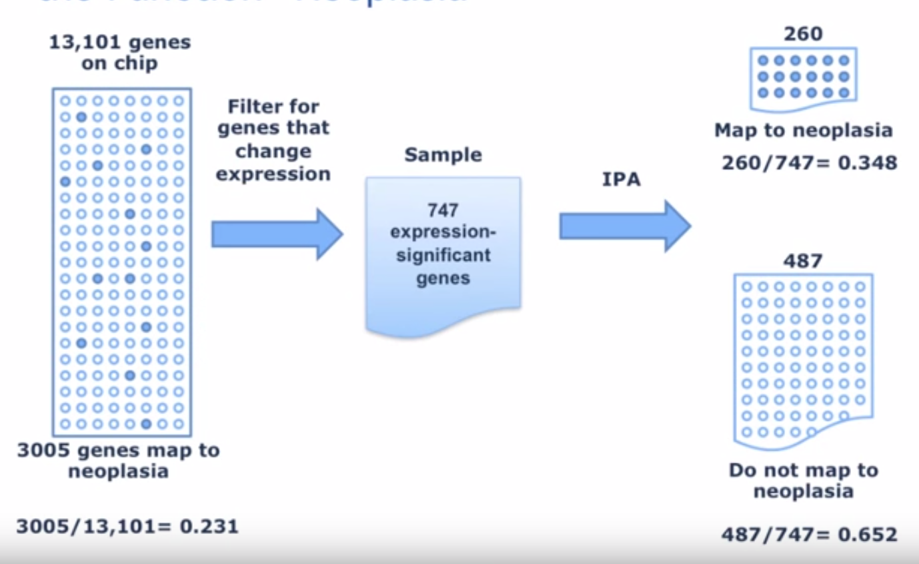

Categorical tests for enrichment
13,101 genes on chip
Related to disease
260/747 = 34.8%
Gene List
 | Gene List | Background
In disease annotated group | 260 | 3005
Not in disease annotated group | 487 | 10096
3005 genes related to disease
3005/13,101=
23.1%
Not related to disease

Slide 30
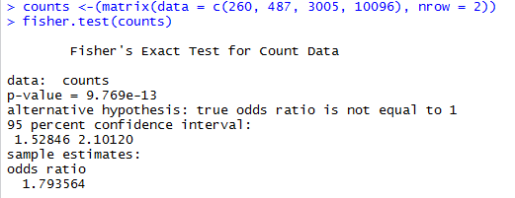
Fisher’s Exact test
 | Gene List | Background | Total
In disease annotated group | 260 E = 176.1 | 3005 E = 3088.8 | 3265
Not in disease annotated group | 487 E = 570.9 | 10096 E = 10012.1 | 10583
Total | 747 | 13101 | 13848
(260/487) / (3005/10096)

Slide 31
Categorical tests are influenced by where you set the cutoff for “interesting” genes
Function X
  3 hits out of 32 in ‘interesting’ list
  Not significant (p=0.07)
Hit1
Hit17
Hit2
Hit18
Hit3
Hit19
Hit4
Hit20
Hit5
Hit21
Hit6
Hit22
Hit7
Hit23
Hit8
Hit24
Hit9
Hit25
Hit10
Hit26
Hit11
Hit27
Hit12
Hit28
Hit13
Hit29
Hit14
Hit30
Hit15
Hit31
Hit16
Hit32

Slide 32
Categorical tests are influenced by where you set the cutoff for “interesting” genes
Function X
  3 hits out of 7 in ‘interesting’ list
  Significant (p=0.02)
Hit1
Hit17
Hit2
Hit18
Hit3
Hit19
Hit4
Hit20
Hit5
Hit21
Hit6
Hit22
Hit7
Hit23
Hit8
Hit24
Hit9
Hit25
Hit10
Hit26
Hit11
Hit27
Hit12
Hit28
Hit13
Hit29
Hit14
Hit30
Hit15
Hit31
Hit16
Hit32

Slide 33
Ordered, but not quantitative lists allow sequential categorical analysis
Function X
  Length=1 p=0.60
  Length=2 p=0.80
  Length=3 p=0.30
  Length=4 p=0.35
  Length=5 p=0.40
  Length=6 p=0.45
  Length=7 p=0.05
  Length=8 p=0.08
  Length=9 p=0.10
Hit1
Hit17
Hit2
Hit18
Hit3
Hit19
Hit4
Hit20
Hit5
Hit21
Hit6
Hit22
Hit7
Hit23
Hit8
Hit24
Hit9
Hit25
Hit10
Hit26
Hit11
Hit27
Hit12
Hit28
Hit13
Hit29
Hit14
Hit30
Hit15
Hit31
Hit16
Hit32

Slide 34
Quantitative Enrichment Analysis

Slide 35
Quantitative comparisons offer more power, if you have a suitable metric
What quantitation can we use?
  Differential p-value (normally -10 log(p))
  Fold change
  Absolute difference
Measures often have odd distributions and biases
  Z-scores
  Ranks

Slide 36
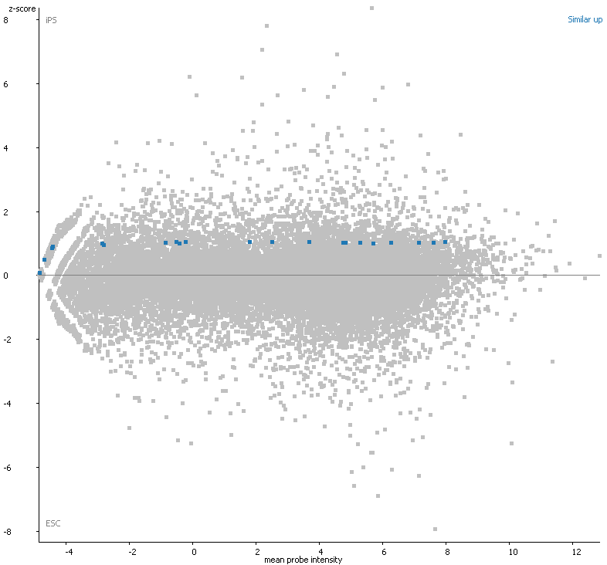
What kind of changes do we expect in an interesting category?
Student’s T-test
Genes in that category all change, and by about the same amount?

Slide 37
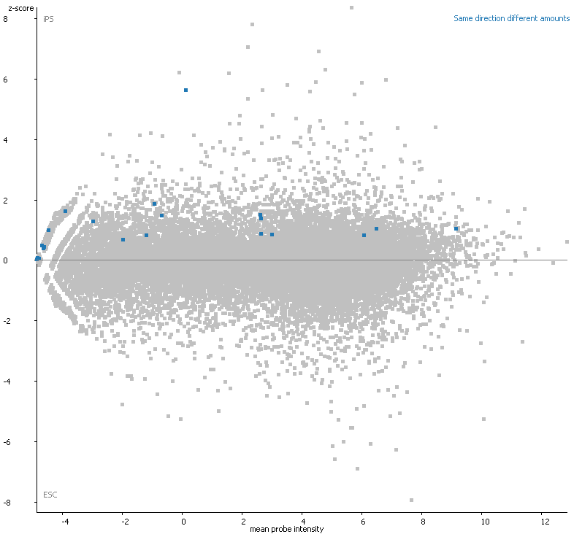
What kind of changes do we expect in an interesting category?
Kolmogorov Smirnov Test
Genes in that category all change in the same direction, but by different amounts?

Slide 38
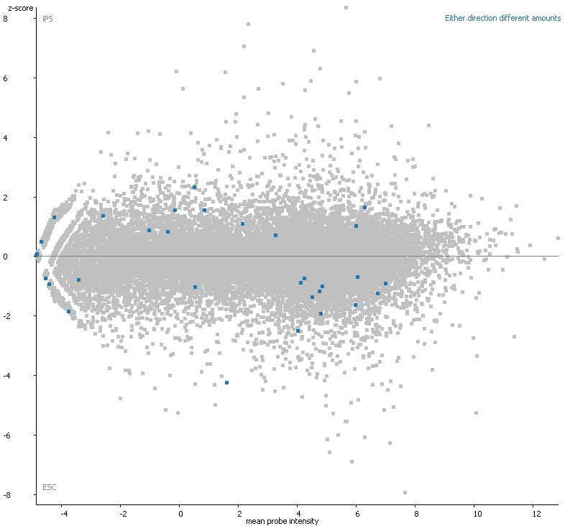
What kind of changes do we expect in an interesting category?
Absolute KS Test
Genes in that category all change in either direction, but by different amounts?

Slide 39
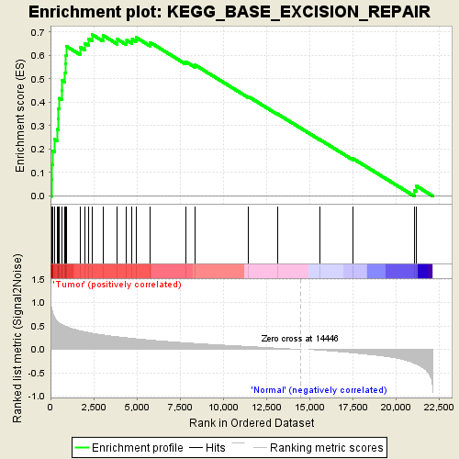
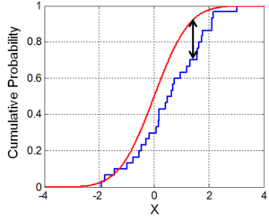
Kolmogorov Smirnov
Looks for the biggest point of difference between the background and test lists
Background list
Our gene list

Slide 40
Multiple testing correction
More annotations/functions being tested = more chance of increase in false-positives
  Bonferroni
  Significance level (e.g. 0.05) /number of tests = new threshold
  Over correction if tests are correlated
  Benjamini-Hochberg
  Rank the p-values
  Apply more stringent correction to the most significant, and least stringent to the least significant p-values
False Positives
Multiple tests with no correction
Benjamini-Hochberg (FDR)
Bonferroni

Slide 41
What do we get back from an enrichment test?
A p-value
  Remember that this reflects not only difference but also variance and power (number of observations)
A difference value
  Enrichment difference (odds ratio)
  Mean quantitative difference
  Remember large differences are easier to obtain with small numbers of observations

Slide 42
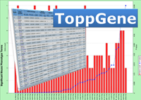
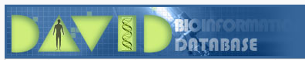




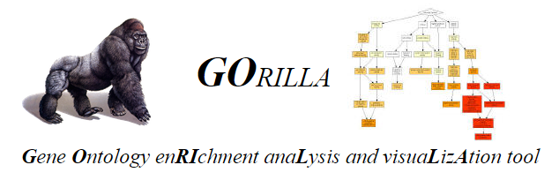


Tools for functional gene list analysis
There are many different tools available, both free and commercial
Popular tools include:

Slide 43
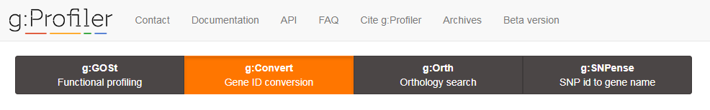
Categorical or ordered statistics
Lots of additional options
Wide species support
Interesting presentation
  Doesn’t scale well to lots of hits

Slide 44
Categorical or Quantitative statistics
Part of Gene Ontology Consortium
  Annotations are up to date
Simple enrichment analysis
Functional lists and categorical break down

Slide 45
Categorical or quantitative statistics
Pathway focussed
Simple submission interface (no custom background)
Really nice visualisations

Slide 46
Categorical statistics
Limited species support
Allows custom backgrounds
Uses PathwayCommons gene sets
Innovative detection and presentation of artefacts

Slide 47
Categorical Statistics
Most popular system (mostly historic)
Has been behind the latest annotation
  Was updated again, but now behind once more
Lots of support for different IDs and Species
Configurable gene sets
Simple output presentation

Slide 48
Categorical Statistics
Biggest selection of gene sets
Simple interface, but limited options
  No species information
  No background list option
Simple interactive visualisation
Novel scoring scheme to rank hits

Slide 49
Categorical or ranked analysis
Mostly GO gene list support
Interesting visualisation options

Slide 50
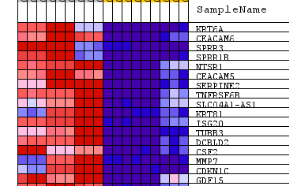
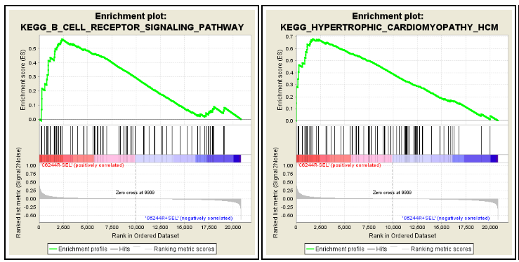
GSEA
Quantitative enrichment
Designed for expression datasets
Local application
Imports tab delimited expression data

Slide 51
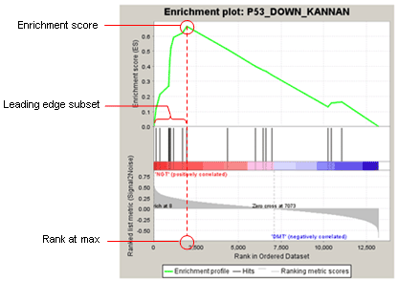
Genes ranked based on correlation to annotation groups
Genes from a gene set placed onto the ranked lists
Look for sets where there is unusual grouping at the top or the bottom of the list

Slide 52

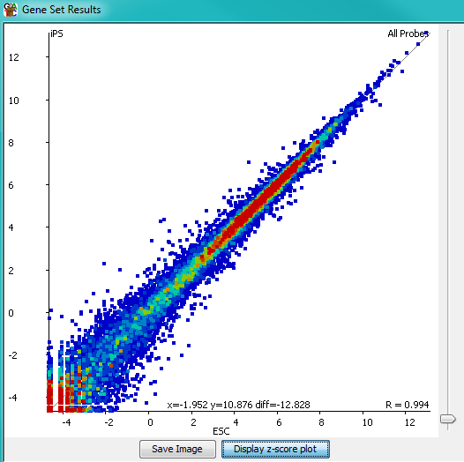
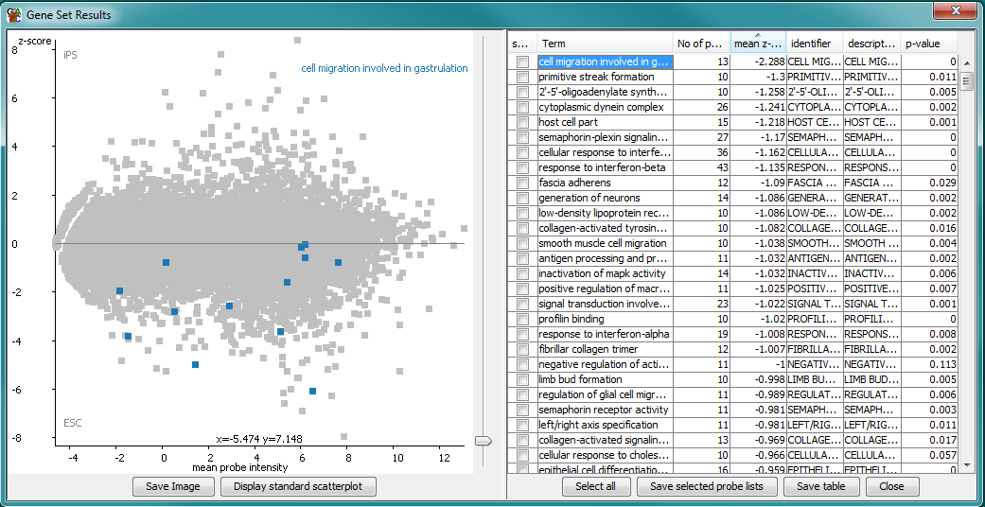
Quantitative enrichment of sequencing datasets
Local Java application

Slide 53
Gene List Practical

